Slide 1
Tennessee Direct Admissions

Slide 2
Why Direct Admissions?
Research shows that many students find the college application process overwhelming, leading many to abandon college altogether.
Direct admissions programs proactively admit students based on pre-existing data, eliminating the need for traditional applications.
Current direct admissions initiatives boost college access, especially for first-generation students, but affordability remains a challenge.
Notes:
Operating across about a dozen states so far, direct or proactive admissions policies have been shown to support college-going behaviors and enrollment, especially among students of color, those from low-income backgrounds, and first-generation students.
Significant increases in first-time undergraduate enrollments were observed, especially at two-year, open-access institutions.
However, while response to the direct admissions letter was even across demographic groups, enrollment among those with lower median household incomes did not increase. Researchers found that quite a few students would commit to four-year institution, but when they received their bills in July, they realized it just wasn’t affordable for them.

Slide 3
What if students could be proactively admitted to college and provided with an upfront signal of financial aid?
Goal: Simplify college admission by proactively admitting students based on pre-existing data, eliminating traditional applications and application fees.
Tennessee’s Direct Admissions Study will be the first to combine direct admissions and financial aid in statewide practice and to include technical/vocational institutions tuition-free.
Notes:
So the project team approached us and posed the question, what if students could be proactively admitted to college and provided with an upfront “guarantee” or signal of financial aid?
Tennessee will the first state to combine direct admissions with financial aid at this scale, striving to ensure that more students know their college options and grants and scholarships available to them.

Slide 4
Tennessee Direct Admissions
What It Is: A statewide program offering admission to eligible high school seniors. No applications or fees required.
Who It Reaches: Over 70,000 state aid eligible seniors in the class of 2027 (includes public, private, and homeschool students.
Participating Institutions: Over 60 colleges including TCATs, community colleges, and public/private universities.
Launch Timeline: Letters beginning to send in September 2026 and continue through the close of Tennessee Promise application and into December.
Notes:
In Tennessee, 39.1% of Fall 2023 undergraduate enrollments were at open-access community colleges, and another 31.7% were at public four-year institutions that accept at least three quarters of applicants.
The TN Board of Regents has agreed to partner with us on this, as well as 17 public and private four-year schools.
The scope of this pilot project and study will be larger than any undertaken so far.

Slide 5
Statewide Launch – Year 2
Expanding Direct Admissions to all state aid eligible high school seniors in the class of 2027. (including Private and Home Schoolers)
All Students will be presented institutional merit-based aid and up-front state-supported financial aid information.
Expanded number of institutions.
Double mailing to both students and the schools
Address Verification
Notes:
In Tennessee, 39.1% of Fall 2023 undergraduate enrollments were at open-access community colleges, and another 31.7% were at public four-year institutions that accept at least three quarters of applicants.
The TN Board of Regents has agreed to partner with us on this, and we will be reaching out to public and private universities over the next couple of months.
The scope of this pilot project and study will be larger than any undertaken so far.

Slide 6
Participating Higher Ed Institutions
All TBR TCATs and Community Colleges
Austin Peay State University
Bethel University
Bryan College
Christian Brothers University
Cumberland University
East Tennessee State University
Fisk University
Freed-Hardeman University
Johnson University
King University
Lane College
Lee University
LeMoyne-Owen College
Maryville College
Middle Tennessee State University
Milligan University
Southern Adventist University
Tennessee State University
Tennessee Wesleyan University
Trevecca Nazarene University
Tusculum University
Union University
University of Memphis
University of Tennessee at Chattanooga
University of Tennessee at Martin
University of Tennessee Southern
Welch College
William R Moore Technical College
Notes:
Our TCATs and community colleges already admit anyone that applies. With some obvious exceptions like UT Knoxville, Vanderbilt, and a few others, most of the 4-year schools in Tennessee admit more than three quarters of their applicants. These schools account for more than 70% of enrollments each year.
We are not asking any of them to lower their admissions standards; we are simply cutting through some of the “red tape” and reaching out directly to students and their families about opportunities that already exist for them.
The bottom line is there are students out there that can succeed in postsecondary training or education but aren’t enrolling simply because of perceived administrative burden, lack of awareness of the financial aid available to them, or just a gap in hope and belief that they are “college material.”

Slide 7
Tennessee Direct Admissions
Letter
HS senior receives letter with list of postsecondary options, institutional financial aid, and state-supported aid
Student scans QR code or follows link in TSAC Student Portal to claim their spot
Data Transmission
THEC provides student’s data file to institution through FAST, serving as official application
Follow-Up
Institution sends follow up email and needed items
Student enrolls
Institution follows up in Spring- matriculation details
Notes:
Benefits for Tennessee
● Tennessee would develop and piloted a new direct admissions program in partnership with leading researchers in this area and in tandem with another state/system partner.
● The project and its insights would thus expand capacity for scaling direct admissions in Tennessee while also contributing to the research base on these programs and serving as a national model for integrating direct admissions and financial aid for other states.
● Tennessee and THEC would continue to be a national innovator in higher education by being one of the first states to combine direct admissions and financial aid.
● Lumina grant funds would provide support to THEC for work on the project in the form of a small annual stipend for administration, IT, advertising, operation, etc.
● THEC and partners would also have access to a dedicated liaison who will also serve as project manager, as well as access to the expertise of the project team.
● The project team would also provide THEC with quantitative and qualitative insights on the program’s effects and feature THEC as a partner on any team or Foundation materials.

Slide 8
Tennessee Direct Admissions
Tennessee Promise Application
High School Counselor Report 6th semester TELS/HOPE Scholarship GPA (Home Schoolers – DEG GPA)
ACT provides student scores to FAST (Highest Composite)
Letters will go out mid September through close of TN Promise Application (multiple mailings until the close of TN Promise)
Students claim their spot through Enrollment Form
File is provided to institutions through FAST
Institutions follow up through enrollment at institution

Slide 9
Statewide Launch Timeline
April 1, 2026 – Tennessee Promise application opens. It must be completed to be eligible for Direct Admissions
May 27, 2026 – Secure HOPE GPA verification opens. Collection of 6th semester HOPE Scholarship (TELs) GPA from high school counselors
August 17, 2026 – 1st round of data pulled for TN Direct Admissions letter generation. Mailing will begin to arrive in mid September
September 8, 2026 – 2nd round of data pulled for TN Direct Admissions letter generation. Mailing will begin to arrive in early October
October 5, 2026 – 3rd round of data pulled for TN Direct Admissions letter generation. Mailing will begin to arrive in early November
November 2, 2026 – TN Promise application closes. Final round of data pulled for TN Direct Admissions letter generation. Mailing will begin to arrive in late November
Notes:
So this is really direct marketing. We aren’t telling these students anything that isn’t already true. There will be qualifying language, like “based on the information you have provided…” etc. The premise is that this outreach will drive behavior to make that emotional decision to “commit” to a plan for life after high school.

Slide 10
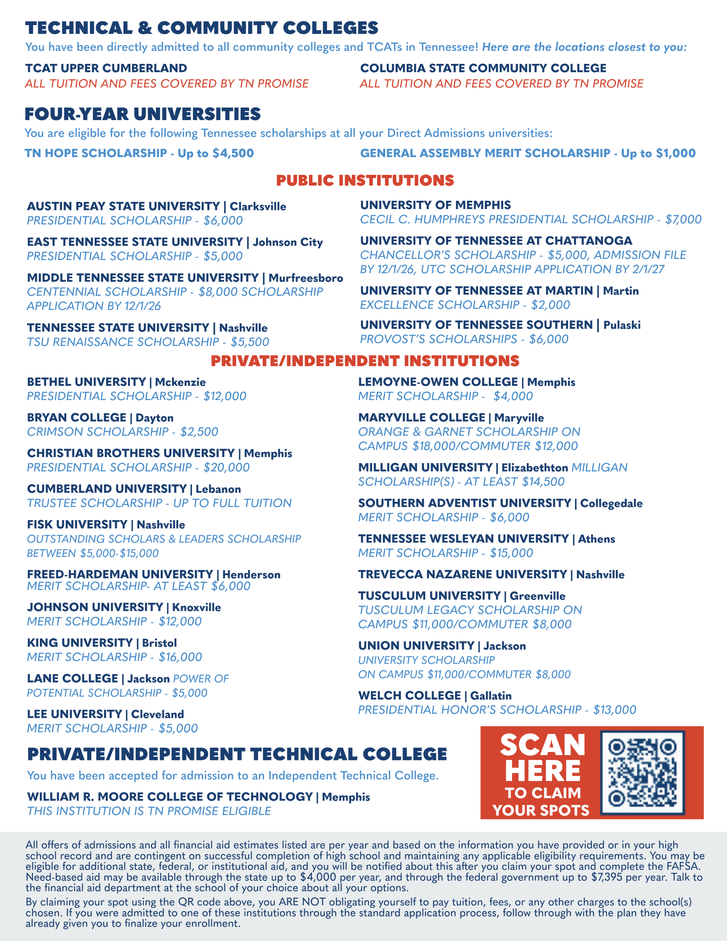
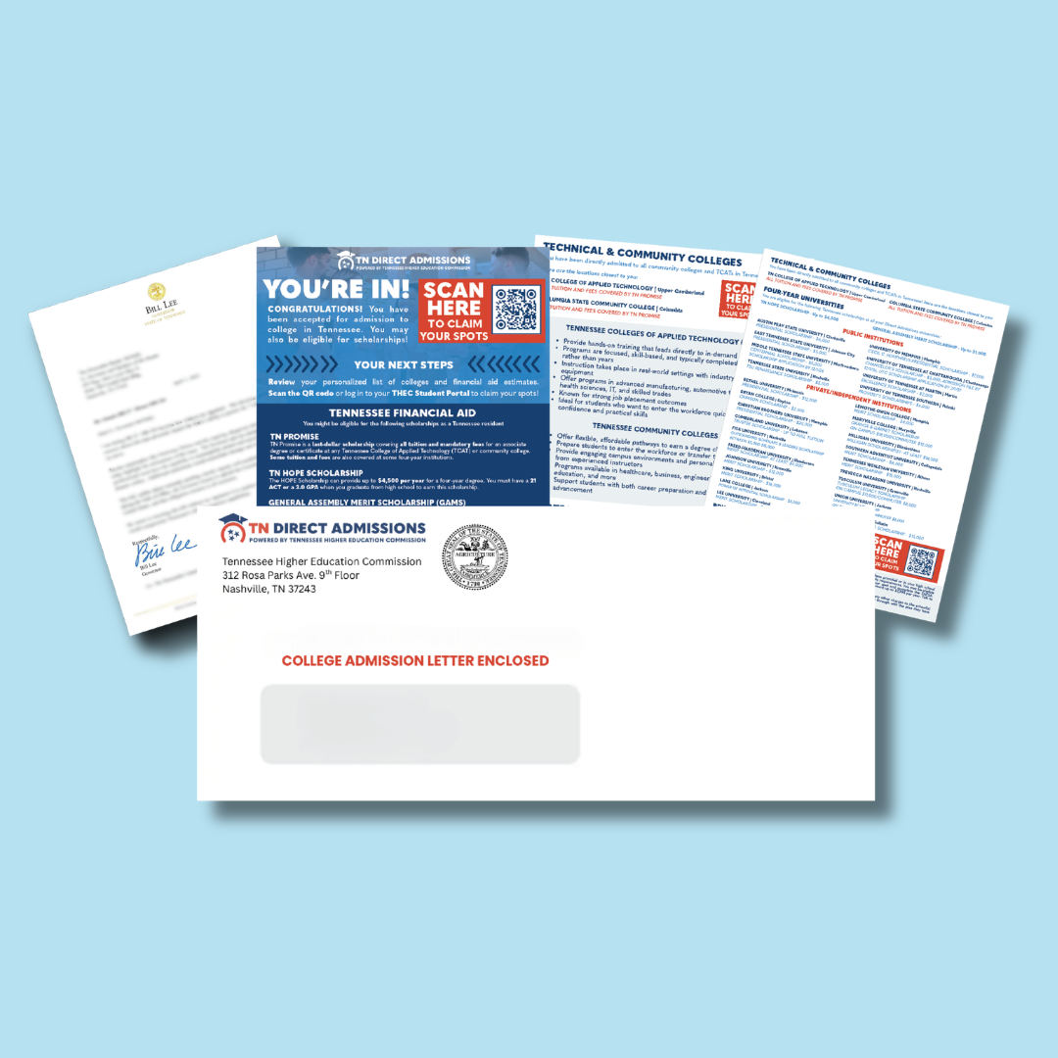

Slide 11
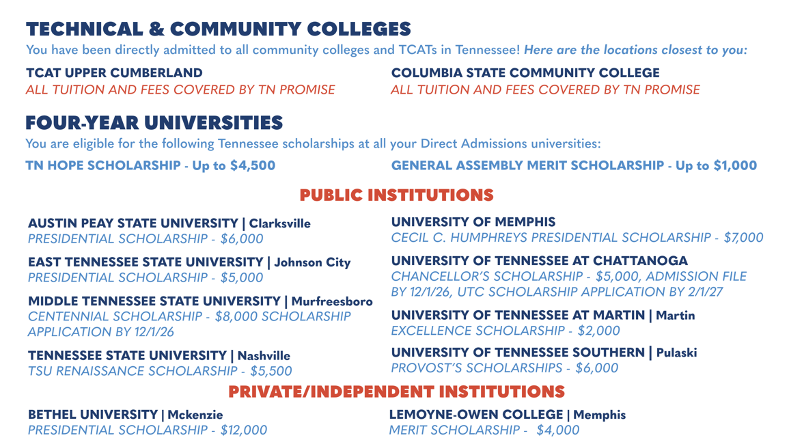
Letter Sample
Notes:
In Tennessee, 39.1% of Fall 2023 undergraduate enrollments were at open-access community colleges, and another 31.7% were at public four-year institutions that accept at least three quarters of applicants.
The TN Board of Regents has agreed to partner with us on this, and we will be reaching out to public and private universities over the next couple of months.
The scope of this pilot project and study will be larger than any undertaken so far.

Slide 12
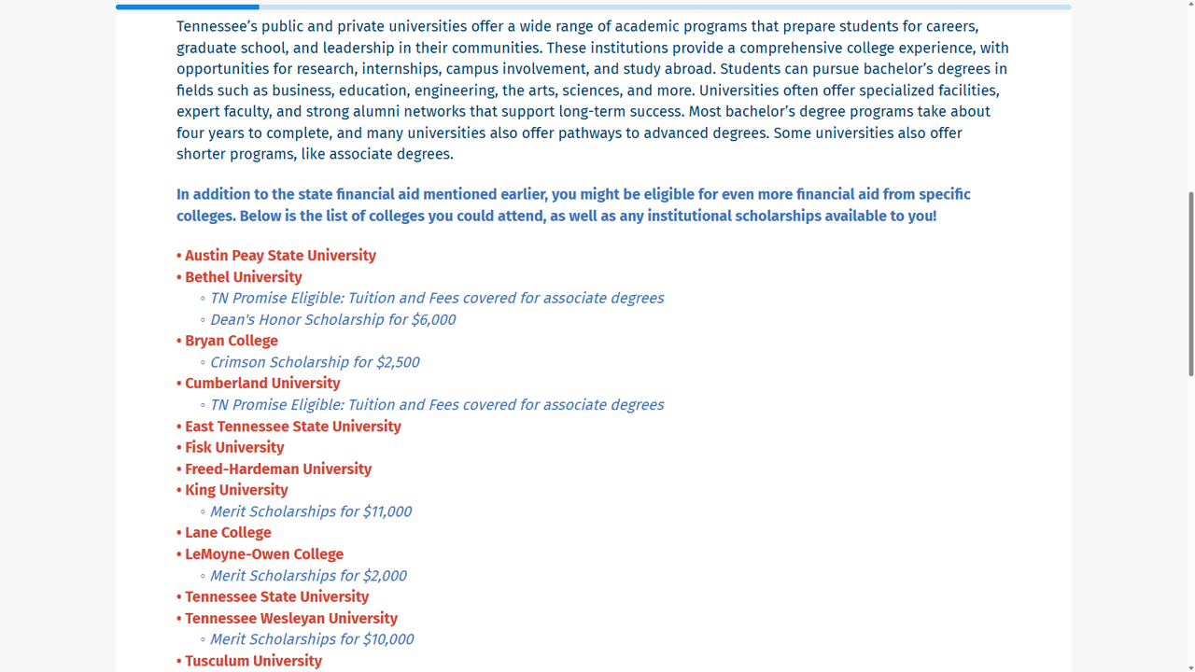

Slide 13
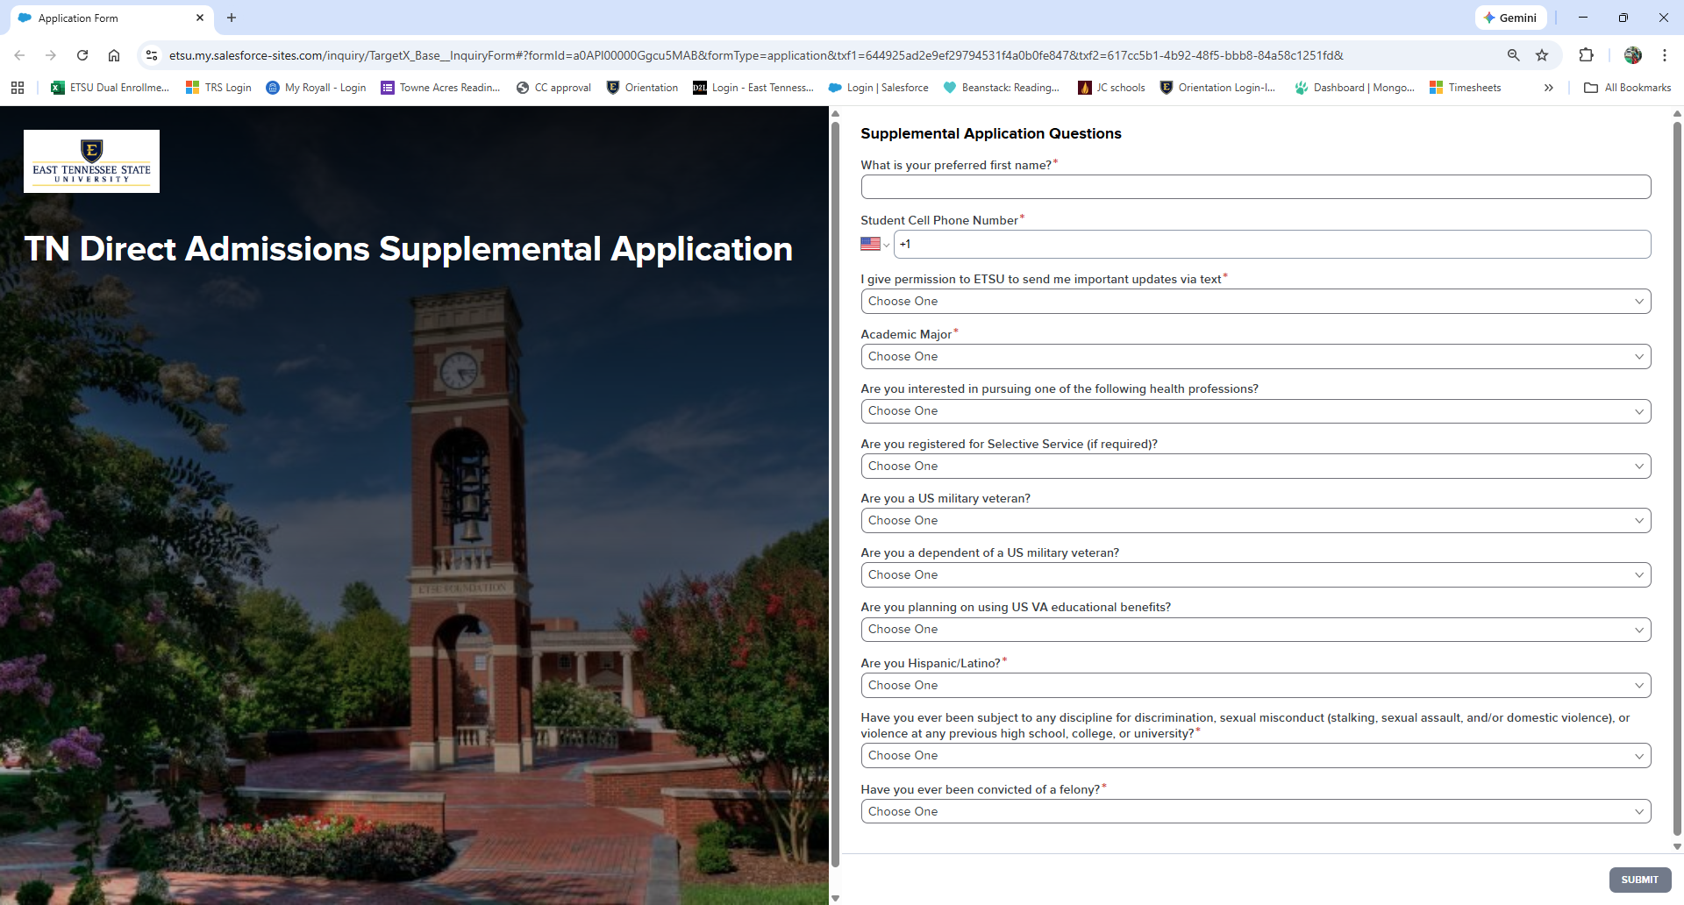
Sample Enrollment Form

Slide 14
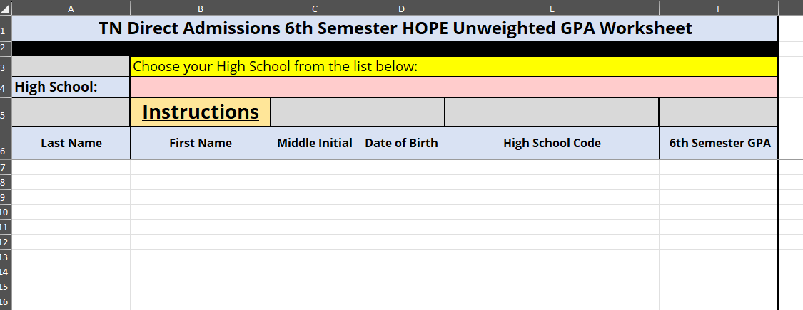
GPA Upload Instructions

Slide 15
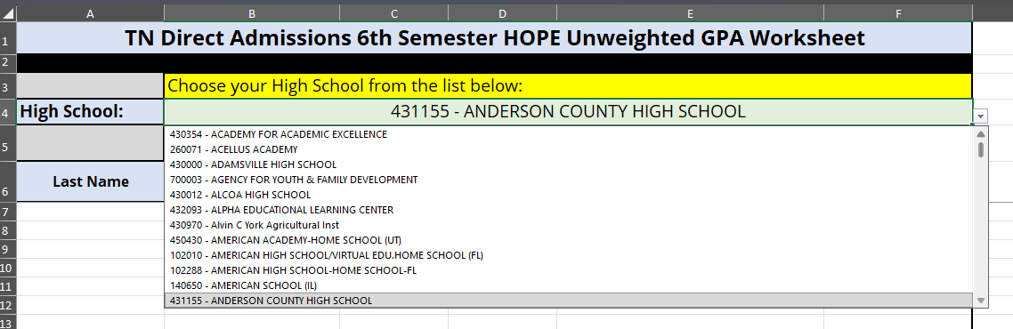
GPA Upload Instructions

Slide 16
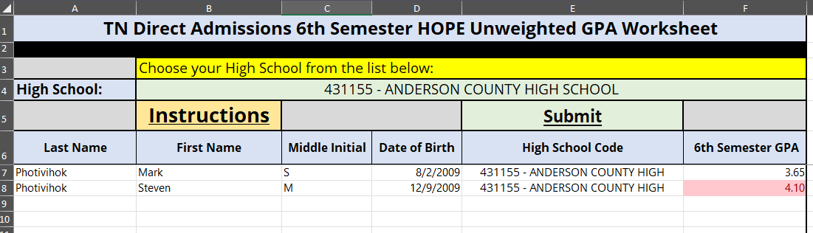
GPA Upload Instructions

Slide 17
Next Steps
TN Promise Applications – Opened of April 1
  Have students complete TN Promise Application
  Currently have over 16,500 Tennessee Promise Applications completed
Collecting GPAs from high school counselors and districts
  Currently have over 100 GPA Uploads
Address and email verification
Early Action target date
  August 17 – First Data Pull
  September 21-25 – Claim Your Spot TN Week
Completing enrollment form and submitting of transcripts and test scores
  NSC transcript exchange

Slide 18
TN College Application & Exploration Month
Aug. 31-Sept. 4: Intro to College Week
Sept. 7-11: Exploration of College Week
Sept. 14-18: Why Apply Week
Sept. 21-25: Claim Your Spot TN Week
Sept. 28-Oct. 2: What’s Next Week
Notes:
So this is really direct marketing. We aren’t telling these students anything that isn’t already true. There will be qualifying language, like “based on the information you have provided…” etc. The premise is that this outreach will drive behavior to make that emotional decision to “commit” to a plan for life after high school.

Slide 19
Multifactor Authentication (MFA)
Students must satisfy MFA upon logging into THEC Student Portal
  Email code; or
  Code provided by FAST user

Slide 20
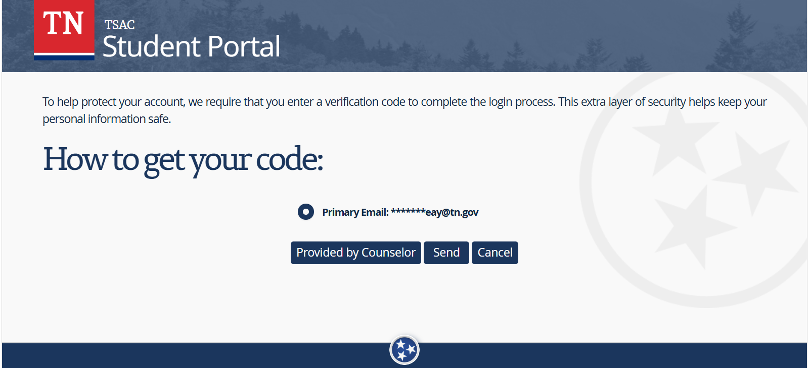
Student Portal Screen

Slide 21
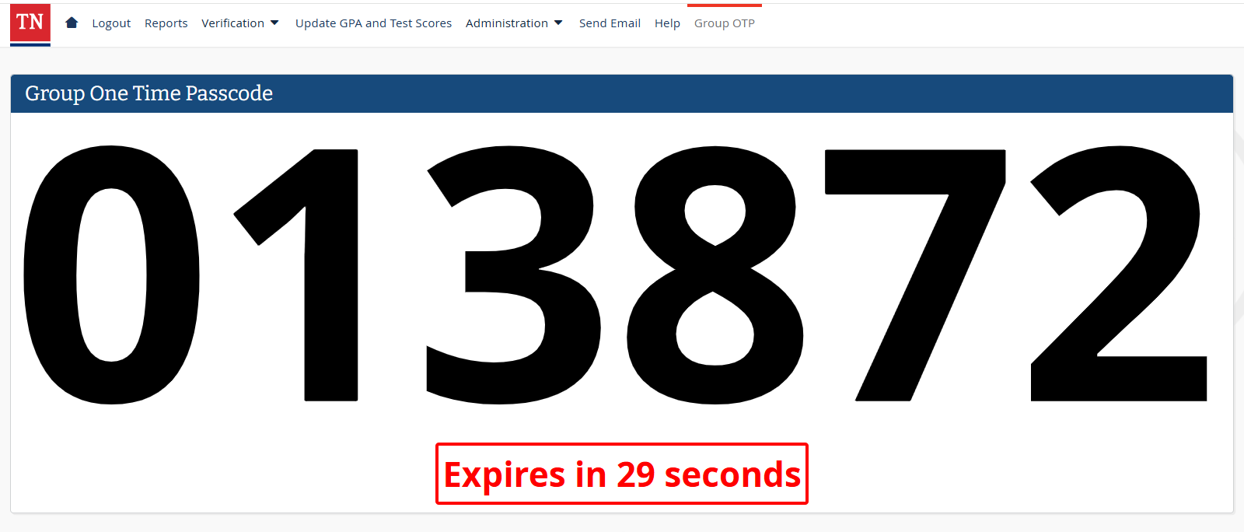
Educator FAST Screen

Slide 22
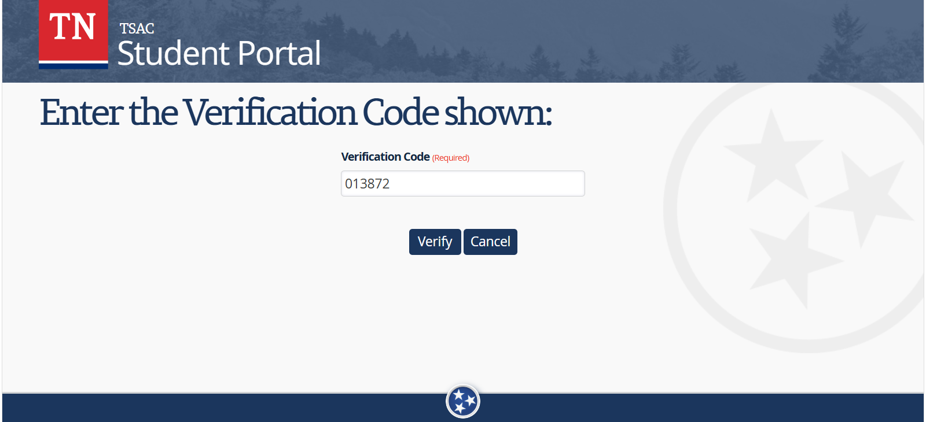
Student Portal Screen

Slide 23
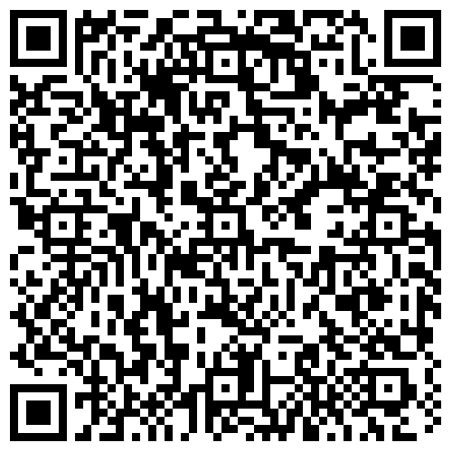
Transcript Exchange Webinar

Slide 24

Questions
Mark Photivihok
TN Direct Admissions Project Manager
Mark.Photivihok@tn.gov
Direct.Admissions@tn.gov
Dr. Dustin Rawls
Assistant Director of Statewide Services
Dustin.Rawls@tn.gov

