Slide 1
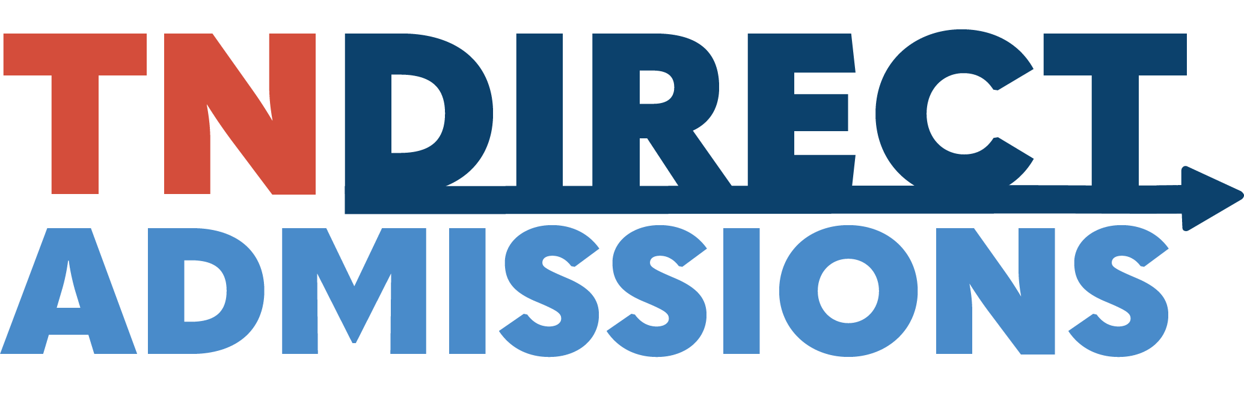

Slide 2
Slido
On average, how many college applications do you think the average student completes in their college admissions process?
Answer: open
Real answer: between 5-10
Notes:
Operating across at least 11 states to date, these policies have been shown to support college-going behaviors and enrollment, especially among students of color, those from low-income backgrounds, and first-generation students.
Significant increases in first-time undergraduate enrollments were observed, especially at two-year, open-access institutions.
However, while response to the direct admissions letter was even across demographic groups, enrollment among those with lower median household incomes did not increase. Researchers found that quite a few students would commit to four-year institution, but when they received their bills in July, they realized it just wasn’t affordable for them.
So the project team approached us and posed the question, what if students could be proactively admitted to college and provided with an upfront “guarantee” or signal of financial aid?
This project will be the first to link direct admissions and financial aid in practice at scale.

Slide 3
Tennessee Direct Admissions
Goal: Simplify college admission by proactively admitting students based on pre-existing data, eliminating traditional applications and application fees.
Affordability remains a challenge, even with expanded college access from direct admissions programs in 11 states.
Tennessee’s Direct Admissions program will be the first to combine direct admissions and financial aid in statewide practice.
Notes:
Operating across at least 11 states to date, these policies have been shown to support college-going behaviors and enrollment, especially among students of color, those from low-income backgrounds, and first-generation students.
Significant increases in first-time undergraduate enrollments were observed, especially at two-year, open-access institutions.
However, while response to the direct admissions letter was even across demographic groups, enrollment among those with lower median household incomes did not increase. Researchers found that quite a few students would commit to four-year institution, but when they received their bills in July, they realized it just wasn’t affordable for them.
So the project team approached us and posed the question, what if students could be proactively admitted to college and provided with an upfront “guarantee” or signal of financial aid?
This project will be the first to link direct admissions and financial aid in practice at scale.

Slide 4
Statewide Launch – Year 2
Expanding Direct Admissions to all state aid eligible high school seniors in the class of 2027. (including Private and Home Schoolers)
Eligible high school students will be admitted to in-state postsecondary institutions based on their high school academic achievements.
Students will be presented institutional merit-based aid and up-front state-supported financial aid information.
Notes:
In Tennessee, 39.1% of Fall 2023 undergraduate enrollments were at open-access community colleges, and another 31.7% were at public four-year institutions that accept at least three quarters of applicants.
The TN Board of Regents has agreed to partner with us on this, and we will be reaching out to public and private universities over the next couple of months.
The scope of this pilot project and study will be larger than any undertaken so far.

Slide 5
Tennessee Direct Admissions
Letter
HS senior receives letter with list of postsecondary options, institutional financial aid, and state-supported aid
Student scans QR code or follows link in TSAC Student Portal to claim their spot
Data Transmission
THEC provides student’s data file to institution through FAST, serving as official application
Follow-Up
Institution sends follow up email and needed items
Student enrolls
Institution follows up in Spring- matriculation details
Notes:
Benefits for Tennessee
● Tennessee would develop and piloted a new direct admissions program in partnership with leading researchers in this area and in tandem with another state/system partner.
● The project and its insights would thus expand capacity for scaling direct admissions in Tennessee while also contributing to the research base on these programs and serving as a national model for integrating direct admissions and financial aid for other states.
● Tennessee and THEC would continue to be a national innovator in higher education by being one of the first states to combine direct admissions and financial aid.
● Lumina grant funds would provide support to THEC for work on the project in the form of a small annual stipend for administration, IT, advertising, operation, etc.
● THEC and partners would also have access to a dedicated liaison who will also serve as project manager, as well as access to the expertise of the project team.
● The project team would also provide THEC with quantitative and qualitative insights on the program’s effects and feature THEC as a partner on any team or Foundation materials.

Slide 6
Tennessee Direct Admissions
Tennessee Promise Application
High School Counselor Report 6th semester TELS/HOPE Scholarship GPA (Home Schoolers – DEG GPA)
ACT provides student scores to FAST (Highest Composite)
Letters will go out Late August through close of TN Promise Application (multiple mailings until the close of TN Promise)
Students claim their spot through Enrollment Form
File is provided to institutions through FAST
Institutions follow up through enrollment at the institution

Slide 7
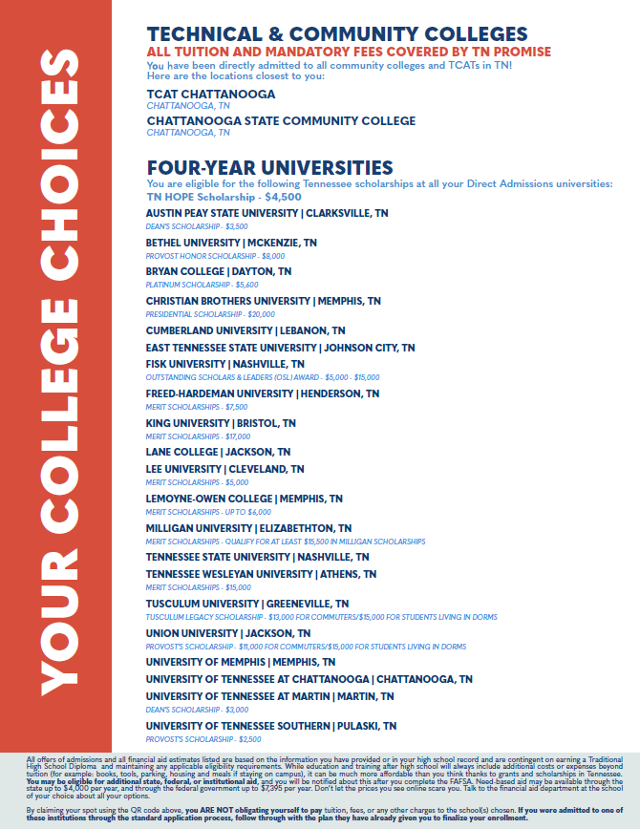
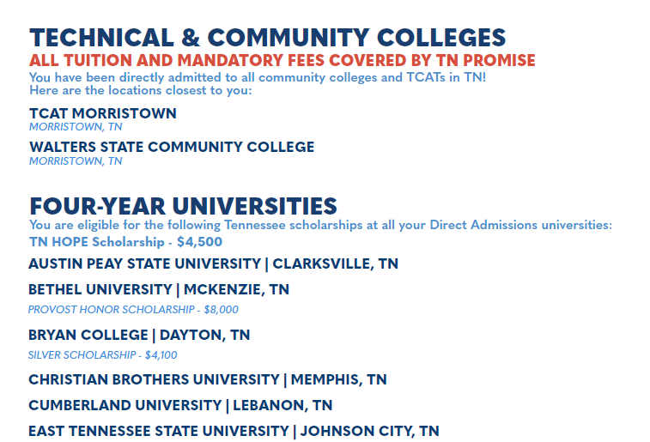

Slide 8
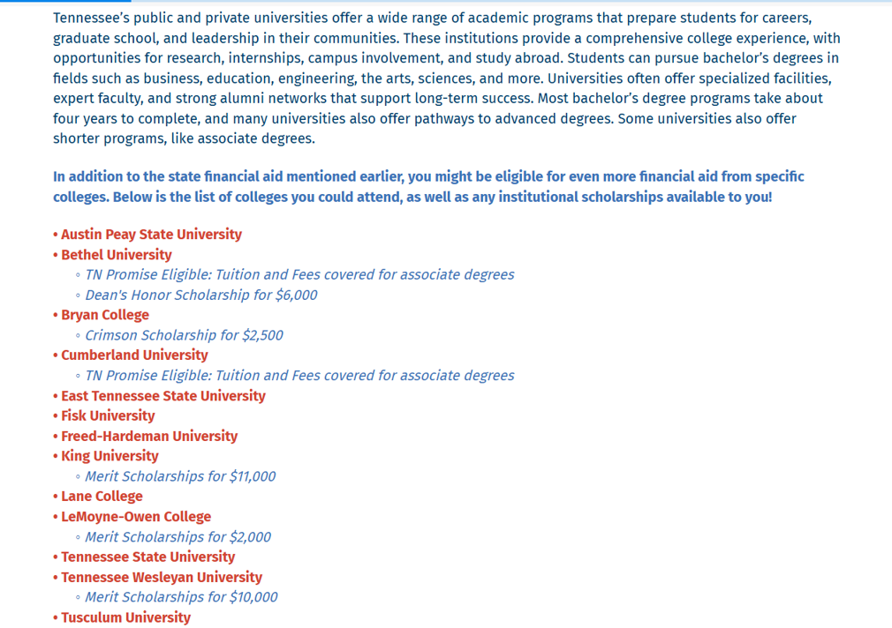

Slide 9
Year 1
Pilot Year: A pilot program offering automatic college admission to eligible high school seniors. No applications or fees required.
Who It Reaches: Over 45,000 students from 255 randomly selected high schools.
Participating Institutions: 57 colleges including TCATs, community colleges, and public/private universities.
Launch Timeline: Letters sent in December 2025 to Class of 2026 students.
Notes:
In Tennessee, 39.1% of Fall 2023 undergraduate enrollments were at open-access community colleges, and another 31.7% were at public four-year institutions that accept at least three quarters of applicants.
The TN Board of Regents has agreed to partner with us on this, as well as 17 public and private four-year schools.
The scope of this pilot project and study will be larger than any undertaken so far.

Slide 10
Participating Higher Ed Institutions
All TBR TCATs and Community Colleges
Austin Peay State University
Bethel University
Bryan College
Christian Brothers University
Cumberland University
East Tennessee State University
Fisk University
Freed-Hardeman University
King University
Lane College
Lee University
LeMoyne-Owen College
Milligan University
Tennessee State University
Tennessee Wesleyan University
Tusculum University
Union University
University of Memphis
University of Tennessee at Chattanooga
University of Tennessee at Martin
University of Tennessee Southern
Notes:
Our TCATs and community colleges already admit anyone that applies. With some obvious exceptions like UT Knoxville, Vanderbilt, and a few others, most of the 4-year schools in Tennessee admit more than three quarters of their applicants. These schools account for more than 70% of enrollments each year.
We are not asking any of them to lower their admissions standards; we are simply cutting through some of the “red tape” and reaching out directly to students and their families about opportunities that already exist for them.
The bottom line is there are students out there that can succeed in postsecondary training or education but aren’t enrolling simply because of perceived administrative burden, lack of awareness of the financial aid available to them, or just a gap in hope and belief that they are “college material.”

Slide 11
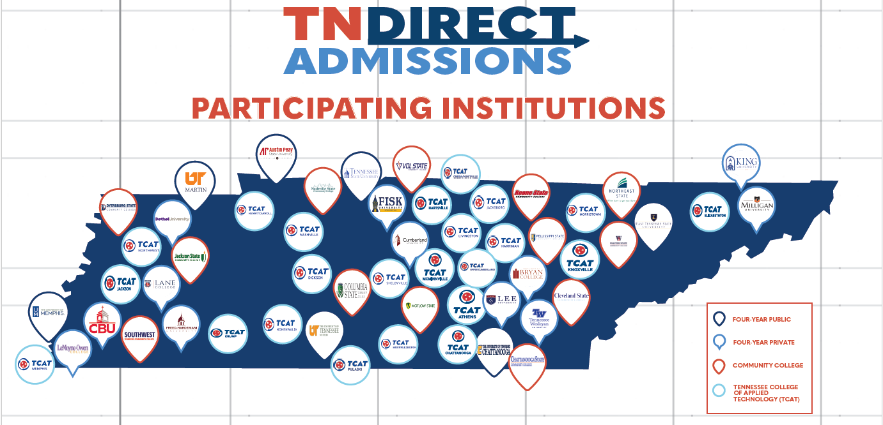

Slide 12
Pilot Year Next Steps
Create awareness and affirm the legitimacy of the project at your school.
Currently around 6,500 have submitted their enrollment form
Remind students to keep an eye out for the Letters and support them in understanding what it means.
Have students complete the FAFSA.
Help them navigate accepting their spot through the QR Code. Enrollment page closes June 1.
Guide students through completing next steps from Accepted Institutions.

Slide 13
Changes for Year 2
All state aid eligible seniors in the class of 2027
Adding institutions
Letter logistics
  Multiple mailings starting in September
  All letters will include financial aid information
  Letter being mailed to school
Working on counselor reports
Additions to the enrollment page
Number of institutions a student can choose

Slide 14
Statewide Launch Next Steps
Create awareness and legitimacy for Direct Admissions– Materials will be mailed to high schools in August
Promote TN Promise registration
  Opened April 1st
Send 6th semester GPAs
  More information about how to upload file to come
Advise and support students once they receive their letters
  Transcripts and ACT Scores sent to institutions chosen

Slide 15

Questions
Mark Photivihok
TN Direct Admissions Project Manager
Mark.Photivihok@tn.gov
Direct.Admissions@tn.gov

