Slide 1


SME Education Foundation and Ford Philanthropy Scholarship
Presentation
January 16, 2026
Dr. Youlanda Jones, President

Slide 2
TCAT Northwest Mission Statement
The Tennessee Colleges of Applied Technology serve as the premier suppliers of workforce development throughout the State of Tennessee. The Colleges fulfill their mission by:
Providing competency-based training through superior quality, traditional and distance learning instruction methods that qualify completers for employment and job advancement;
Contributing to the economic and community development of the communities served by training and retraining employed workers;
Ensuring that programs and services are economical and accessible to all residents of Tennessee; and
Building relationships of trust with community, business, and industry leaders to supply highly skilled workers in areas of need.

Slide 3
Benefits for students enrolling in these programs
High Demand Skills: Learn mechanical, electrical, and computerized systems used in modern manufacturing.
Versatility: Ability to troubleshoot and maintain robotics, automation equipment, and production machinery.
Career Growth: Prepares you for roles like Maintenance Technician, Mechatronics Specialist, or Automation Technician.

Slide 4
Benefits for students enrolling in these programs (continues)
Competitive Pay: Skilled maintenance and mechatronics professionals are among the highest-paid in technical fields.
Industry-Relevant Training: Hands-on experience with PLCs, hydraulics, pneumatics, and robotics.
Job Security: Manufacturing and automation industries consistently need skilled technicians.

Slide 5
How these pathways lead to rewarding careers in the region?
Strong Local Manufacturing Base
Ford Blue Oval City and other local facilities are home to major employers in automotive, food processing, and advanced manufacturing, creating a strong demand for skilled technicians in automation systems, robotics, and electrical maintenance.
High Demand & Job Security
Industrial Maintenance and Electrical roles are among the hardest to fill in manufacturing. Graduates often secure jobs quickly with starting pay between $20–$30/hour, plus overtime opportunities.

Slide 6
How do these pathways lead to rewarding careers in the region? (continues)
Career Advancement: Entry-level positions can lead to supervisory roles, engineering technician positions, or specialized automation careers. Skills in PLC programming, robotics, and electrical troubleshooting are steps to higher-paying roles.
Local Impact: These careers support economic growth in rural areas by keeping manufacturing plants operational. Many employers offer tuition reimbursement, benefits, and long-term stability.
Flexibility Across Industries: Skills apply to automotive, agriculture, food production, and logistics—industries thriving in West Tennessee.

Slide 7
TCAT Northwest offers the following programs:
Computer-Aided Design (CAD) Technology
Industrial Electricity
Industrial Maintenance
Industrial Maintenance Automation
Industrial Maintenance Mechatronics
Industrial Maintenance Molding
Machine Tool Technology

Slide 8
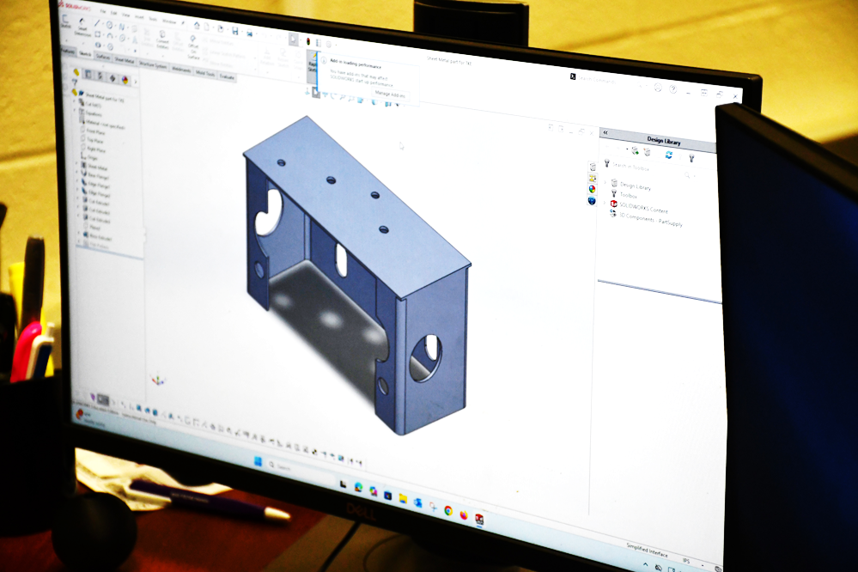

Computer-Aided Design (CAD) Technology (16 months)
This program includes instruction in basic drafting, with the student choosing emphasis in either Architectural or Mechanical drafting. CAD Technology offers certificates as well as a diploma in the area of choice. Computer-Aided Design is incorporated into both areas of concentration, where trainees learn to create accurate and complete drawings using techniques such as red-line drafting.
Trainees are introduced to different aspects of their training through a curriculum that is annually certified by the American Design & Drafting Association, as well as, the participation in “live” projects. Students are encouraged to actively participate in various fundraisers and community service projects.

Slide 9
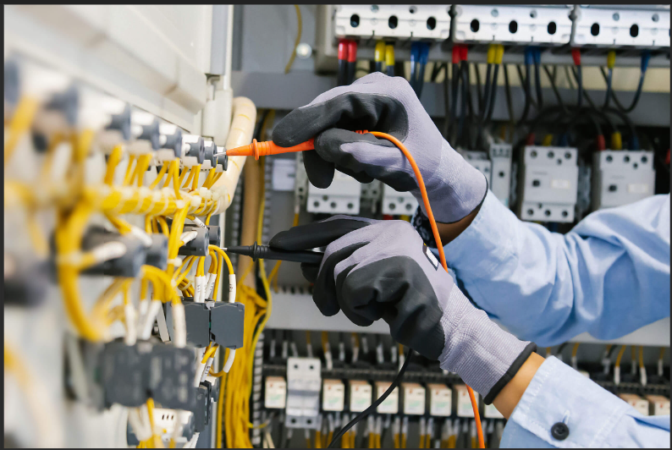
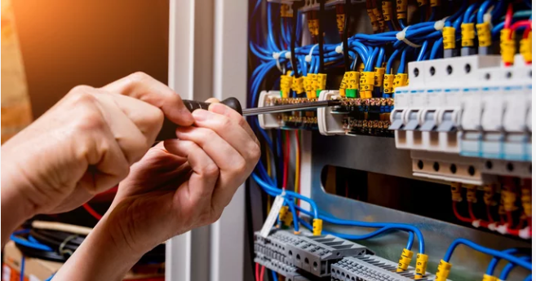
Industrial Electricity
(16 months)
This program includes classroom and “hands-on” experience in electronics, electrical, pneumatics, motor controls, programmable controllers, robotics, and related math. Students completing this program are prepared to perform at the entry level in a typical industrial environment.

Slide 10
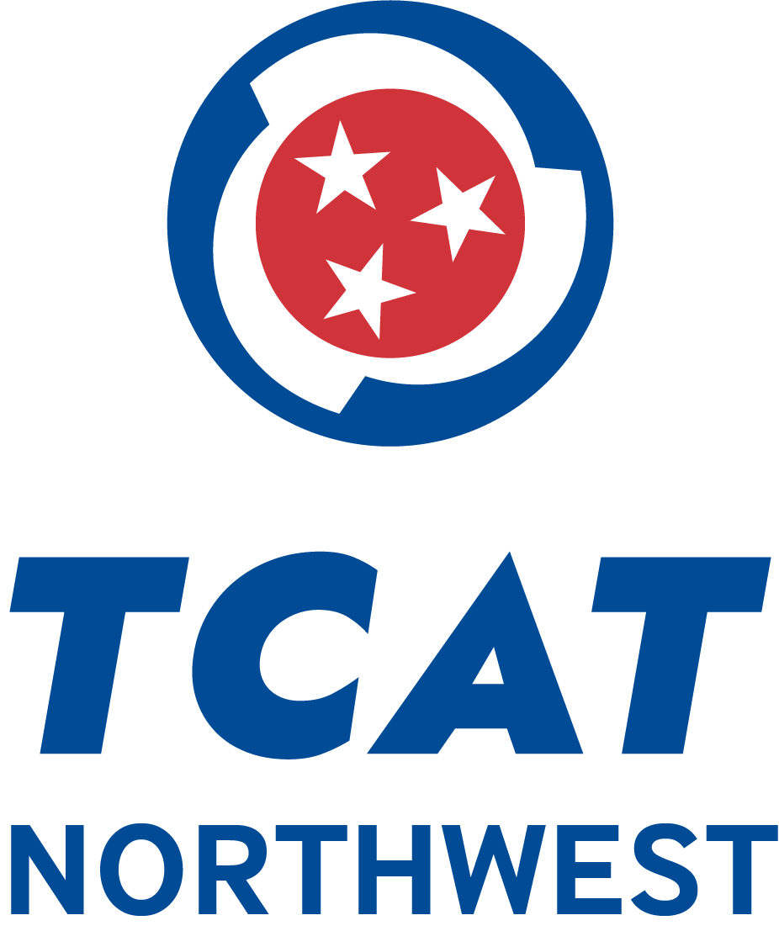

Industrial Maintenance
(16 months)
This program was designed to give the student the knowledge and skills needed to safely and efficiently perform the maintenance tasks that are necessary to maintain the machinery and associated equipment that are common to local industry. This 16-month program offers training on the latest equipment used in the industry. With the implementation of mechatronics training in the classroom, students are well-equipped to enter the workforce as accomplished technicians. Full-Time and Part-Time schedules available.

Slide 11

Industrial Maintenance Automation (20 months)
The Industrial Maintenance Automation program is designed to prepare students to enter the Industrial Maintenance field in an entry-level position and to enhance the skills of students already employed in the field. The program provides instruction to develop the skills needed to succeed in the repair and maintenance of machinery and equipment in industrial environment.
At the completion of the diploma level, graduates will have satisfied the educational requirements for the Industrial Maintenance Automation program. Students are prepared for initial employment as maintenance technicians with experience in programmable logic controllers, hydraulics, pneumatics, mechanical and electrical power, troubleshooting, robotics, and welding.

Slide 12
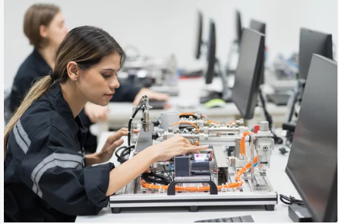
Industrial Maintenance Mechatronics
(20 months)
Trainees learn the fundamentals of electricity and electronics, which provide the foundation for advanced training in electric motor controls, automated machine control circuits, conveyors, pumps, pneumatic and hydraulic systems, test equipment, production equipment (electrical, electronic, and mechanical), programmable controllers, automation, and robotics. In the last phase of the course, students combine all their newly acquired skills in overall systemic troubleshooting and interfacing systems. Hands-on training and safety are stressed throughout the course.
This course also provides an excellent opportunity for those people who are already employed to upgrade their skills to advance into more challenging and profitable careers.

Slide 13

Industrial Maintenance Molding (16 months)
The mission of the Industrial Maintenance/Molding program is to guide individuals through an educational experience to become personally, professionally, and socially effective industrial maintenance workers.
The Industrial Maintenance/Molding Program is designed to produce highly skilled individuals in the areas of Mechanical, Electrical, and Injection Molding-Robotics. The program consists of Mechanical Training, to include numerous types of power transmission techniques, belt drive systems, chain drives, alignment methods, and coupling methods. Pneumatic and Hydraulic operation and application. Basic electrical with motor control, sensors, motor drives, AC and DC motor theory and operation, and troubleshooting. Programmable Logic Controller (PLC), Robotics, and Human Machine Interfaces training that includes both programming and troubleshooting. Advanced Injection Molding will be the final part of the program.

Slide 14
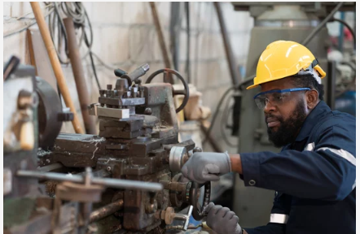
Machine Tool Technology (16 months)
Almost every product made by American industry contains metal parts or is manufactured by machines made of metal parts. Over one million people are employed as machinists, tool and die makers, instrument makers, machine tool operators, set-up and lay-out people.
This program is designed to train students to set-up and safely operate machine tools such as milling machines, lathes, surface grinders, EDM’s and drill presses. Students also learn to determine dimensions and tolerances of a part to be machined, sequence of operations, and the tools, materials, and machines required to make that part from blueprint, sketch, damaged part or description of the part to be replaced. In addition to the traditional shop machines, the most modern Computer Numerical Control (CNC) equipment is available for students to receive hands-on experience.

Slide 15
Questions?

Slide 16
Contact Information
Dr. Youlanda Jones, President
TCAT Northwest
340 Washington Street
Newbern, TN 38059
731-627-2511
www.tcatnorthwest.edu
yjones@tcatnorthwest.edu

