Slide 1
Navigating the TN Transcript Center: Simplifying Transcript Management
Angela Tobin – Account Manager

Slide 2

Agenda
Overview of the Transcript Center
How can Transcript Center help you?
Demo of the Transcript Center
Questions

Slide 3
What is the Transcript Center?
•Web-based application for the secure and electronic exchange of transcripts
•24/7 accessible online ordering application for students and alumni
•Integrated Scholarship Eligibility
The Exchange connects directly to the Tennessee Education Lottery Scholarship (TELS) system, eliminating the need for separate data submissions.

Slide 4
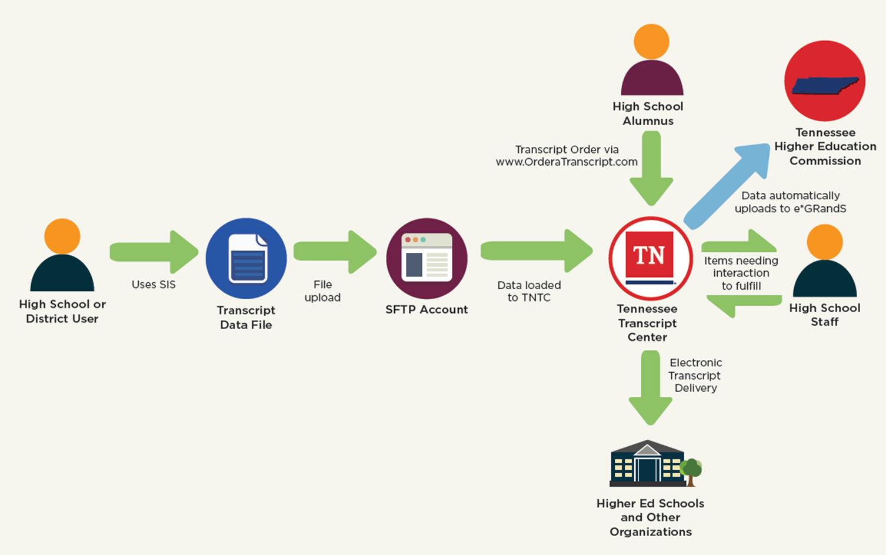
How Does It Work?

Slide 5

Benefits
•Automatic lottery scholarship GPA transmission to FAST
•Central location for receiving and processing transcript requests
•No subscription fees
•No ordering fees for students
•Reduced material use, cost savings
•24/7, 365 online transcript ordering

Slide 6


Student's view
School's view

Slide 7
Questions
STservices@studentclearinghouse.org

