Slide 1
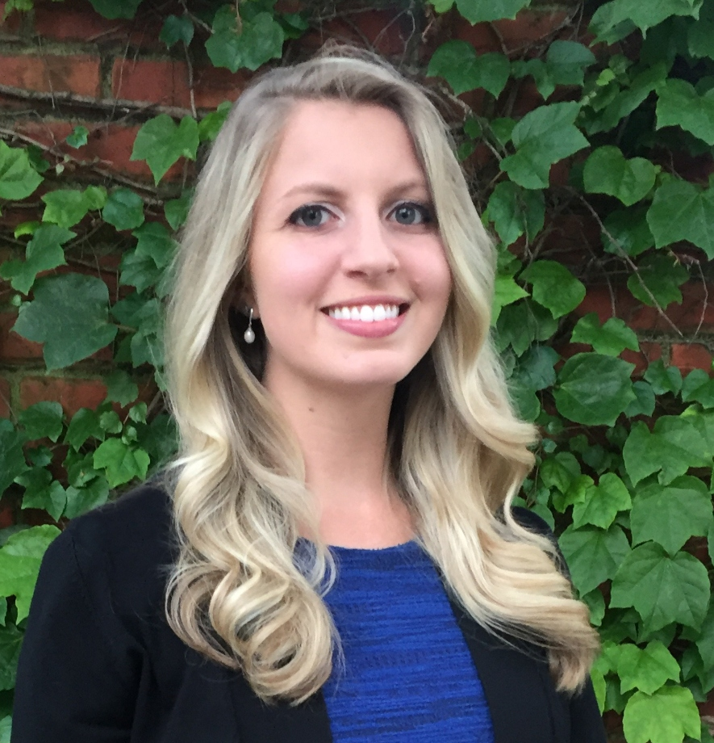
Memphis Rise Academy Charter School
College Application and Exploration Month: Best Practices
Amanda Villani Director of Post- Secondary Counseling
avillani@memphisrise.org
Notes:
Memphis Rise Academy Charter School
Amanda Villani has been the Director of Post-Secondary Counseling at Memphis Rise Academy since the program’s founding year in 2019. She works with all students across all grade levels with regards to college and career readiness and the transition from high school to various post-secondary pathways. Amanda wishes she could present this information herself, but is unable to do so since she is on family leave. She has provided us with some information regarding Memphis Rise Academy’s best practices in promoting college exploration among grades 9 through 11 and application submission among seniors.

Slide 2
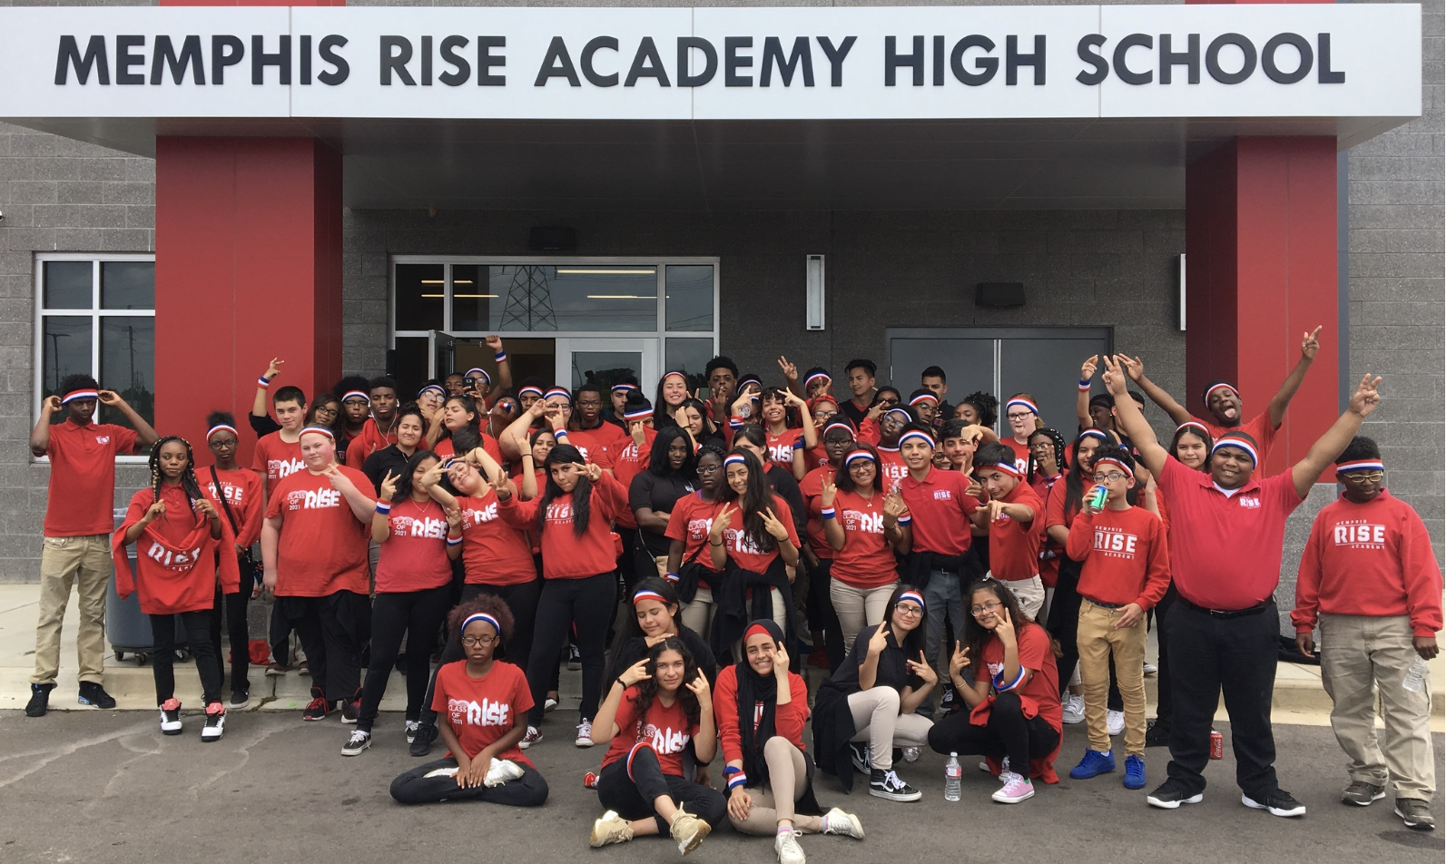
Memphis Rise Academy Charter School
About
MRA is a Title I open-enrollment charter middle and high school serving students in grades 6-12 in Northeast Memphis
Founded in 2014 with a 6th grade class, grew one grade level per year Established a Post-Secondary Counseling program in the 2019-2020 school year.
Post-Secondary Recognitions:
ACAC School of Excellence Recipient (2024)
CollegeforTN Path to College School
Hobsons Education Advances Award (2021)
MRA’s Founding Class of 2021
Notes:
See information on slides.
If worth mentioning…Our Students’ Demographics:
Latino: 52.1%, Black/African-American: 39.5%, White: 5.4%, Asian: 1.5%, Multiple Races: 1.5%
Free & Reduced Lunch according to USDA standards: 84.9%
Over 90% of our students are first-generation college students Photo Caption: As of this past May, the students in this photo not only make up Memphis Rise Academy’s founding class of sixth graders and first graduating class, but now are the first students in the school’s history to graduate from four year colleges including, but not limited to, the University of Memphis, Rhodes, CBU, Rice University, Belmont, and more.

Slide 3
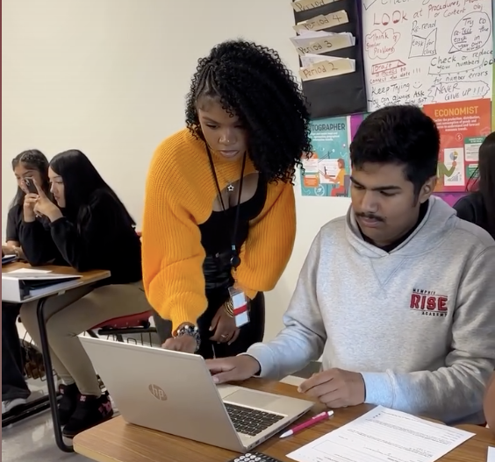
Best Practice #1: Individualized Support for Each and Every Student
Example: Post-Secondary Seminar (Weekly)
Logistics: Materials designed/curated by Director of Post-Secondary Counseling and executed by teachers during a 40-minute advisory period on a weekly basis.
Grade-Level Curricula (Grades 9-12):
Example 11th Grade Activities:
Mock College Admissions Committee
Naviance SuperMatch College Search
Example 12th Exploration and Application Grade Activities:
Common App Creation and Set Up
College Essay Workshop and Competitive Essay Support
Explore a Program at Southwest TN Community College or TCAT
Pathway Differentiation: Juniors and seniors are placed in cohorts based on a combination of academic profile and post-secondary goals.
MRA Class of 2022 alum and current Post-Secondary Counseling Intern assisting with Junior Seminar (8.28.25)
Notes:
Given that every student enters their senior year with different goals and dreams within their own unique context and set of circumstances, Amanda and her team have found that it is critical to celebrate all post-secondary pathways. When students know that their trajectory of choice is just as important and valued as those of the student next to them, they feel more excited about the prospect of communicating their post-secondary goals to the adults in their lives and taking the necessary steps to apply.
While Memphis Rise Academy students explore colleges in middle school through advisory activities and field trips, the official start the college exploration process starts in Freshman Seminar in the 9th grade. Students across grades 9 through 12 have an opportunity to meet once a week for 40 minutes in post-secondary seminars. The materials for these seminars are created and curated by Amanda based on the grade level’s needs and development and executed by advisors. In the 9th and 10th grades, these activities are carried out in their standard advisory setting and focus on a combination of identity exploration, college preparation, and career readiness.
In the 11th and 12th grades, students are placed in cohorts based on a combination of GPA, ACT, and post-secondary aspirations. This allows for content to be differentiated based on students’ goals and remain relevant, and therefore purposeful, to the students in the room. For example, seniors in one cohort may spend time comparing the difference between programs at TCAT versus Southwest and receive support on one of the applications, while seniors down the hall are adding institutions to Common App and brainstorming possible essay topics to the personal statement prompts. Students can advocate to move cohorts, especially if their plans change, allowing this model to remain fluid rather than placing students in a box.
(See examples on the slide of the types of activities our juniors and seniors will complete this fall.)
In addition to weekly seminar times, students have an opportunity to schedule individual meetings with Amanda outside of class time for additional individualized support.

Slide 4
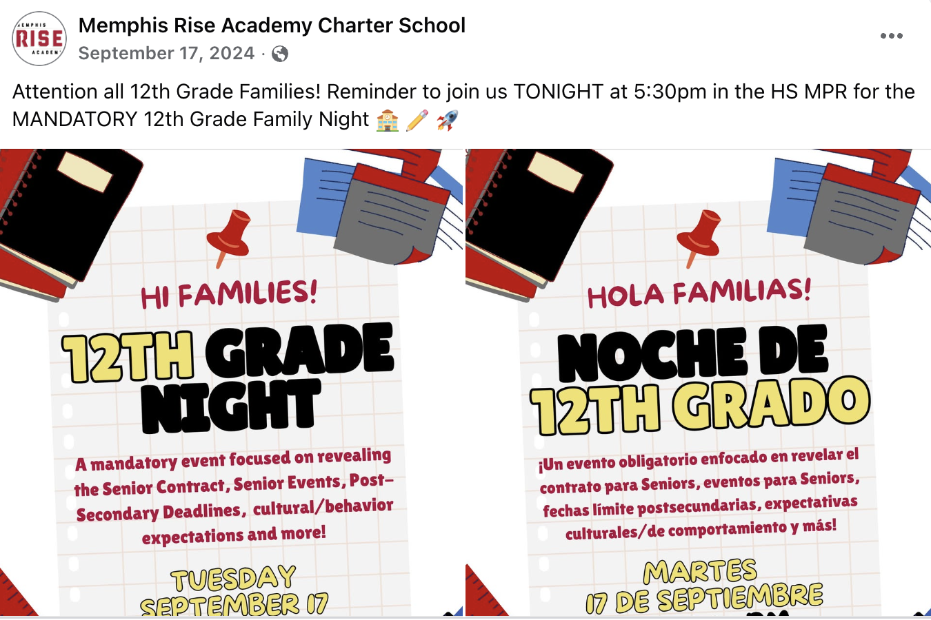
Best Practice #2: Authentic Family Partnerships
Events
Example: Senior Family Night (August 26, 2025)
Hispanic Heritage Festival
Materials in Multiple Languages
Regular and Consistent Communication
Example: REMIND
Create a Welcoming Environment & Build Trust through an Open Door Policy and Active Listening
Social media post for our 2024 Senior Night in English and Spanish
Notes:
Our best practice for assisting our students with college exploration and application is through authentic family partnerships.
Amanda tries to find opportunities to share information about important post-secondary deadlines and resources through mandatory or well-attended events like Senior Family Night and Hispanic Heritage Festival in the fall.
Materials including college and financial aid deadlines, as well as documents like the newly updated College for TN College Application and Fee Waiver Toolkit, are shared with families are translated to Spanish.
Amanda makes sure that these materials are not just shared at events but sent in soft copy out afterwards via Remind. Remind is also key for sharing out information that students receive regarding upcoming college trip sign ups and important deadlines.
Creating a welcoming environment and genuinely listening to and validating family members’ concerns can go a long way in earning and building the family’s trust. When mutual trust is established, families are more likely to support the school and their students in completing application action items. In order to establish this trust, Memphis Rise curates an open door environment where no question, comment, or concern is too big or small, and staff members are genuinely interested in listening and collaborating with families rather than just disseminating information.

Slide 5
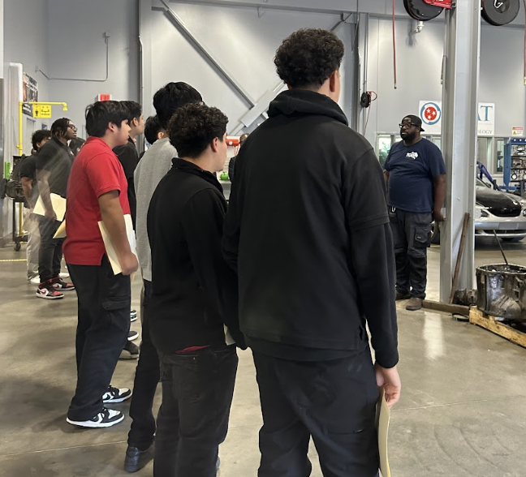
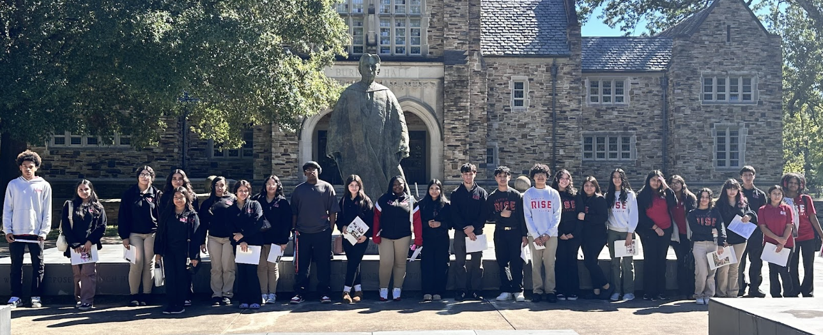
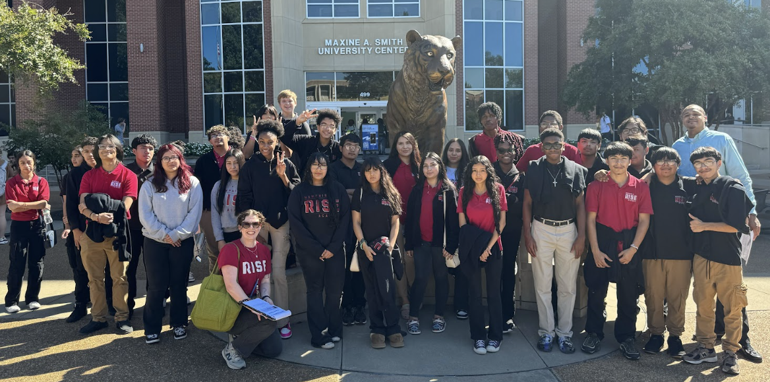
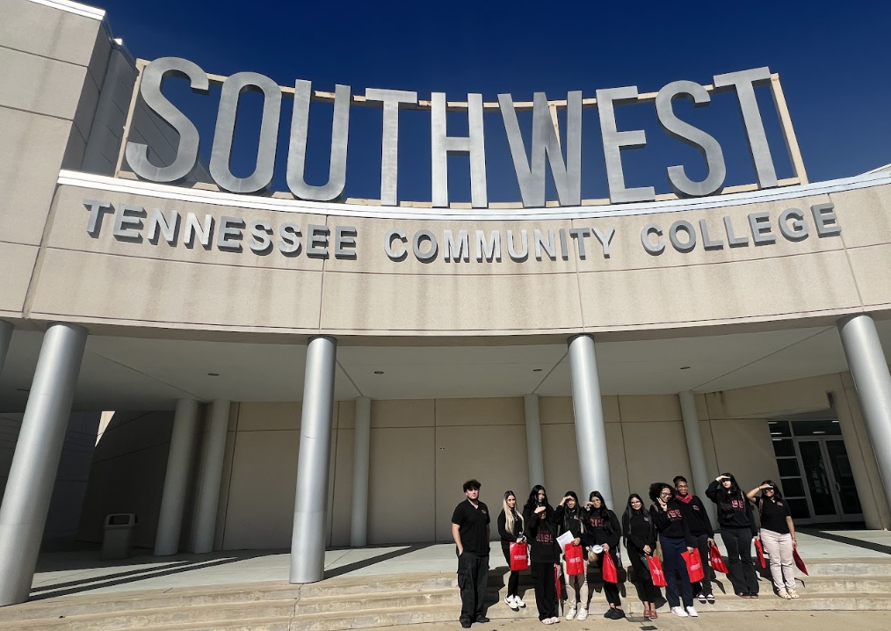
Best Practice #3: Collaboration with Higher Education Partners
NACAC’s Memphis-Area College Night
Memphis-Area Post-Secondary Trip (Application-Based Opportunity)
Post-Secondary RepVisits (College admissions counselors, military recruiters, professors, and professionals from different sectors)
ACAC’s #WhyApply Social Media Campaign
HBCU Awareness Foundation College Fair
Memphis-Area Post-Secondary Trip, 2024
Notes:
Memphis Rise Academy has also learned the importance of collaborating with external partners in providing students access to various post-secondary institutions. The first annual trip of the year is to NACAC’s Memphis-Area College Night. Students and families can register to attend with Memphis Rise Academy or indicate that they are interested in attending separately.
Following this is our annual Memphis-Area Post-Secondary Field Trip. During Junior and Senior Seminar in mid-September, students complete an application where they use their GPA, ACT, and areas of interest to choose a first and second choice college trip of best fit. In order to mirror the application and process, students receive an “acceptance” letter to their trip and need to accept the offer. Amanda is excited that this year, students can have the opportunity to select up to TWO trips, which has not been the case in previous years.
During Focus Study period (study hall) and lunches, students can sign up for visits with representatives from colleges and other external partners. Prior to the visit, Memphis Rise sends the representatives questions and topics of interest submitted by students during the registration process.
Over the past few years, Memphis Rise Academy’s staff has partnered with ACAC in their annual #WhyApply campaign. If you have someone to take point on social media, this is a very simple way to engage staff and alumni in celebrating all college pathways and offer words of wisdom in response to the question, “Why Apply?” Also…who doesn’t like a chance to dress down in jeans and a college t-shirt?
Even though it’s not until early November, Amanda also wants to shout out the HBCU Awareness Foundation’s annual college fair that provides juniors and seniors with an opportunity to explore and apply to HBCUs across the country in a traditional college fair setting.

Slide 6
Memphis Rise Academy Charter School
Questions?
Amanda Villani Director of Post- Secondary Counseling
avillani@memphisrise.org
Notes:
Attendees can reach out to me with questions or concerns, but given that I’m on leave, I might be a little bit slower to respond.

