Slide 1
Tennessee Direct Admissions Pilot
Simplifying Enrollment in Practice: Studying the Integration of Direct Admissions Programs and Financial Aid Project Team: Taylor Odle (UW-Madison), Richard Weissbourd and Trisha Ross Anderson (Making Caring Common at the Harvard Graduate School of Education) Supported by The Lumina Foundation, The Kresge Foundation, and Bloomberg Philanthropies
Notes:
Students enter the college application process on unequal footing – with various levels of financial, social, and cultural capital they can rely on to navigate it.
Research shows that the college application process can seem overly complex to many students, sometimes leading them to abandon college altogether. A quarter of students start a college application but never hit submit.
Additionally, students living in communities with lower educational attainment and lower median household incomes were the least likely to submit a college application.
These non-submitters, however, were just as academically qualified for college. They had similar GPAs and ACT/SAT scores as those who ultimately submitted an application. These descriptive differences show that even academically well-prepared students can succumb to complexities in the college application gauntlet.

Slide 2
Why Direct Admissions?
Research shows that many students find the college application process overwhelming, leading many to abandon college altogether.
Direct admissions programs proactively admit students based on pre-existing data, eliminating the need for traditional applications.
Current direct admissions initiatives boost college access, especially for first-generation students, but affordability remains a challenge.
Notes:
Operating across about a dozen states so far, direct or proactive admissions policies have been shown to support college-going behaviors and enrollment, especially among students of color, those from low-income backgrounds, and first-generation students.
Significant increases in first-time undergraduate enrollments were observed, especially at two-year, open-access institutions.
However, while response to the direct admissions letter was even across demographic groups, enrollment among those with lower median household incomes did not increase. Researchers found that quite a few students would commit to four-year institution, but when they received their bills in July, they realized it just wasn’t affordable for them.

Slide 3
What if students could be proactively admitted to college and provided with an upfront signal of financial aid?
Goal: Simplify college admission by proactively admitting students based on pre-existing data, eliminating traditional applications and application fees.
Tennessee’s Direct Admissions Study will be the first to combine direct admissions and financial aid in statewide practice and to include technical/vocational institutions tuition-free.
Notes:
So the project team approached us and posed the question, what if students could be proactively admitted to college and provided with an upfront “guarantee” or signal of financial aid?
Tennessee will the first state to combine direct admissions with financial aid at this scale, striving to ensure that more students know their college options and grants and scholarships available to them.

Slide 4
Tennessee Direct Admissions
Project Proposal
Eligible high school students will be automatically admitted to in-state postsecondary institutions and offered up-front state-supported financial aid information specific to them
Approximately 255 Participating High Schools and 45,000 students
Partner Institution Commitment
Participating postsecondary institutions will align admissions criteria and collaborate with THEC on a unified communications strategy.
Every TBR Community College and TCAT, plus 21 public and private 4-year institutions across the state.
Notes:
In Tennessee, 39.1% of Fall 2023 undergraduate enrollments were at open-access community colleges, and another 31.7% were at public four-year institutions that accept at least three quarters of applicants.
The TN Board of Regents has agreed to partner with us on this, as well as 17 public and private four-year schools.
The scope of this pilot project and study will be larger than any undertaken so far.

Slide 5
Participating Higher Ed Institutions
All TBR TCATs and Community Colleges
Austin Peay State University
Bethel University
Bryan College
Christian Brothers University
Cumberland University
East Tennessee State University
Fisk University
Freed-Hardeman University
King University
Lane College
Lee University
LeMoyne-Owen College
Milligan University
Tennessee State University
Tennessee Wesleyan University
Tusculum University
Union University
University of Memphis
University of Tennessee at Chattanooga
University of Tennessee at Martin
University of Tennessee Southern
Notes:
Our TCATs and community colleges already admit anyone that applies. With some obvious exceptions like UT Knoxville, Vanderbilt, and a few others, most of the 4-year schools in Tennessee admit more than three quarters of their applicants. These schools account for more than 70% of enrollments each year.
We are not asking any of them to lower their admissions standards; we are simply cutting through some of the “red tape” and reaching out directly to students and their families about opportunities that already exist for them.
The bottom line is there are students out there that can succeed in postsecondary training or education but aren’t enrolling simply because of perceived administrative burden, lack of awareness of the financial aid available to them, or just a gap in hope and belief that they are “college material.”

Slide 6
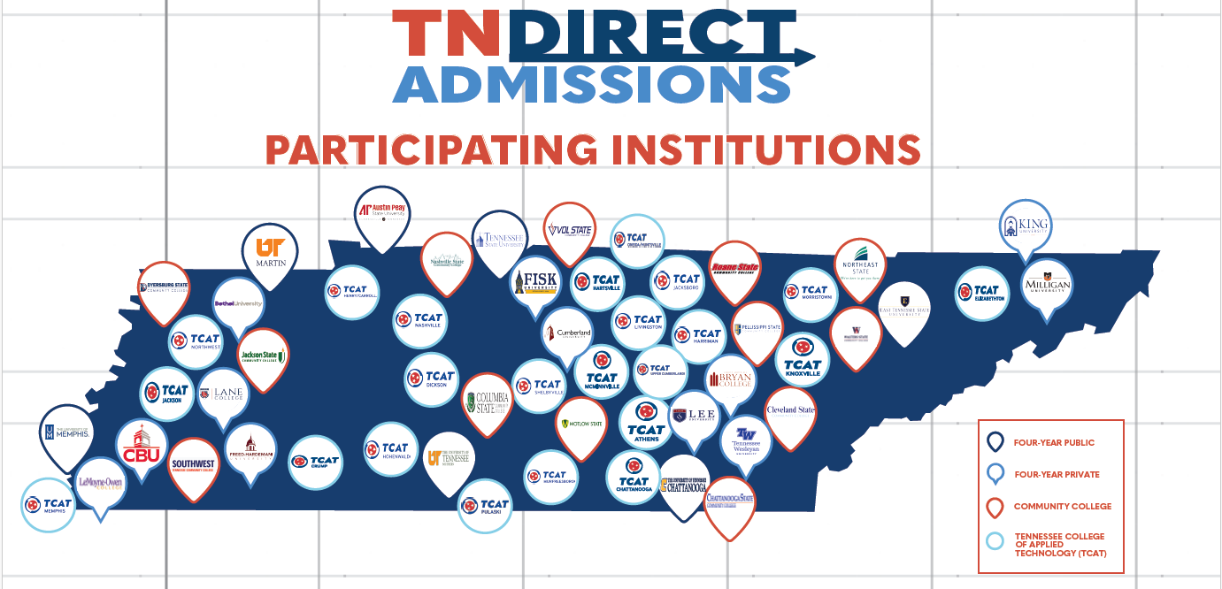

Slide 7

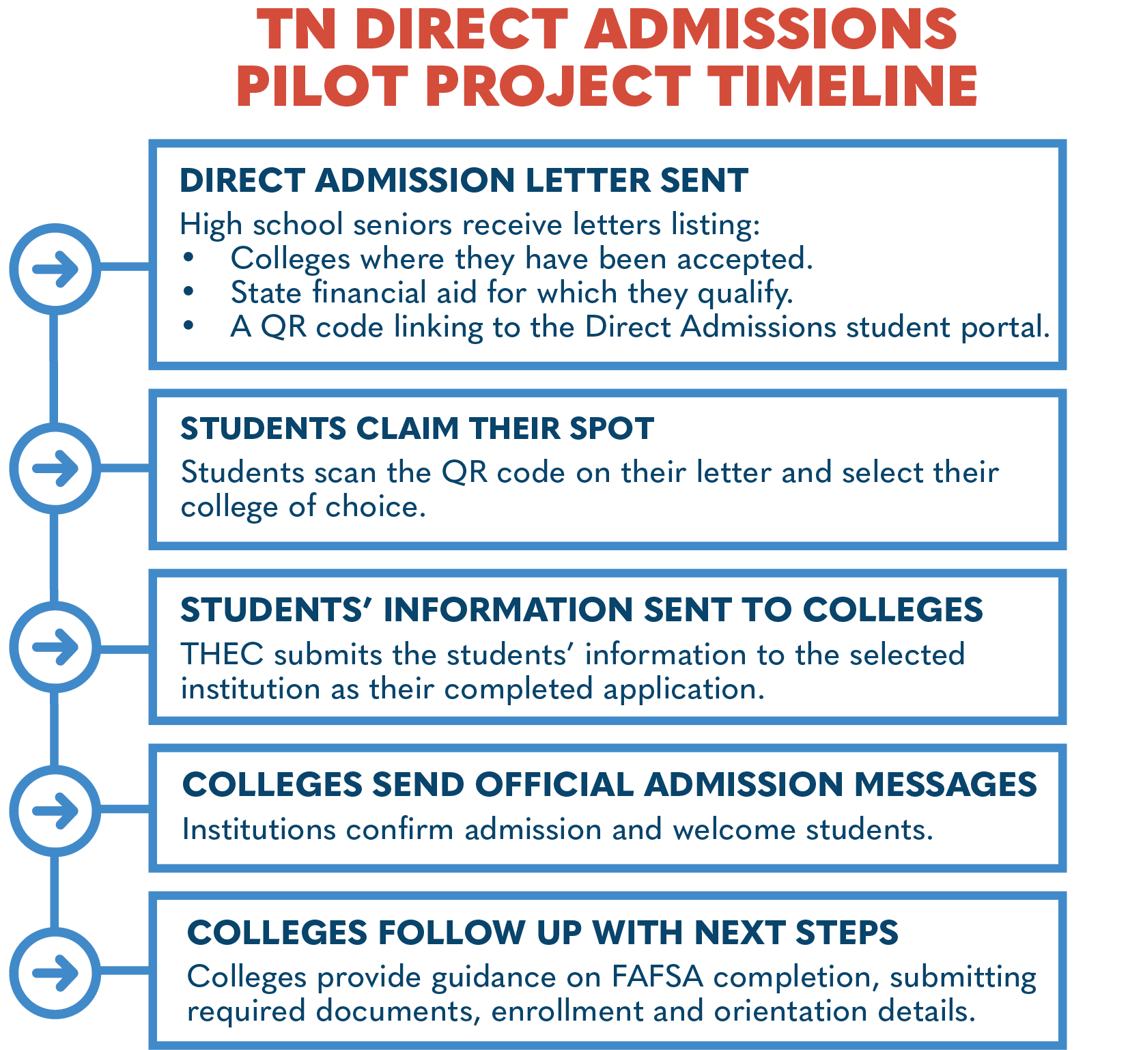
Leveraging data from the TN Promise application, ACT records, the Electronic Transcript Exchange, and existing FAST accounts, roughly two thirds of high school seniors (approx. 40,000) will receive a Direct Admissions letter in the mail from Governor Lee in November.
Notes:
So this is really direct marketing. We aren’t telling these students anything that isn’t already true. There will be qualifying language, like “based on the information you have provided…” etc. The premise is that this outreach will drive behavior to make that emotional decision to “commit” to a plan for life after high school.

Slide 8
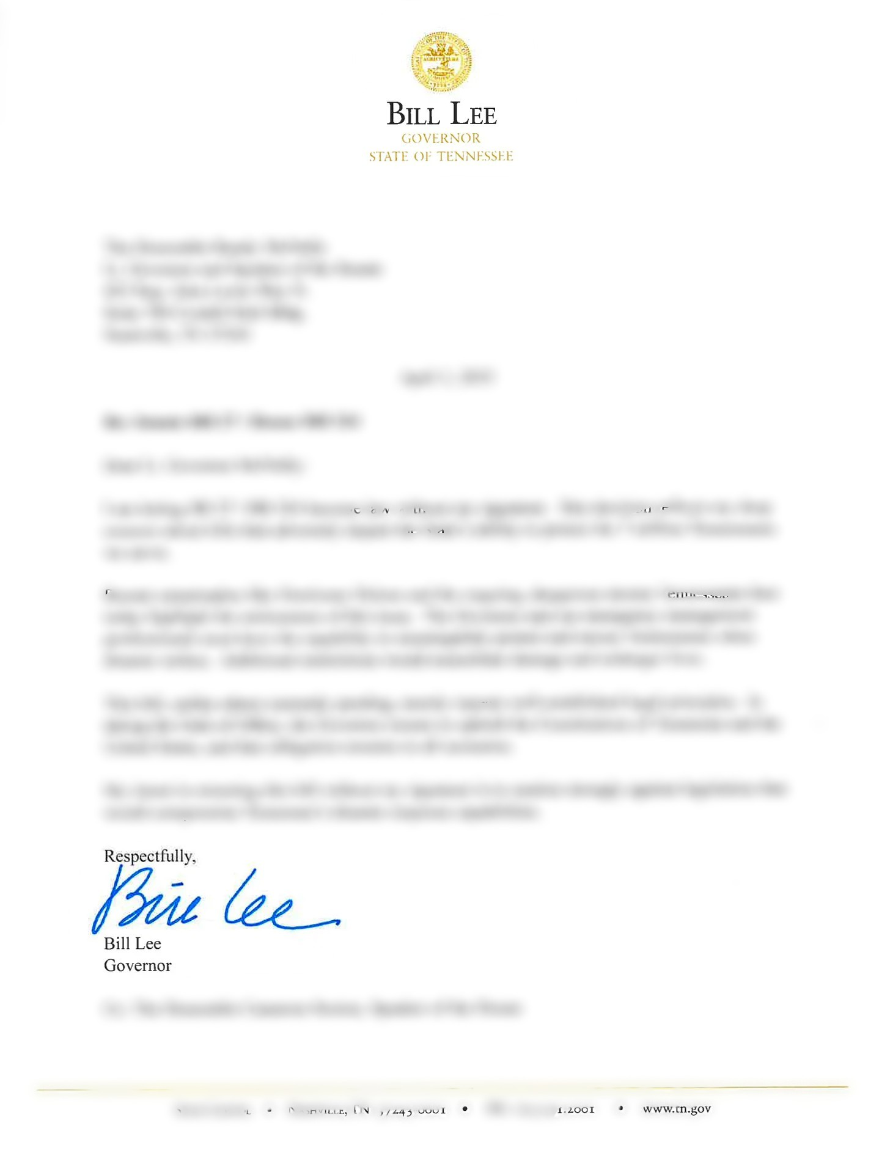
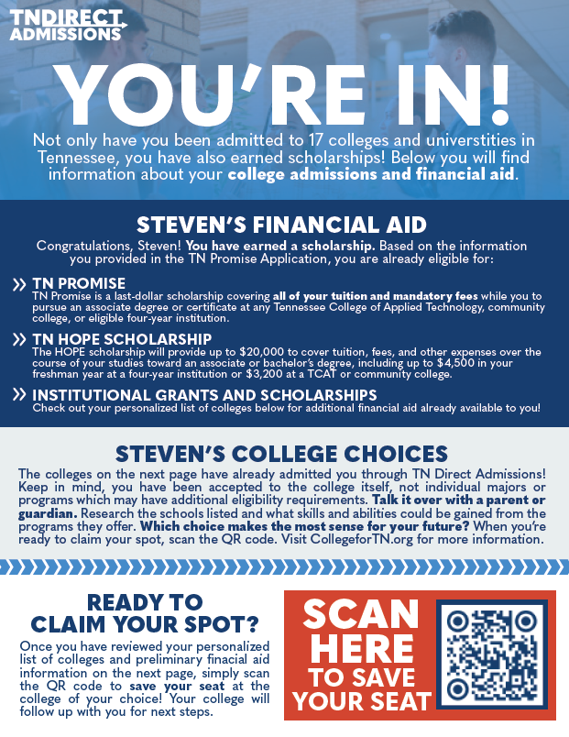
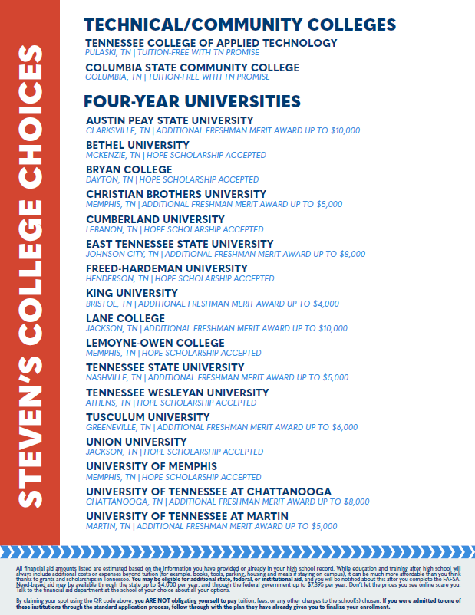

Slide 9

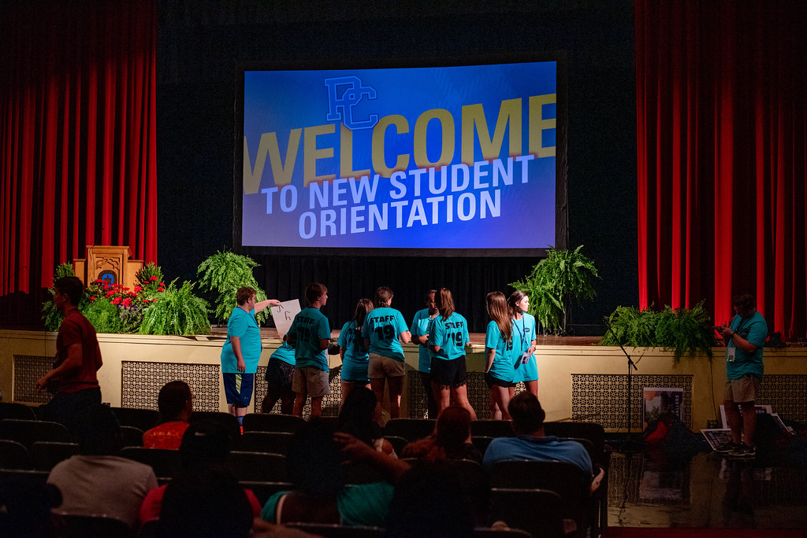
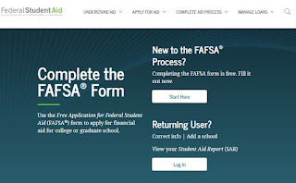
From Acceptance to Enrollment
This Photo by Unknown Author is licensed under CC BY-SA-NC
This Photo by Unknown Author is licensed under CC BY-NC

Slide 10
Treatment Groups
To assess the impact of this pilot, every public high school in the state will be assigned to one of five study groups:
• Group 1: No direct admissions letters. (Control)
• Group 2: Seniors get letters listing the institutions where they are already admitted.
• Group 3: Seniors get letters listing the institutions where they are already admitted, along with an early indication of financial aid for which they may qualify.

Slide 11
Treatment Groups
To assess the impact of this pilot, every public high school in the state will be assigned to one of five study groups:
• Group 4: Seniors get same letters as Group 3, but students/parents will receive coordinated mass texts about the direct admissions process. (Approximately 40 high schools and 7100 students)
Group 5: Seniors get the same letters as Group 3, alongside additional college-going supports, including individualized student/parent texts and personalized outreach from a dedicated direct admissions advisor. (Approximately 38 high schools and 7100 students)

Slide 12

K-12 Outreach and Resources

Slide 13
Tennessee Direct Admissions Resources
List of RANDOMLY Selected Participating Schools - Direct Admissions Selected High Schools - collegefortn.org
TN Direct Admissions Website for High School Partners - Direct Admissions - collegefortn.org
Social Media Tool Kits, Postcards, Info Sheets, Poster
FAQs
Have questions about Direct Admissions?
Email us at direct.admissions@tn.gov
Notes:
In Tennessee, 39.1% of Fall 2023 undergraduate enrollments were at open-access community colleges, and another 31.7% were at public four-year institutions that accept at least three quarters of applicants.
The TN Board of Regents has agreed to partner with us on this, and we will be reaching out to public and private universities over the next couple of months.
The scope of this pilot project and study will be larger than any undertaken so far.

Slide 14
What do we need from you?
Create awareness and affirm the legitimacy of the project at your school.
Have all of your seniors register for the TN Promise.
Answer students’ questions about the project or their letters as needed.
Provide students with their HOPE Scholarship GPA through 6 semesters that is requested on the TN Promise application. – This is the GPA that conforms to the State Board of Education’s Uniform Grading Policy.
You will receive an email from James Snider requesting that you provide THEC with all seniors’ Hope Scholarship GPA through a secure link to TN Cloud.

Slide 15
FAQs
What if my school was not selected to participate in the direct admissions pilot?
The pilot study is just for 2025-2026. At this time, we anticipate expanding Direct Admissions to all high schools and all seniors that complete the TN Promise application in 2026-2027.
What if we normally encourage seniors to complete college applications in September during College Exploration and Application Month?
Continue to do that as you have done in the past. They can still select the same or different institutions through Direct Admissions.
Will school counselors have access to the letters that each of their students’ will receive?
The letters will be mailed and emailed to the students, but we will also place a link in their TSAC student portal. We should be able to provide these to you directly through a secure folder as well.

Slide 16

Questions
Dr. Taylor Odle
University of Wisconsin-Madison
Assistant Professor/Co PI
Dr. Duane Gregg
Tennessee Higher Education Commission
Senior Director, College Access Initiatives
duane.Gregg@tn.gov

