Slide 1

TN Direct Admissions Pilot
Break-Out for K-12

Slide 2
Welcome and Introductions

Slide 3
What if students could be proactively admitted to college and provided with an upfront signal of financial aid?
Goal: Simplify college admission by proactively admitting students based on pre-existing data, eliminating traditional applications and application fees.
Tennessee’s Direct Admissions Study will be the first to combine direct admissions and financial aid in statewide practice and to include technical/vocational institutions tuition-free.

Slide 4
K-12 Outreach & Resources
CollegeforTN Webinars
CollegeforTN Newsletter
CollegeforTN Podcast
TDOE Newsletter
TDOE Counselor Collaboratives

Slide 5

K-12 Outreach and Resources

Slide 6

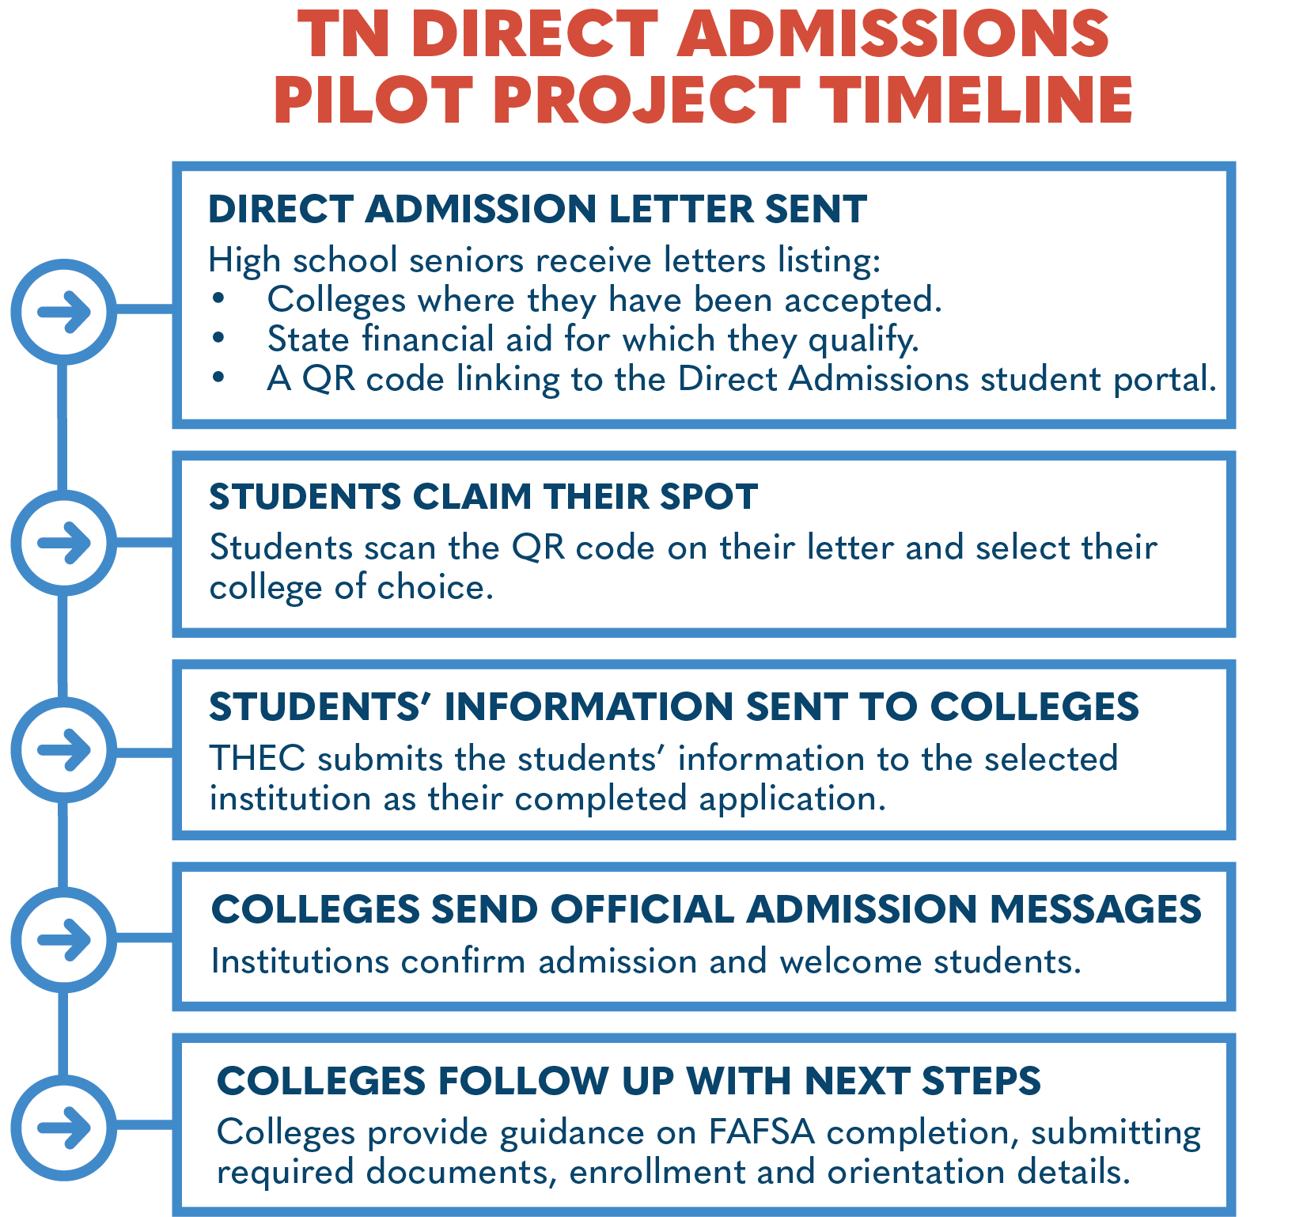
Leveraging data from the TN Promise application, ACT records, the Electronic Transcript Exchange, and existing FAST accounts, roughly two thirds of high school seniors (approx. 40,000) will receive a Direct Admissions letter in the mail from Governor Lee in November.

Slide 7
Tennessee Direct Admissions
Project Proposal
Eligible high school students will be automatically admitted to in-state postsecondary institutions and offered up-front state-supported financial aid information specific to them
Approximately 255 Participating High Schools and 45,000 students
Partner Institution Commitment
Participating postsecondary institutions will align admissions criteria and collaborate with THEC on a unified communications strategy.
Every TBR Community College and TCAT, plus 17 public and private 4-year institutions across the state.

Slide 8
Participating Higher Ed Institutions
All TBR TCATs and Community Colleges
Austin Peay State University
Bethel University
Bryan College
Christian Brothers University
Cumberland University
East Tennessee State University
Freed-Hardeman University
King University
Lane College
LeMoyne-Owen College
Tennessee State University
Tennessee Wesleyan University
Tusculum University
Union University
University of Memphis
University of Tennessee at Chattanooga
University of Tennessee at Martin

Slide 9
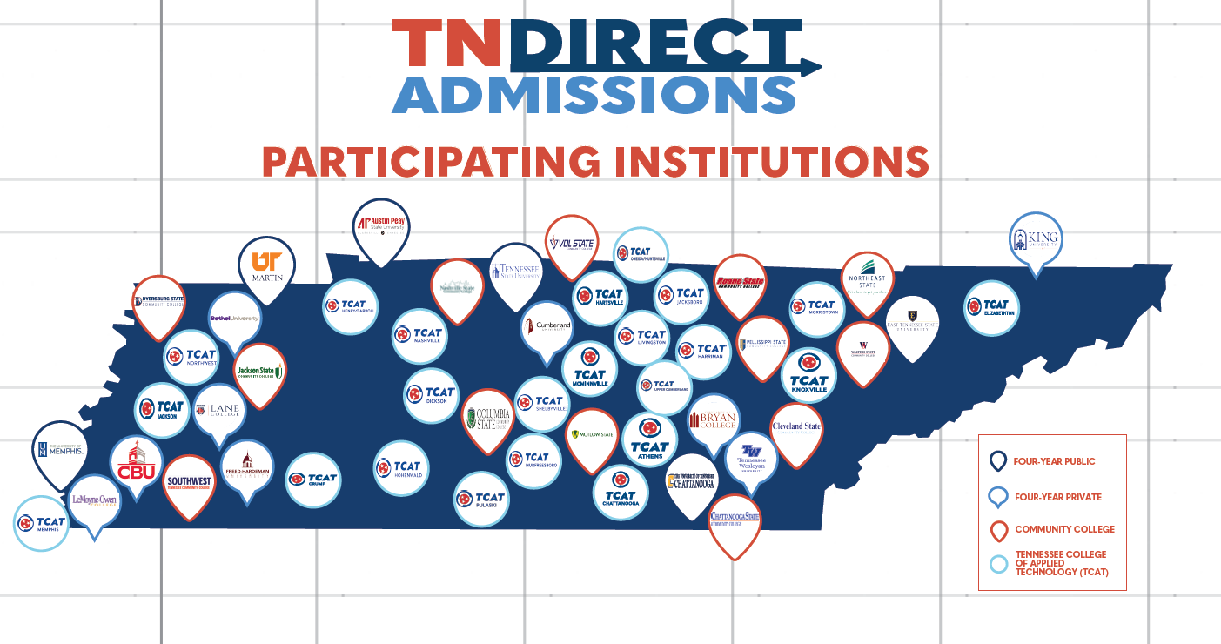

Slide 10
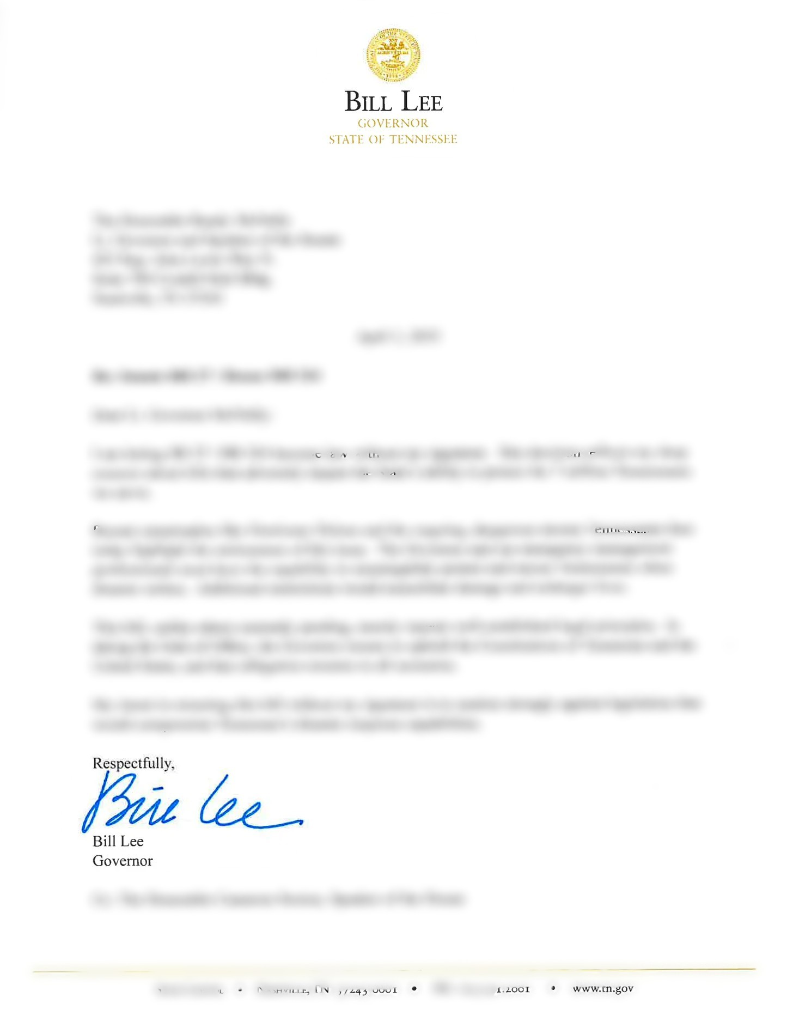

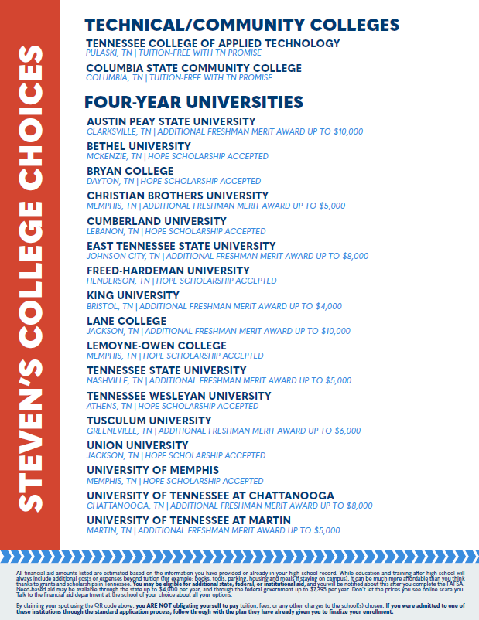

Slide 11
Treatment Groups
To assess the impact of this pilot, every public high school in the state will be assigned to one of five study groups:
• Group 1: No direct admissions letters. (Control)
• Group 2: Seniors get letters listing the institutions where they are already admitted.
• Group 3: Seniors get letters listing the institutions where they are already admitted, along with an early indication of financial aid for which they may qualify.

Slide 12
Treatment Groups
To assess the impact of this pilot, every public high school in the state will be assigned to one of five study groups:
• Group 4: Seniors get same letters as Group 3, but students/parents will receive coordinated mass texts about the direct admissions process. (Approximately 40 high schools and 7100 students)
Group 5: Seniors get the same letters as Group 3, alongside additional college-going supports, including individualized student/parent texts and personalized outreach from a dedicated direct admissions advisor. (Approximately 38 high schools and 7100 students)

Slide 13

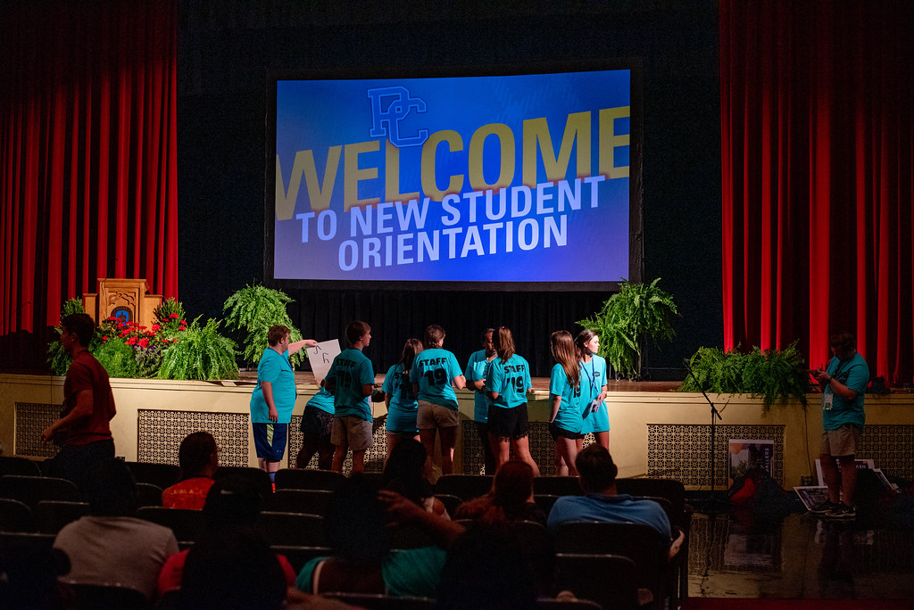
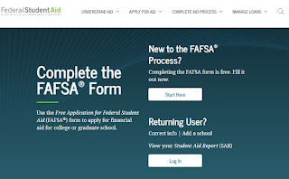
From Acceptance to Enrollment
This Photo by Unknown Author is licensed under CC BY-SA-NC
This Photo by Unknown Author is licensed under CC BY-NC

Slide 14

K-12 FAQs
Direct Admissions FAQs - collegefortn.org

Slide 15

Group 4 - Texting

Slide 16
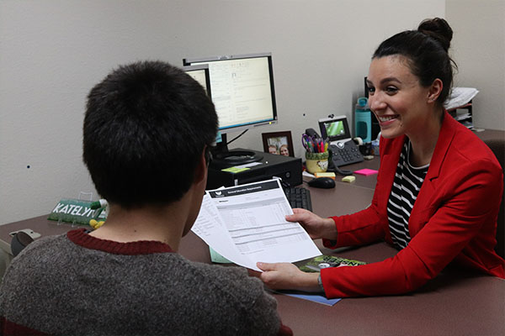
Group 5 – Direct Admissions Advising

Slide 17
Project Evaluation
https://docs.google.com/presentation/d/1AARxkYbo05bHbZvbvm01mUJivFZGUK1tLT-ltTKpnSk/edit?slide=id.g3634d1f56ab_0_716#slide=id.g3634d1f56ab_0_716

Slide 18

Questions and Feedback

