Slide 1
HOPE GPA Reporting

Slide 2
GPA Reporting Option 1
For schools/districts currently using the Tennessee Electronic Transcript Exchange, you will upload final senior transcripts as you normally would.
Your students’ uniform grading policy GPAs should be loaded into FAST within 24 – 48 hours of your upload.

Slide 3

Schools/districts using the transcript exchange do not have to manually enter all GPAs via FAST, too.
Check with your school/district contact to learn when uploads are planned. Large districts may upload into the summer.

Slide 4
What if your transcripts don’t list
Social Security numbers?
FAST will look for a perfect match on the following data points:
  First Name
  Last Name
  Date of Birth
  High School Code

Slide 5
Are all matches perfect?
No. Please wait 24-48 hours after uploading final transcripts through the Transcript Exchange, then log in to FAST to make sure all your student GPAs have successfully uploaded.
There may be a small number that will need to be verified manually.

Slide 6
It may not be too late for 2025!
Not currently a member of the Exchange? Email Sara Byrd for more information about getting started with the TN Electronic Transcript Exchange
  Sara.Byrd@tn.gov
For additional resources and tutorials
  https://theclearinghouse.help/tc-tn

Slide 7
GPA Reporting Option 2
Enter final GPAs via FAST (fast.tn.gov)
  Please report final GPAs for 0 – 20 ACT & 29 – 36 ACT
  Locked out?
    Wait a few minutes and a THEC/TSAC colleague should email you a temporary password; or
    Call the call center at 800-342-1663 (8:00am – 4:30pm central time)
  College Board no longer sends test records due to PII concerns.

Slide 8
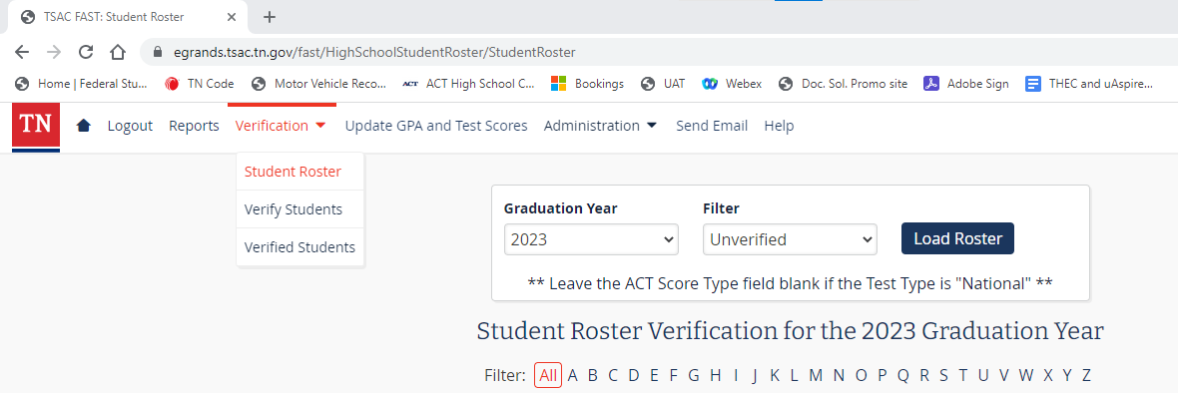

Student Roster
1
2
2025
3

Slide 9
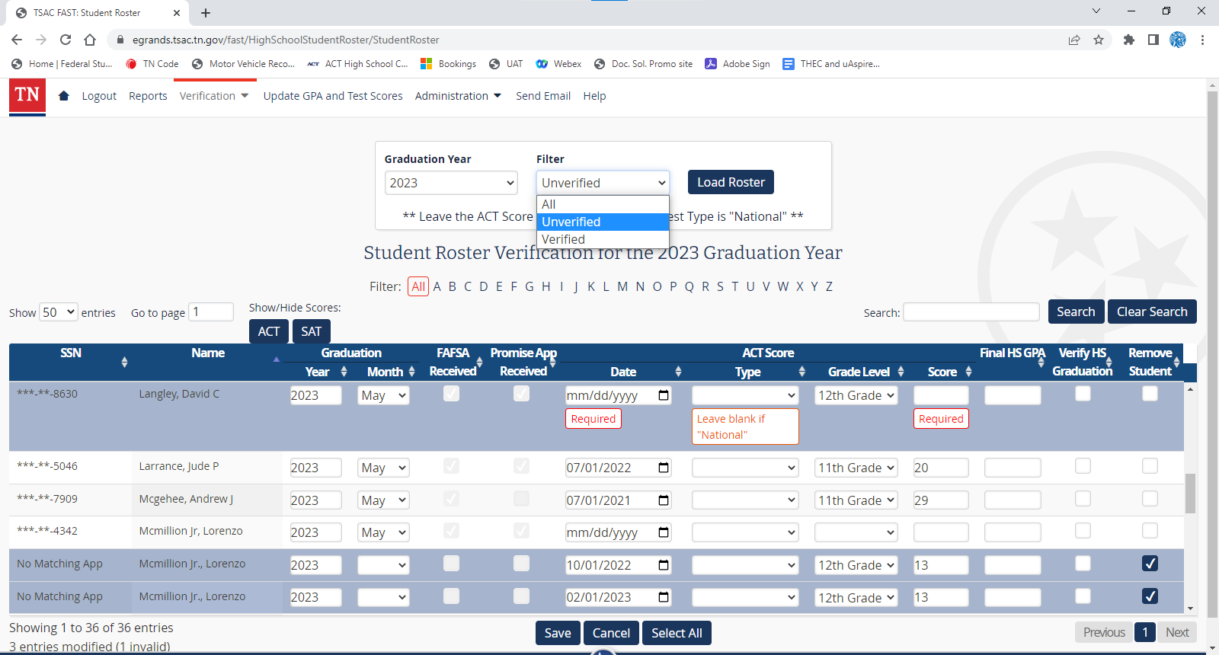

FAST GPA Reporting
2025
1
Marrero, Sara
2025
3.92
Seay, Jason
Telli, Suzette
2025
2.83
2025
4.00
2

Slide 10
FAST ACT/SAT Updating
2025
1
2
Marrero, Sara
2025
03/01/2022
23
Seay, Jason
Telli, Suzette
2025
2025
3

Slide 11
FAST Remove Records
2025
1
Seay, Jason
2025
03/01/2022
23
3.92
Seay, Jason
Seay, Jason
2025
2025

Slide 12
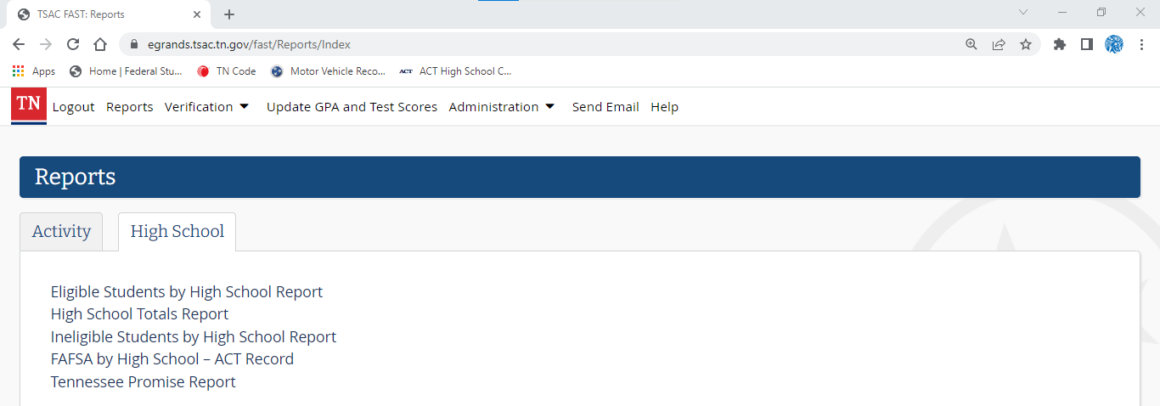
Totals Report
1
2
3

Slide 13
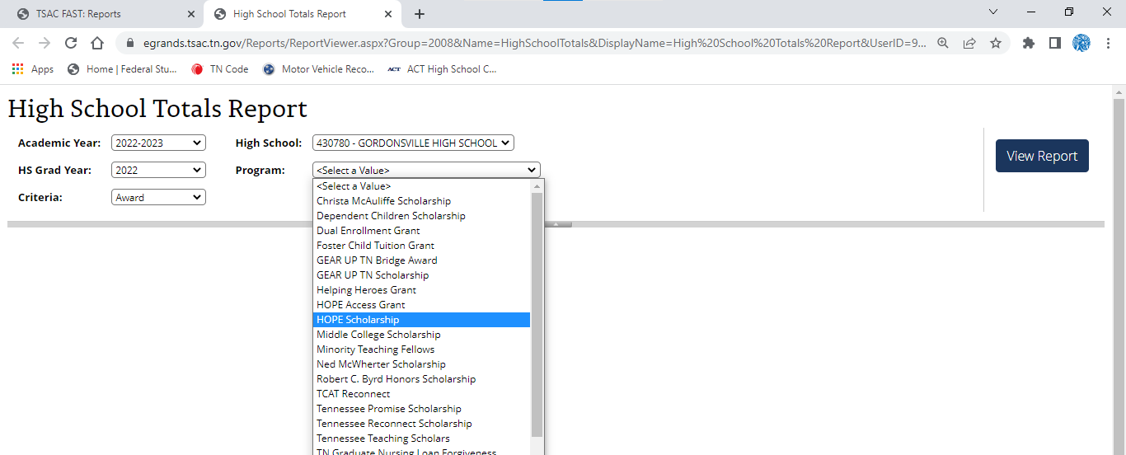
Totals Report
1
2
2025-2026
3
4
2025

Slide 14
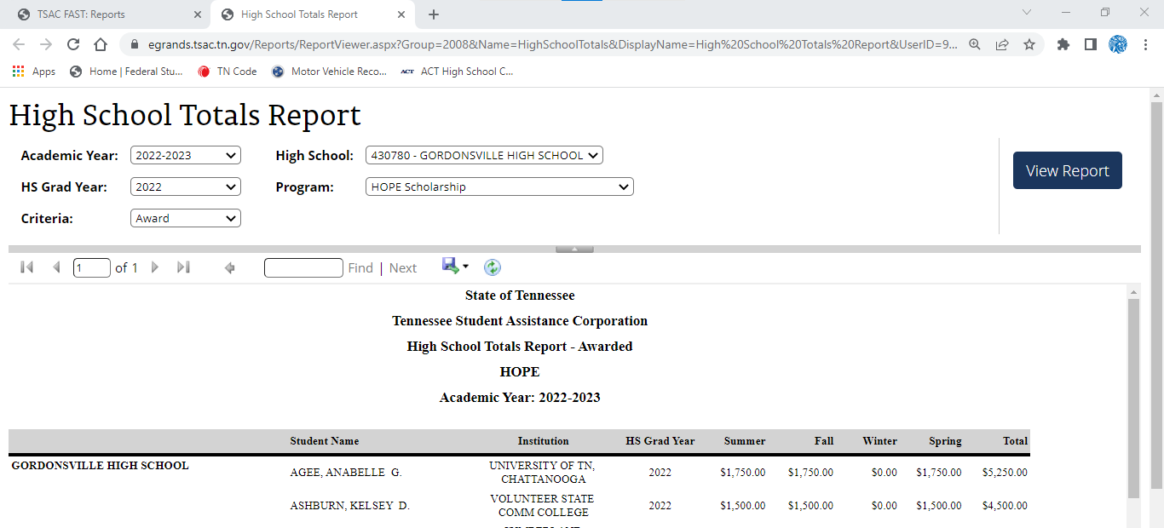
Totals Report
2025-2026
2025
1
Academic Year: 2024-2025
Suzette Telli
Jason Seay
2025
2025

Slide 15


sara.byrd@tn.gov
615-741-3055
jason.seay@tn.gov
615-319-1740
tnpromise
collegefortn.org

