Slide 1
Dual Enrollment Trends
Victoria Harpool
Victoria.harpool@tn.gov

Slide 2
Why Dual Enrollment
Students that participate in dual enrollment are more likely to complete high school AND enroll in postsecondary.

Slide 3
Dual Enrollment Grant (DEG)
9th
TCAT
10th
TCAT
11th
TCAT, 2yr, or 4yr
12th
TCAT, 2yr, or 4yr
It is Dual Enrollment Grant (DEG) data that informs the trend analysis presented.
2022

Slide 4
DEG Participation

Slide 5
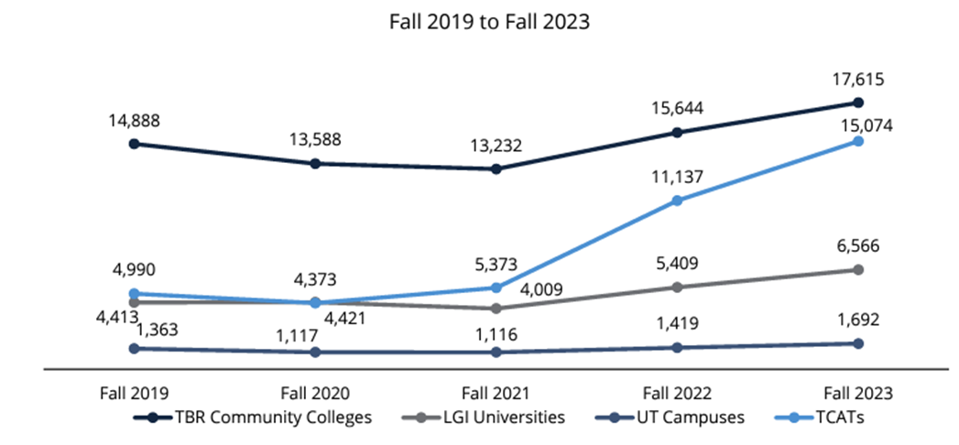
DEG in Public Sector

