Slide 1
Dual Enrollment Grant
&
Middle College Scholarship

Slide 2
Dual Enrollment Grant
Fall 2024, Spring 2025, Summer 2025 application deadline is June 30, 2025
Effective July 1, 2025 (2025-26 academic year)
  Separate DEG GPAs for students enrolled at 2/4-yr colleges & TCATs
  Students who do not achieve a 2.0 DEGPA at 2/4-yr college may remain DEG eligible at TCATs and vice versa

Slide 3
Dual Enrollment Grant
9th
TCAT
10th
TCAT
11th
TCAT, 2yr, or 4yr
12th
TCAT, 2yr, or 4yr

Slide 4
Dual Enrollment Grant (DEG)
Pays the average tuition plus a 5% access fee for community colleges for first five courses (public colleges) and 1296 TCAT clock hours
  Translation, it is now possible for a student to earn a TCAT credential and have a semester of college credit paid for while in high school.
  Private colleges may now charge DE tuition and fees above the Dual Enrollment Grant (DEG).
Students may still receive DEG courses 6 – 10 ($100/credit hour)
  Money awarded will not be reduced from initial HOPE Scholarship.

Slide 5
Dual Enrollment Grant (DEG)
Award amounts for Courses 1 – 5 at 2-Year & 4-Year Schools
Credit Hours Per Course | Credit Hours Rate | Total | Dual Enrollment Access Fee | GRAND TOTALS
1 | $176 | $176 | $8.80 | Up to $194.25
2 | $176 | $352 | $17.60 | Up to $388.50
3 | $176 | $528 | $26.40 | Up to $582.75
4 | $176 | $704 | $35.20 | Up to $777.00
5 | $176 | $880 | $44.00 | Up to $971.25
6 | $176 | $1,056 | $52.80 | Up to $1,165.50

Slide 6
Dual Enrollment Grant (DEG)
Award amounts at TCATs
Clock Hours | Maintenance Fees | Dual Enrollment Access Fee | GRAND TOTALS
1-40 | $201 | $10.05 | Up to $221.55
41-80 | $271 | $13.55 | Up to $299.25
81-135 | $410 | $20.50 | Up to $452.55
136-217 | $714 | $35.70 | Up to $788.55
218-340 | $1,153 | $57.65 | Up to $1,273.65
341-450 | $1,290 | $64.50 | Up to $1,424.85

Slide 7
DEG Reminders
Citizenship “Status” eligibility is determined by TBR EVEA which can differ from FAFSA eligibility
Student must satisfy dual enrollment (DE) admissions criteria set by the college.
2.0 college GPA, as determined by the institution, to remain DEG eligible.

Slide 8
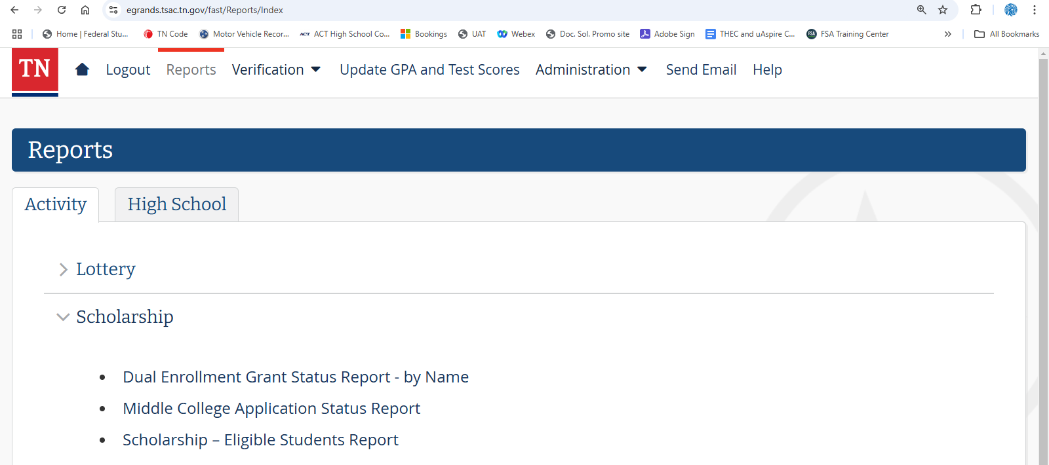
Dual Enrollment Grant Report
1
fast.tn.gov
2
3
4

Slide 9
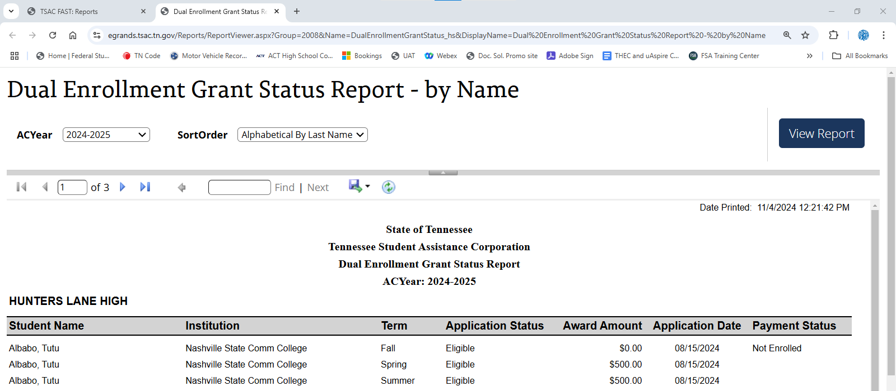
Dual Enrollment Grant Report
1
2
3
4
Stephens, Jana
Stephens, Jana
Stephens, Jana

Slide 10
Middle College Scholarship
Fall semester high school junior with 3.0 high school GPA through 10th grade
Enroll full-time each semester at an eligible college in pursuit of an Associate degree
Must maintain a minimum 3.0 college GPA
Application deadline is September 1
  tn.gov/tsacstudentportal
  $2,000/semester ($6,000 per year)

Slide 11
Middle College Scholarship
Eligible Postsecondary Institutions
Chattanooga State | Northeast State
Cleveland State | Roane State
Dyersburg State | Southwest TN
Jackson State | Volunteer State
Motlow State | Walters State
Nashville State

Slide 12
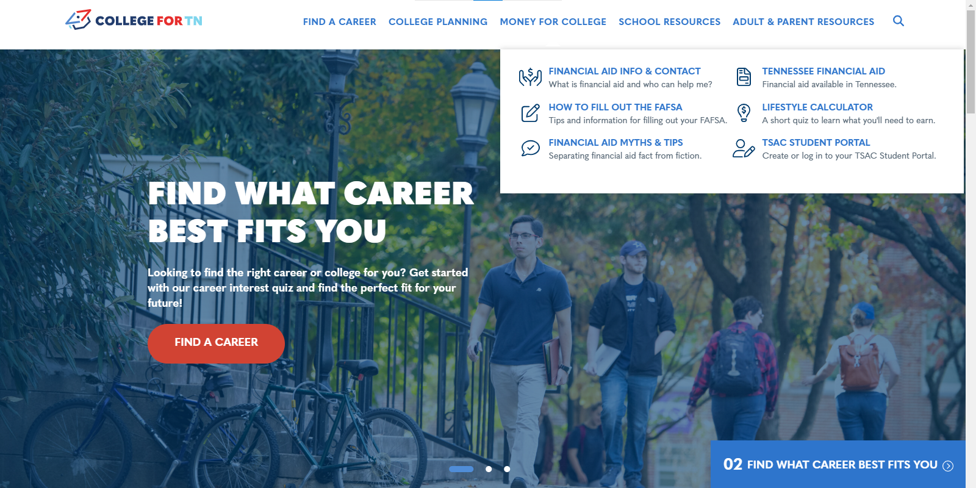
collegefortn.org/dualenrollment

Slide 13





robert.biggers@tn.gov
jana.stephens@tn.gov
tnpromise
collegefortn.org

