Slide 1


Slide 2

TN Path to College Events, CollegeForTN.org, & Other Free Resources From THEC/TSAC
August 30, 2024
Notes:
Sara

Slide 3
Agenda
Welcome/Introductions
What the heck is THEC?
Things we did this summer
TN FAFSA Frenzy
GEAR UP TN GRANT
CollegeForTN.org
TN Path to College Events & Resources
Information Sharing
Q & A
Notes:
Sara

Slide 4
WHAT THE HECK IS THEC?
Notes:
Sara

Slide 5
Tennessee Higher Education Commission (THEC)
Formed in 1967, the Tennessee Higher Education Commission is the state’s higher education coordinating board and is responsible for an array of duties under TCA 49-7-202:
Administration of the outcomes-based funding formula
Approval of all new academic degree programs
Development of the state master plan for higher education
Serving as the hub for postsecondary data analysis and research
Authorization and regulation of proprietary institutions
Serving as the state approving agency for veteran education benefits

Slide 6
Tennessee Student Assistance Corporation (TSAC)
Created by the Tennessee General Assembly in 1974 as a non-profit corporation with the merging of the Tennessee Educational Loan Corporation and the Tennessee Tuition Grant Program, the Tennessee Student Assistance Corporation (TSAC) administers over 20 different state student financial aid programs.
Administers over $500 million in state aid
Outreach and training to students, families, and staff
Consults with postsecondary financial aid offices to improve program effectiveness, compliance, and efficiency

Slide 7
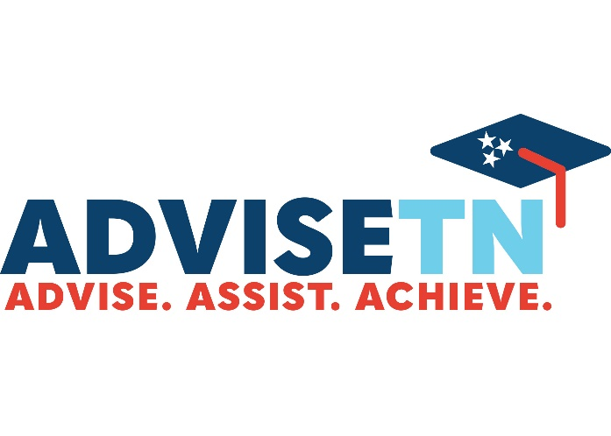




College Access and Outreach Bureau
Outreach
Team
Adult Learner
Initiatives

Slide 8
THINGS WE DID THIS SUMMER…
Notes:
Suzette

Slide 9
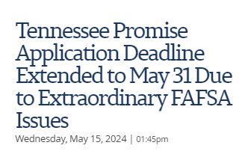
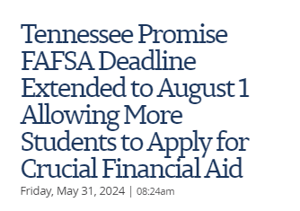
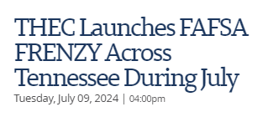
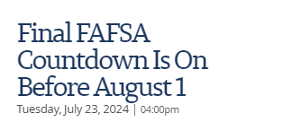

Slide 10
Hired 56 FAFSA Coaches
Supported 82 FAFSA Events
Promoted 329 Statewide FAFSA Events
Ordered FAFSA Frenzy Swag!!
“This decision to push the deadline is in part due to THEC/TSAC being notified of a $1 million award from the Educational Credit Management Corporation (ECMC) as part of the U.S. Department of Education’s FAFSA Student Support Strategy initiative. This funding will enable THEC to enhance FAFSA completion efforts and provide more targeted support to students and families across the state.”

Slide 11
FAFSA Filing Among TN Promise Applicants – April 15 Deadline
Notes:
The next few slides add in the Class of 2024.
This slide shows what Tennessee’s FAFSA filing rates would have been if we had stuck with the original April 15 FAFSA deadline for Promise.
Only 45% percent of students had a complete FAFSA.
I think about this in relation to CGR. Logic would say that the CGR won’t be higher than the FAFSA completion rate, because students need financial aid for college so 45% FAFSA completion would be very concerning.
However, on April 15, students were still unable to log back in to make corrections to a previously submitted FAFSA, and the form was rife with glitches so we knew we were not going to be able to keep this deadline.

Slide 12
FAFSA Filing Among TN Promise Applicants – First Deadline Extension to May 15
Notes:
Next, the deadline was extended until May 15. this is the deadline we thought would be final. It was chosen because after May 15, high school seniors would no longer be in the school buidling where they receive the majority of their FAFSA assistance.
Here we can see that FAFSA completion would have been 62%, which is still a lot lower than in past years.
THEC unexpected received a $1million grant from a foundation called ECMC to support efforts to increase FAFSA filing. ECMC began awarding states these grants in response to the challenges with the FAFSA this year, and the declines in FAFSA completion that were being seen on a national level.

Slide 13
FAFSA Filing Among TN Promise Applicants – Final August 1 Deadline
Notes:
And so, the deadline was extended until August 1 and this is where we landed. 78% of TN Promise applicants submitted a FAFSA and 74% had a complete FAFSA.
While FAFSA submissions at the deadline declined, the FAFSA completion rate did not change much.
THEC did introduce a streamlined “exception request” this year, so if a student missed the deadline, honestly they only need to fill out form and we will allow them to remain eligible for Promise.. We are trying to do everything we can to make sure students are not left behind because of the FAFSA

Slide 14


Slide 15










Slide 16
COLLEGEFORTN.ORG
Notes:
Sara

Slide 17
TN Path to college EVENTS
CLICK HERE TO REGISTER

Slide 18
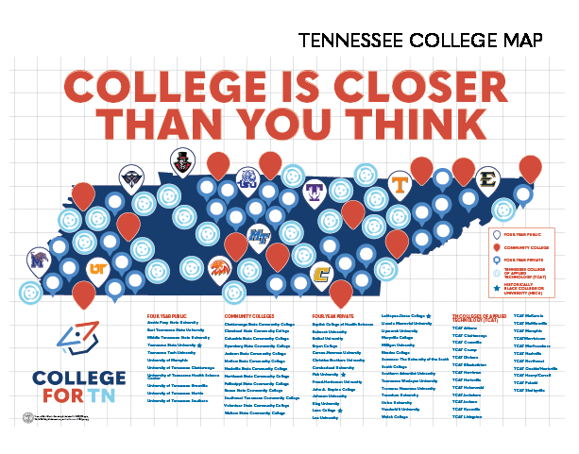

RESOURCE MAILING
Notes:
Suzette

Slide 19


Slide 20
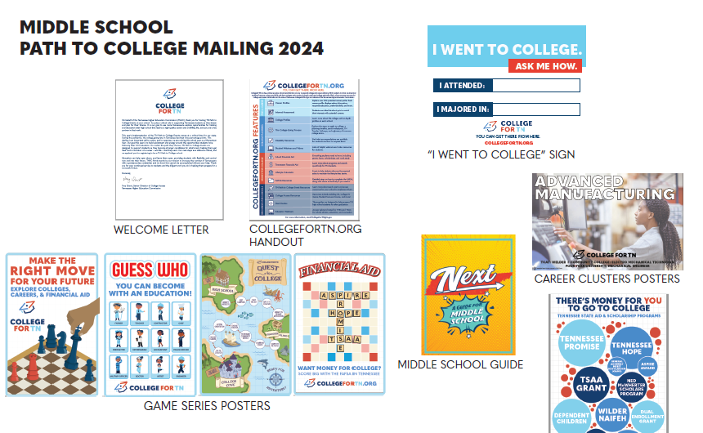

Slide 21
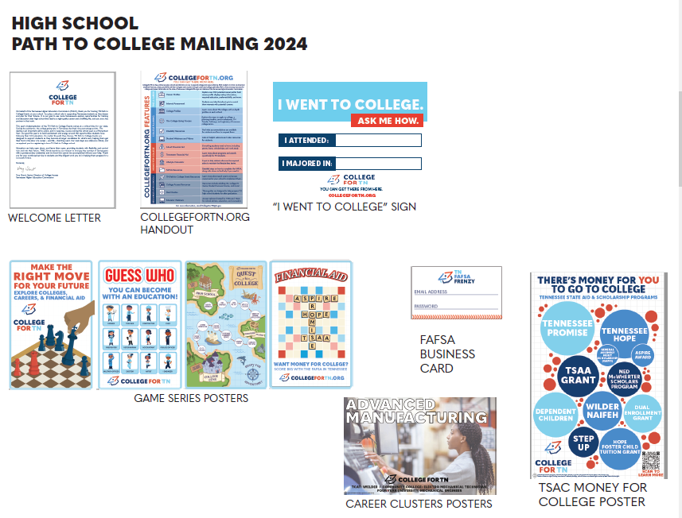

Slide 22
INFORMATION SHARING
Notes:
Sara

Slide 23
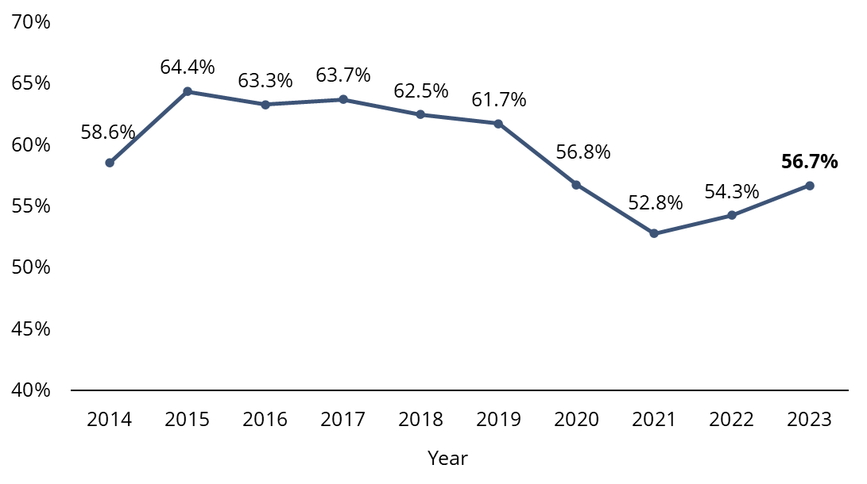
Tennessee’s College-Going Rate (CGR)
Notes:
LPE
Here you’ll see the news that brought us all together today – college-going rate for Tennessee’s public high school students increased by 2.4 percentage points to 56.7% for the class of 2023! This longitudinal view shows two major changes in Tennessee’s higher education history – the implementation of Tennessee Promise statewide for the class of 2015, and the shocks of the COVID-19 pandemic’s impacts on the classes of 2020 and 2021. Since those sharp declines, we have seen two consecutive years of growth. This year’s statewide increase in college-going rate is the largest since the implementation of Tennessee Promise.

Slide 24
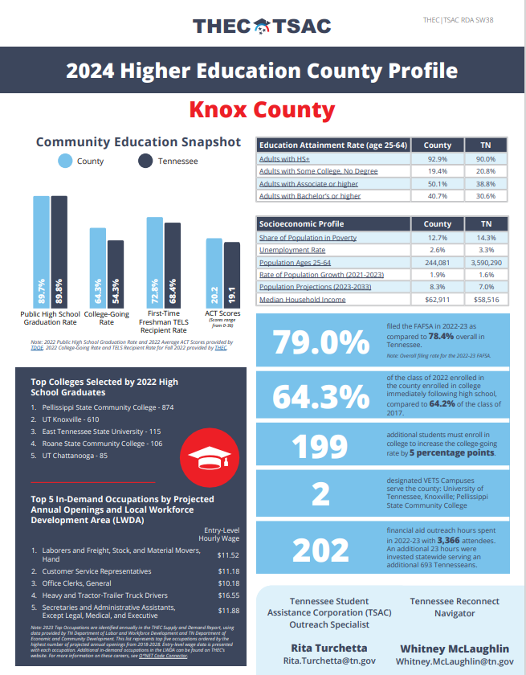
County Profiles
County Profiles (tn.gov)
Notes:
Change to general county profile webpage

Slide 25
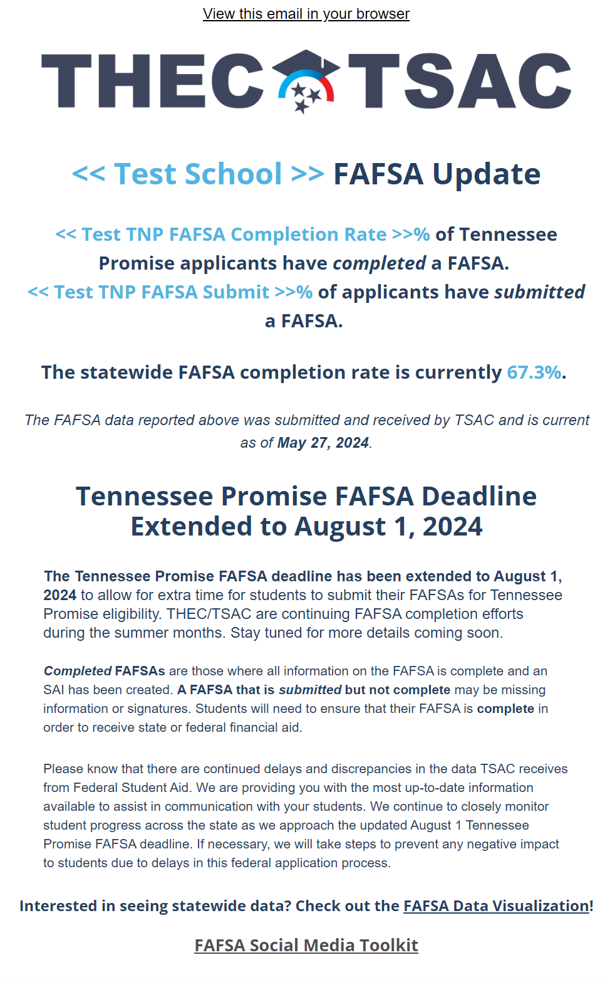
TN FAFSA Frenzy Weekly Updates
Notes:
Change to general county profile webpage

Slide 26
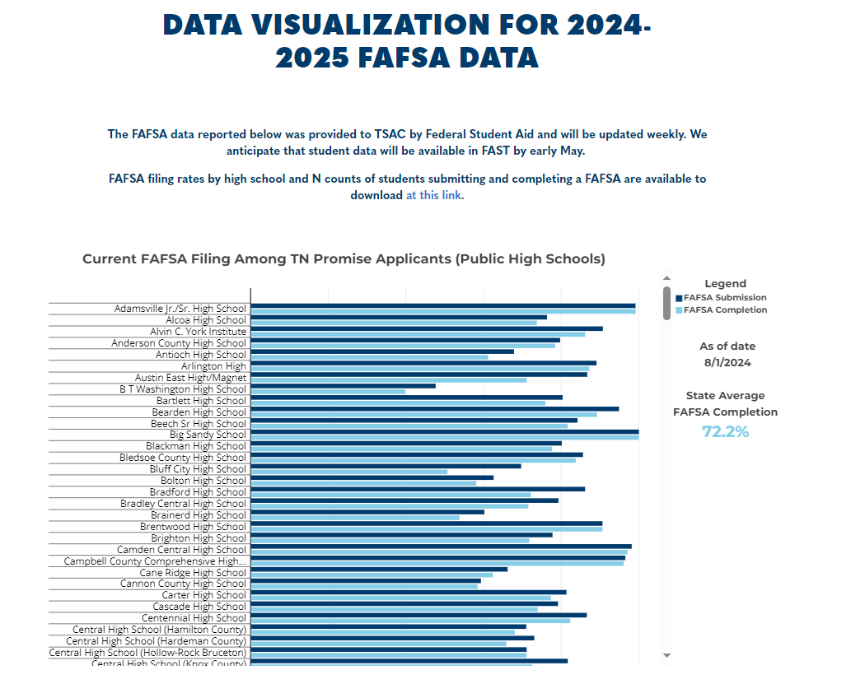
TN FAFSA Frenzy Data Visualizations
Notes:
Change to general county profile webpage

Slide 27

Coming soon to a campus near you!
Notes:
Change to general county profile webpage

Slide 28
Q & A
Suzette Telli Sara Marrero
Statewide Services Coordinator Coordinator of College
GUTN, THEC Access Communications
suzette.telli@tn.gov sara.marrero@tn.gov

