Slide 1
Student Instructions
Notes:
This presentation is designed to use with students to introduce them to the game and provide them with instructions for playing. Feel free to adapt this presentation to best fit the needs of your school and your students.

Slide 2
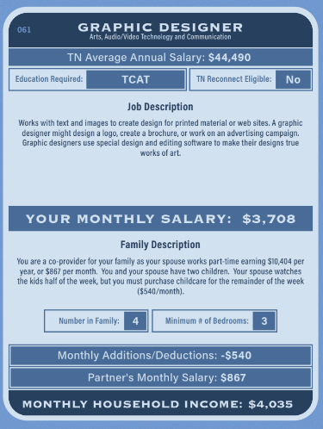
“Who Am I?” Cards
Before you can begin the game, you must receive your “Who Am I?” Card.
You may not trade or exchange your card– careers are assigned randomly.
Review all the information on your card carefully before starting the game
The careers and salaries listed on these cards are based on actual jobs in TN.
After the game, you can visit www.collegefortn.org to review more careers and salaries in the state
Use this number to start the game
Notes:
Review all items on the “Who Am I?” Card with students.
Note- salaries and prices in the game are based on a mid-sized, growing city in TN. The prices are based on real life– but may be higher or lower in your community based on where you live.
For simplicity, taxes are not factored in to salaries.

Slide 3
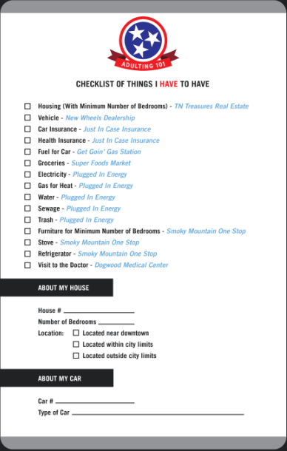
Checklist
The checklist lists all of the purchases you must make during the game along with which stations you need to visit to make those purchases.
Note- you must write down the house ID number, number of bedrooms, and location of the house you purchase.
You must also write down the vehicle ID number for the car you purchase.

Slide 4
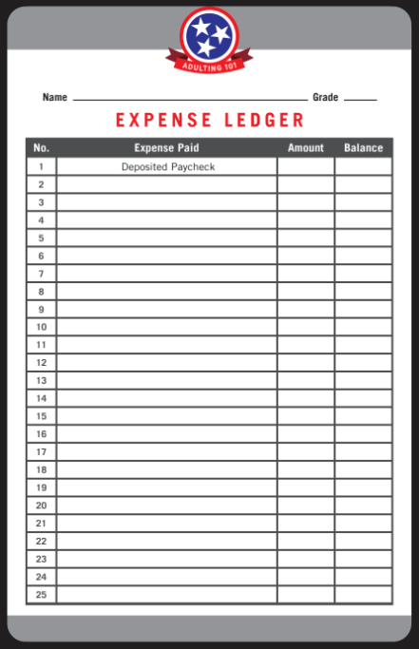
The Expense Ledger
You will use your expense ledger to keep track of the purchases that you make throughout a pretend month of your assigned life in the game.
List the amount of your monthly household paycheck on the first line in the balance column. This is the amount you are starting with in the game that you must use to budget for your expenses.
After each purchase, make sure to write down the expense and also deduct it to have a new balance on each line.

Slide 5
$4,035
Monthly House Payment
-$1,000
$3,035
Monthly Car Payment
-$250
$2,785
Groceries
-$275
$2,510

Slide 6
TN Treasures Real Estate
Visit TN Treasures Real Estate to find a place to live! They have homes and condos to purchase as well as apartments available to rent.
In the game, you will only be responsible for paying the monthly mortgage or rent payment on your expense ledger, not the full price of the house! Make sure to add that to your expense ledger.
You will have to purchase a home with enough bedrooms for your family. * Keep location, commute, and associated gas cost in mind when make your selection!
Make sure to note your house number, number of bedrooms, and location on your checklist!
Notes:
Students will need to make note of the house number, number of bedrooms, and location of their house on their checklist. They will need this information later in the game when they are calculating their gas expenses and purchasing their furniture!

Slide 7
New Wheels Dealership
To purchase your car, you will need to visit New Wheels Dealership.
Here, you will choose from a variety of car options to fit your style (or your budget).
Make sure to write down the Car Number and Type of Car on your Checklist!
When making a selection, remember you will be responsible for deducting the monthly car payment from your expense ledger.
Notes:
Students must write down their car ID number and type of car on their checklist. They will need this information later in the game when they are making calculating the cost of their gas.

Slide 8
Plugged In Energy
At this station, you will select utility services for your home. Prices, based on actual TN prices, are provided for you at the station.
You must purchase all essential services:
Electricity
Gas
Water
Sewage
Trash pickup
You also able to select other optional “non-essential” services such as cable and internet.
Make sure to write down your monthly expenses on your expense ledger! If you select non-essential services, make sure to write a line for each selection!
Notes:
Students will need to write a line for each of the non-essential services they select. If they bust their budgets, they will need to see which non-essential services they selected so they can make decisions about which ones they “need” vs which ones they “want”

Slide 9
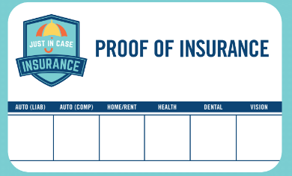
Just in Case Insurance
At this station, you will select your insurance plans.
You must select auto, but you can choose between liability and complete coverage.
You must also select health insurance. If you have a family, you must pick the family plan.
Dental, vision, and home insurance are optional.
After making your selections, you will receive an insurance card and will need to list the expenses on your ledger.

Slide 10
Get Goin’ Gas Station
At this station, you will purchase fuel for your car.
To do so, you’ll need your vehicle ID and the location of your home.
Add the monthly expense to your expense ledger.
*Before visiting this station, you must purchase a car.

Slide 11
Super Foods Market
At this station, you add the cost of groceries and other household items to your budget.
You’ll make your selections based on the number of people in your family.

Slide 12
Smoky Mountain One Stop
Here, you will purchase appliances, furniture and optional electronics
You must purchase a stove, refrigerator, and enough furniture for the number of bedrooms in your home. You can choose to purchase new furniture, which requires monthly payments or consignment furniture.
You can also choose to purchase electronics. These items must be paid in full.
*Before visiting this station, you must purchase a home.
Notes:
Students should make sure to write down their purchases line-by-line. If they bust their budget, they will need to be able to see exactly what they have purchased to make decisions about how to rectify their budget.

Slide 13
Dogwood Medical Center
At this station, you will visit the doctor.
Here you will receive a diagnosis card. Some of you will receive a “clean bill of health.” Others will receive a diagnosis and associated expense. Your insurance selections will determine the amount you owe.
*Before visiting this station, you must purchase a insurance.

Slide 14
The Green Reaper
The Green Reaper represents the unforeseen expenses in life– the flat tire, the parking ticket, etc.
During the game the Green Reaper will circulate and distribute cards at random.
If you receive a Green Reaper card, you must add the associated expense to your budget.

Slide 15
Financial Coaching
What happens if you run out of money? Visit the Financial Coaching station
At this station, you will answer a few questions about your budget and then meet with a financial coach to reconsider your financial decisions, make a plan to balance your budget, and rejoin the game.

Slide 16
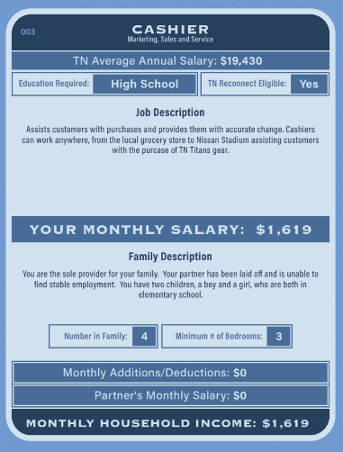
TN Reconnect
If you receive a “Who Am I?” card with a TN Reconnect logo, this means the career you have been assigned does not require a postsecondary degree or certificate.
If you receive this card, you have the option of visiting the TN Reconnect booth to discuss options for returning to college to advance your career.
If you choose to return to college, you can select a new “Who Am I?” card with a new career.

