Slide 1
2024-25 FAFSA Preview

Slide 2
2024-25 FAFSA
Available by December 31, 2023 at studentaid.gov
2022 income/tax information
Student Aid Index (SAI) replaces EFC
Priority deadline April 15, 2024
2025-26 FAFSA should open October 1, 2024

Slide 3
Role-based FAFSA
Student will complete/submit a student section
Parent(s) will complete/submit a parent section(s)
No order of operation
Student/parent(s) will identify one another by name/SSN to connect sections
45-day expiration

Slide 4
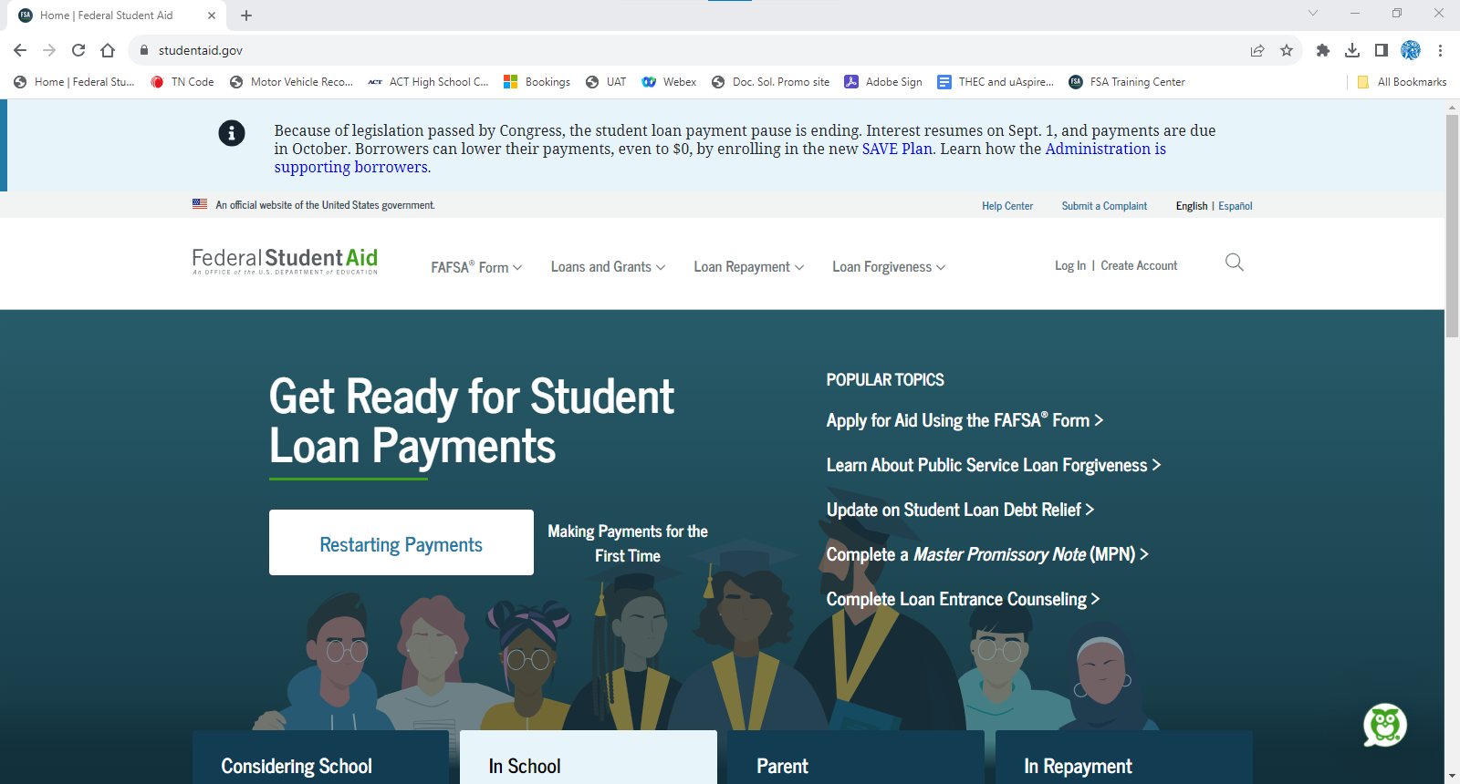
Create FSA ID at least 3 days prior to completing the FAFSA.
studentaid.gov
Notes:
To create a FSA ID, go to studentaid.gov, and click create account. [click]

Slide 5
FSA ID = Username/Password
Parent 1
Parent 2*
FSA IDs needed for a dependent student completing the 2024-25 FAFSA…
Student
✓
✓
✓
*Required if married to parent 1 and filed 2022 taxes separately.
Notes:
The 24-25 FAFSA will require all users to login with their username/password which is known as the FSA ID. A dependent student completing the FAFSA will need an FSA ID as well as one parent. In some scenarios, the second parent will also need an FSA ID.

Slide 6
FSA ID = Username/Password
Student’s Spouse*
FSA IDs needed for an independent student completing the 2024-25 FAFSA…
Student
✓
*Required if married to student and filed 2022 taxes separately.
Notes:
An independent student completing the FAFSA will need an FSA ID. In some scenarios, the student’s spouse will also need an FSA ID.

Slide 7
Parents w/o SSNs
FSA ID site update to coincide with opening of 2024-25 FAFSA
Knowledge-based questions posed after two-step verification
Which of the following is the street name of your most recent previous address?
Which of these phone numbers have you ever used?
Which of the following is a current or previous employee?

Slide 8
Parents w/o SSNs
Two pathways upon answering knowledge-based questions…
Account created; your identity has been verified
FSA ID can be used immediately
Account created but you need to contact us
User must call FAFSA at 800-433-3243 to confirm their identity
If identity is unconfirmed, paper FAFSA

Slide 9
Proofing Documents
Driver’s License
State or City ID Card
Foreign Passport
Utility Bill + ONE of the following
Municipal ID Card
Community ID
Consular ID Card

Slide 10
2024-25 FAFSA Preview Student Application

Slide 11
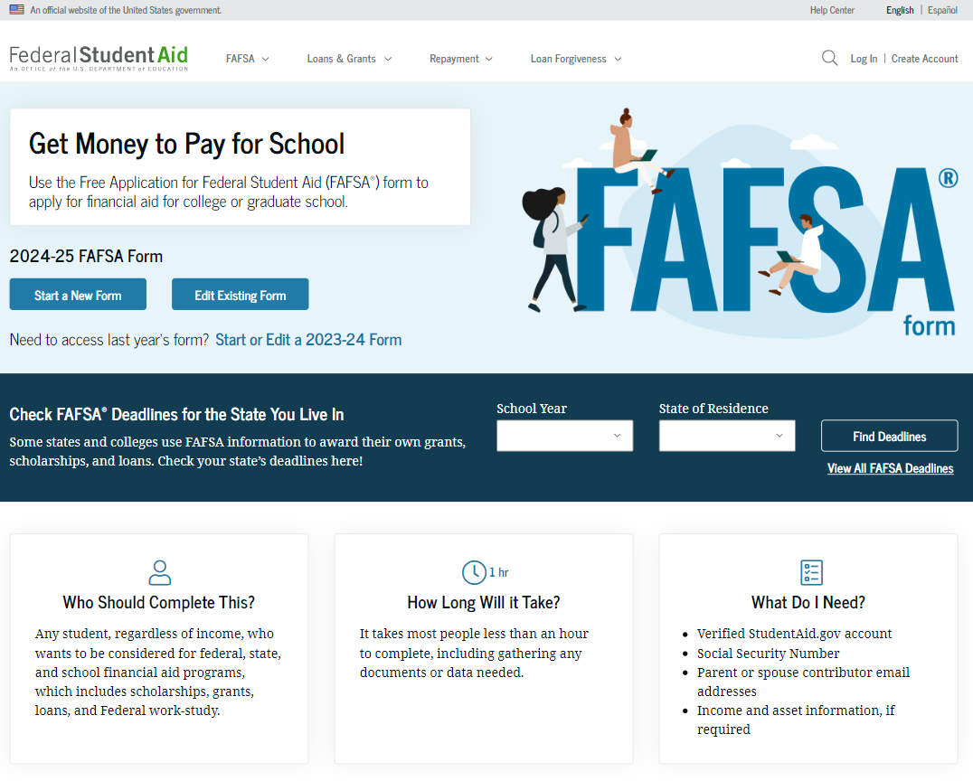
Need to start/edit 2023-24 FAFSA, click here.
Notes:
When updates are implemented, fafsa.gov will be dedicated to the 24-25 FAFSA. Students will click start a new form to begin. Note, if a student still needs to submit or correct their 23-24 FAFSA, they can click start or edit a 23-24 form. [click]

Slide 12
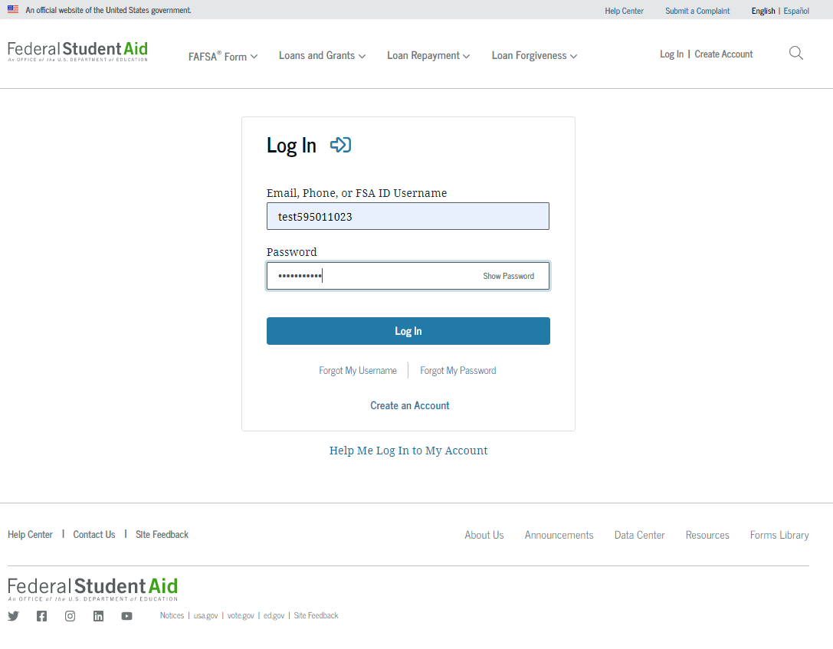
Notes:
The 24-25 FAFSA will now require the student or parent to login with their FSA ID username and password to begin. [click]

Slide 13
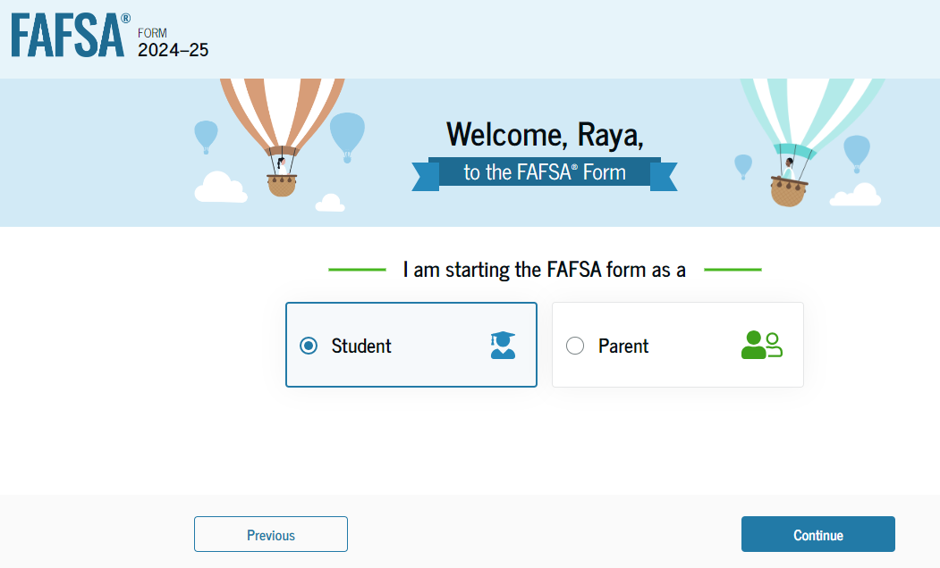
Notes:
The user will select their role to continue. Hereafter, we will explore the 24-25 FAFSA as the student. [click]

Slide 14
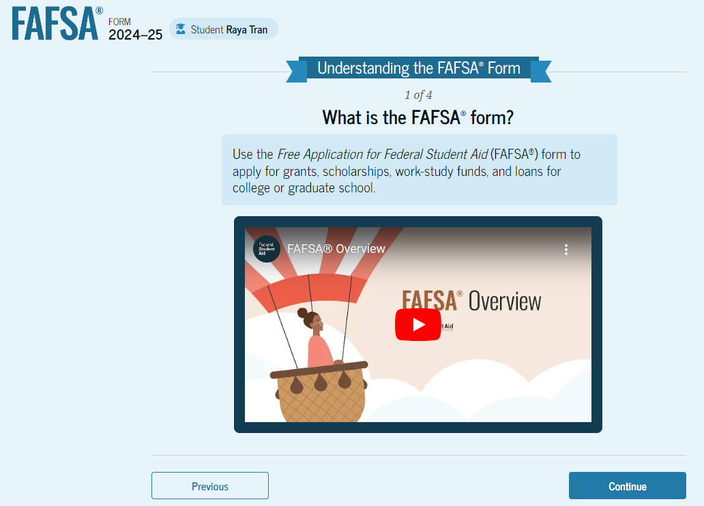
Notes:
When logging into the 24-25 FAFSA for the first time, you will review four introductory screens. First is the overview of the FAFSA.

Slide 15
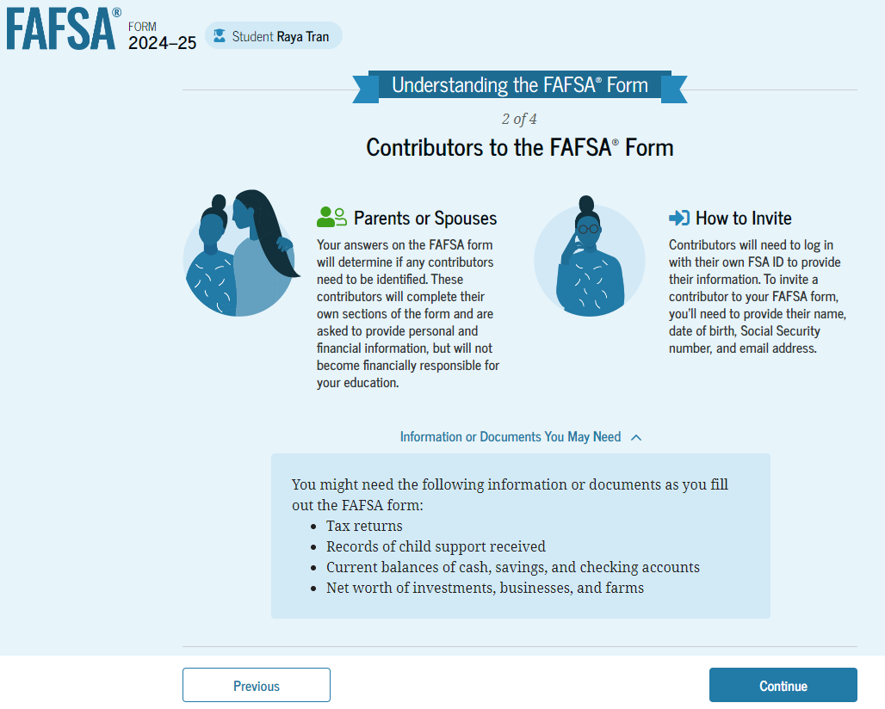
Notes:
Screen 2 outlines the contributor definition and how to invite them. Contributor means parents for dependent students or spouses for married independent students.

Slide 16
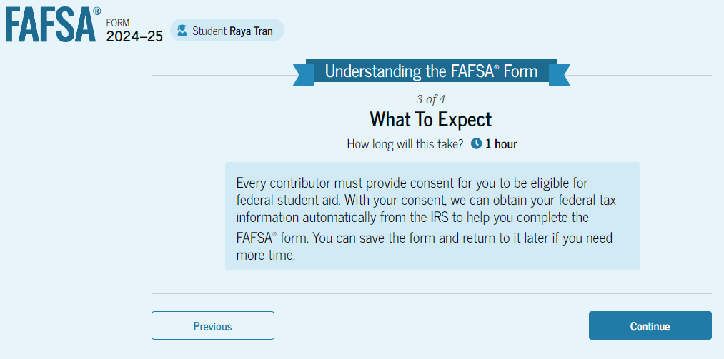
Notes:
Screen 3 of 4 will let the student know what to expect.

Slide 17
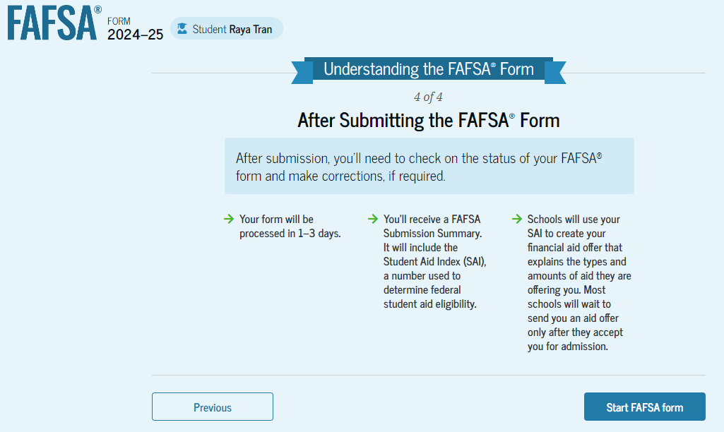
Notes:
Finally, FAFSA will explain what happens after the FAFSA is submitted.

Slide 18
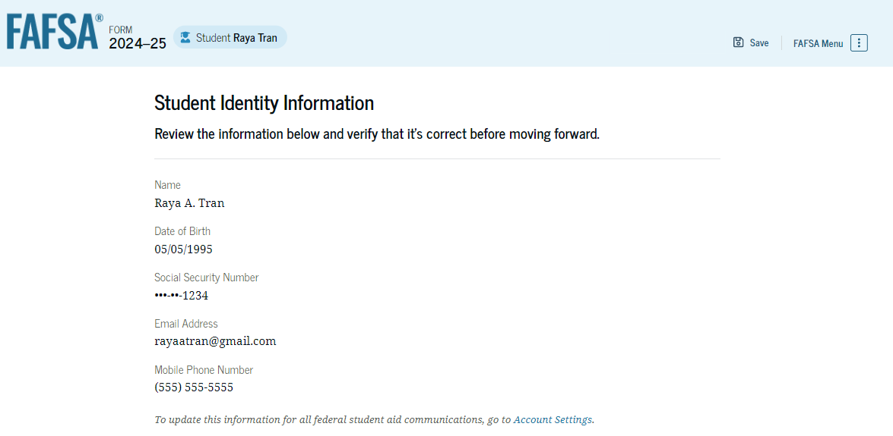
Notes:
The student will review their information which will autopopulate from their FSA ID.

Slide 19
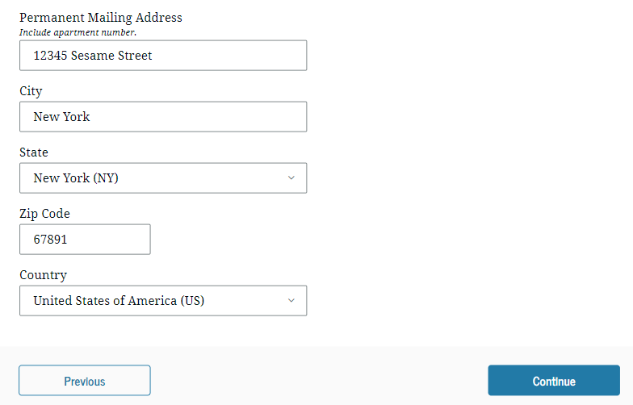
Notes:
This includes their mailing address. Review and click continue. [click]

Slide 20
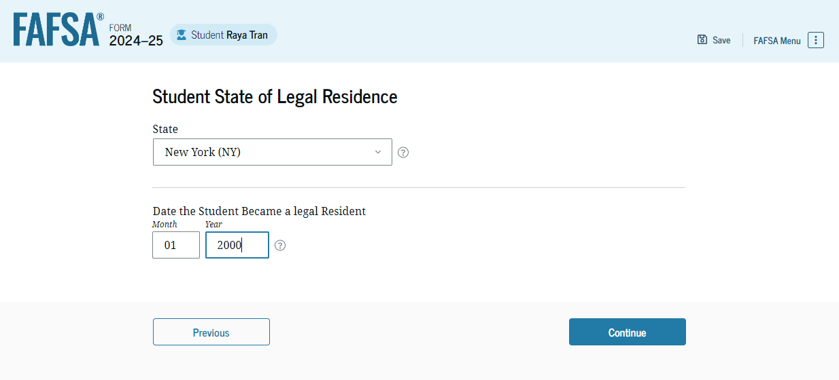
Notes:
Select the state where you live and enter the month and year you began living in the state. [click]

Slide 21
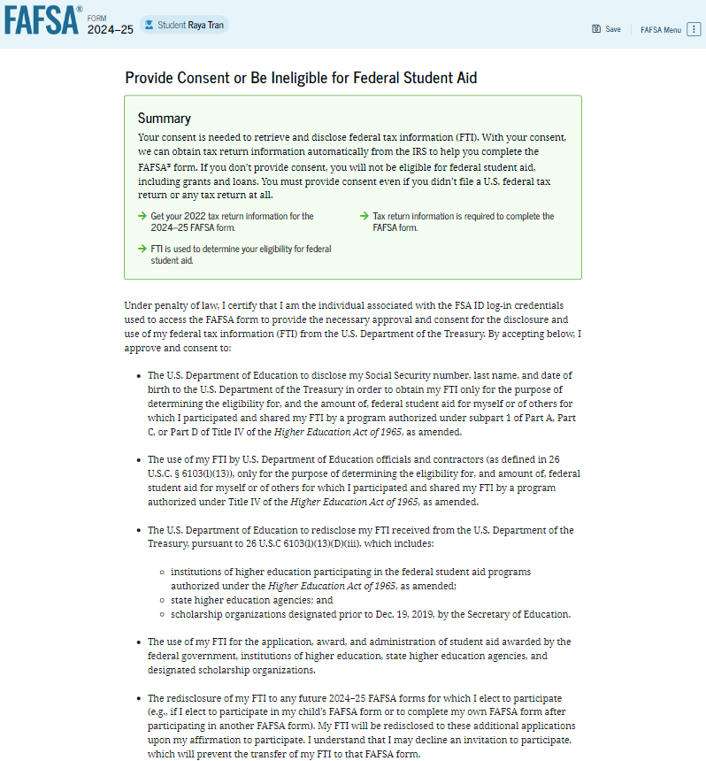
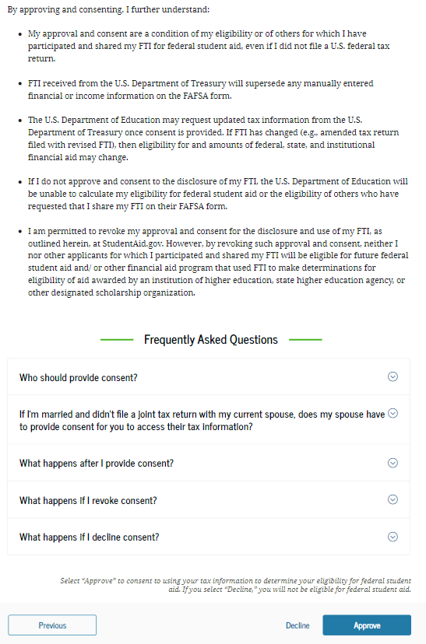
Notes:
This is a new screen. The student will have to agree to provide their consent to allow FAFSA to connect with the IRS. If consent is not provided, then the student will not qualify for federal or state aid.

Slide 22
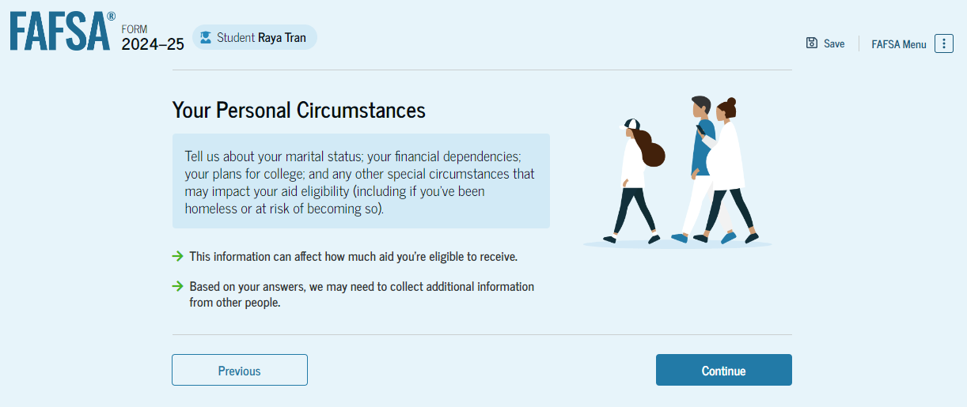
Notes:
Onto the student’s personal circumstances section of the FAFSA.

Slide 23
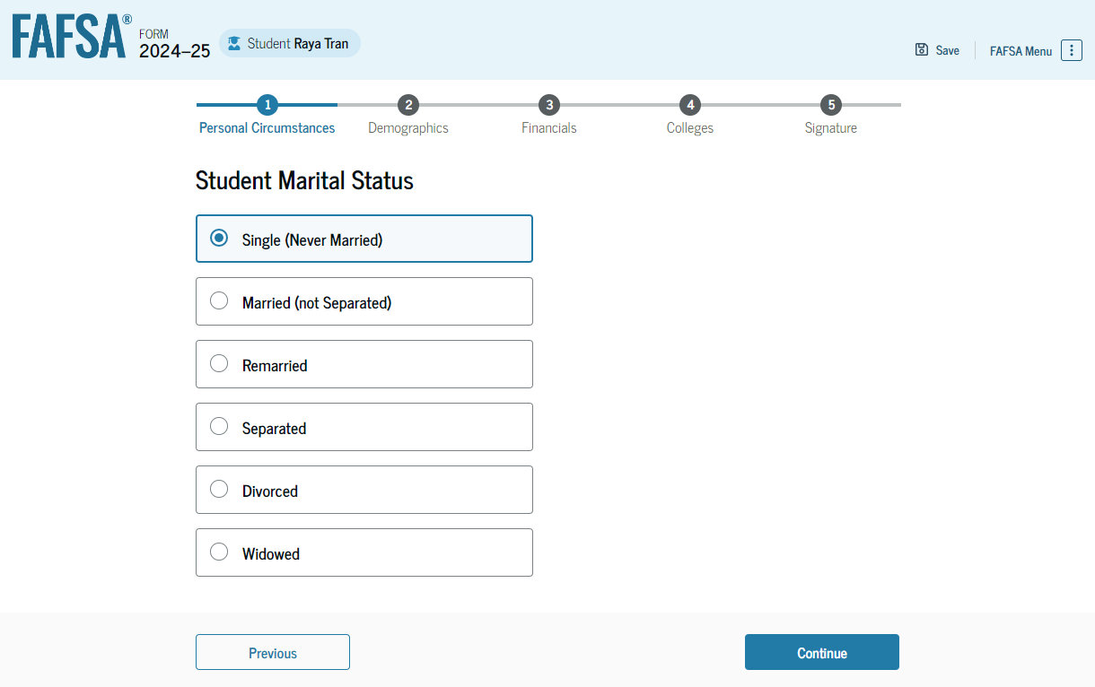
Notes:
Student, what is your marital status? [click]

Slide 24
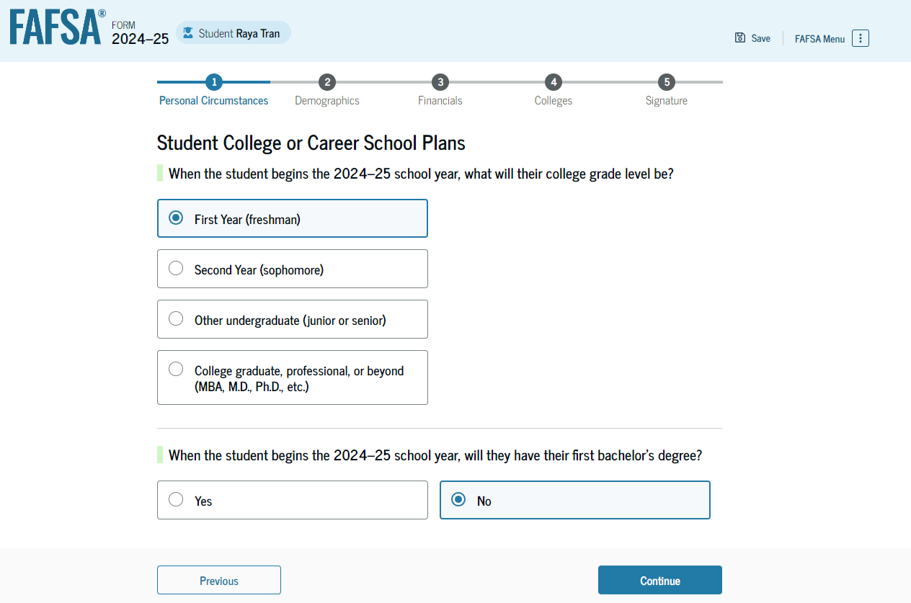
Notes:
When you begin the 24-25 school year, what will your college grade level be; next will you have your first bachelor’s degree?

Slide 25
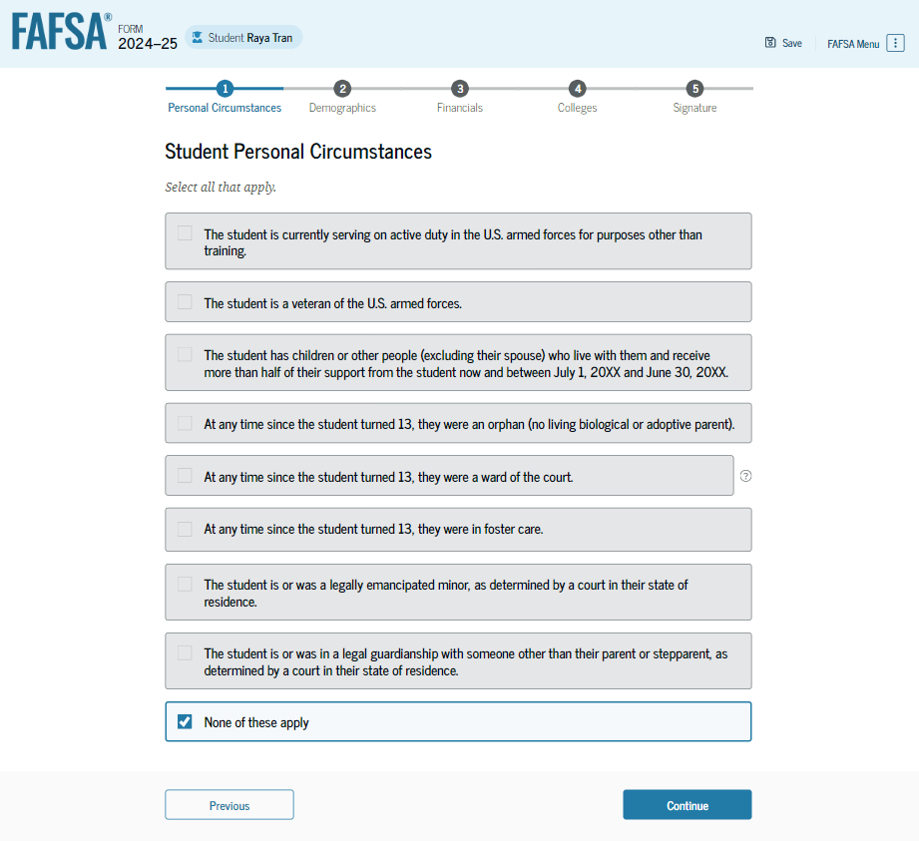
Parents without SSNs
Is the student dependent or independent?
Notes:
Review the following circumstances and select any that apply. If none, select none of these apply and click continue. [click]

Slide 26
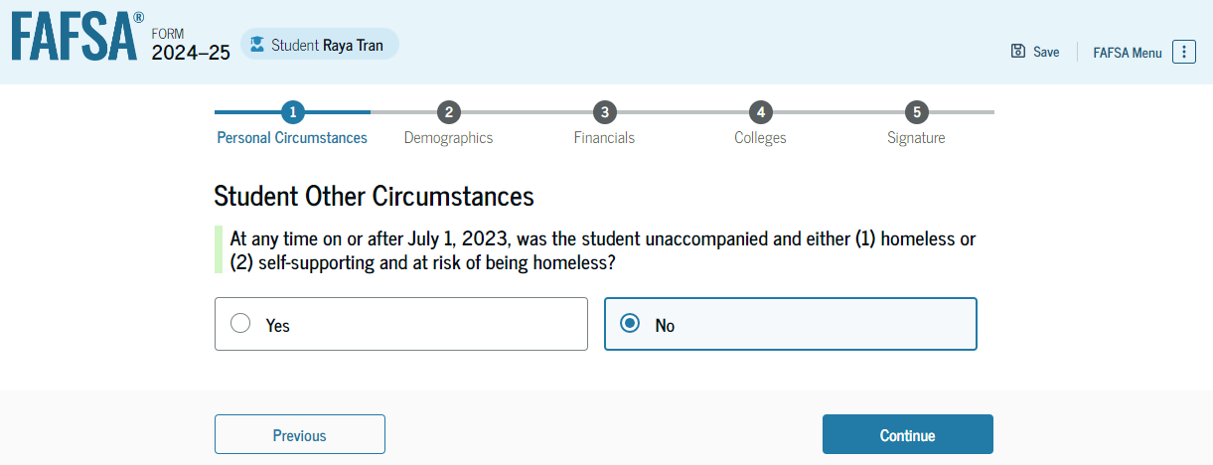
Notes:
On or after July 1, 2023, were you homeless or at-risk of being homeless? If this does not apply, select no and click continue. [click]

Slide 27
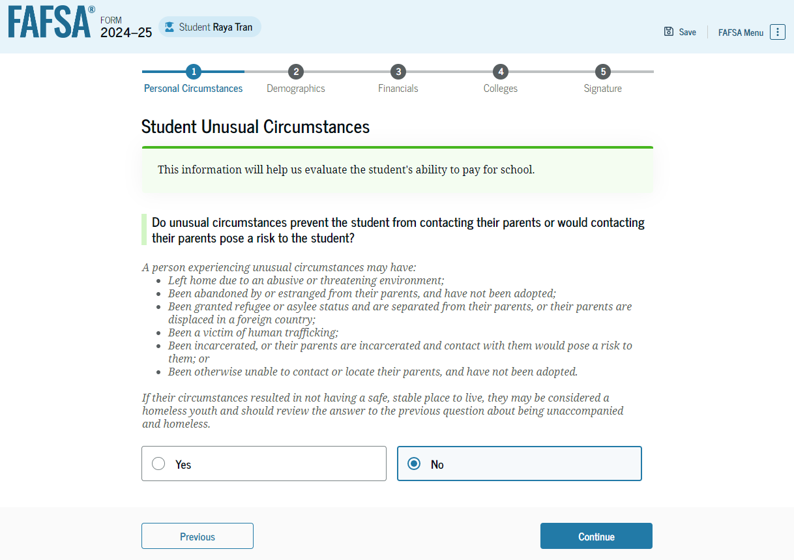
Notes:
The unusual circumstance screen may apply to some students unable to provide parental information. If the student does not have an unusual circumstance, select no and click continue.

Slide 28
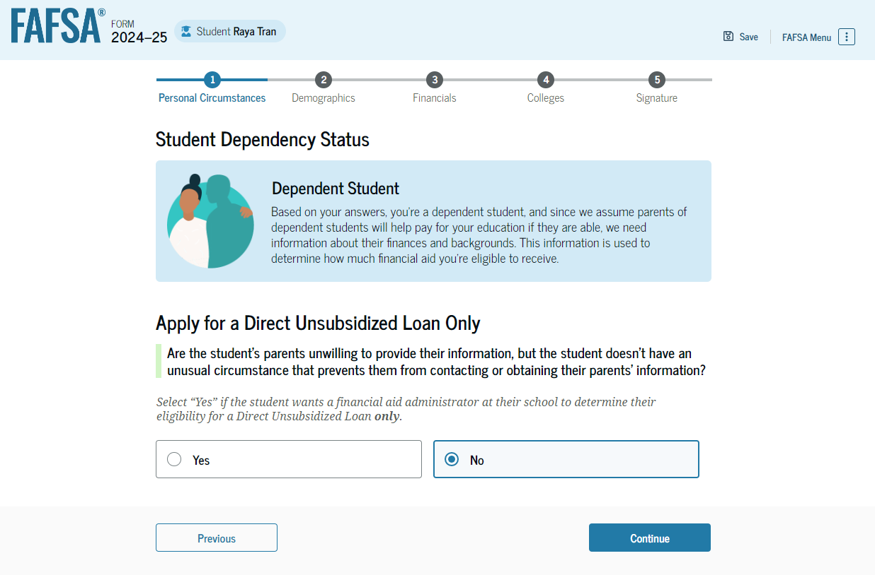
Notes:
Dependent students who do not have an unusual circumstance and are unable to provide parental information may submit the FAFSA to apply for loans only.

Slide 29
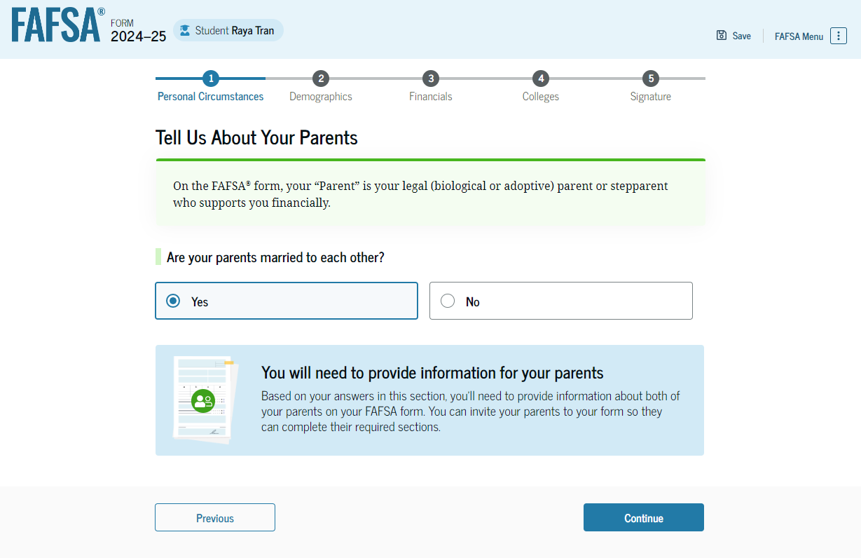
Parents without SSNs
Who is a FAFSA parent?
Notes:
This is a new screen for dependent students. Tell us about your parents. If parents are married to one another, select yes. If not, then the student will be posed more questions to determine which parent’s information to provide. Such screenshots are not available yet.

Slide 30
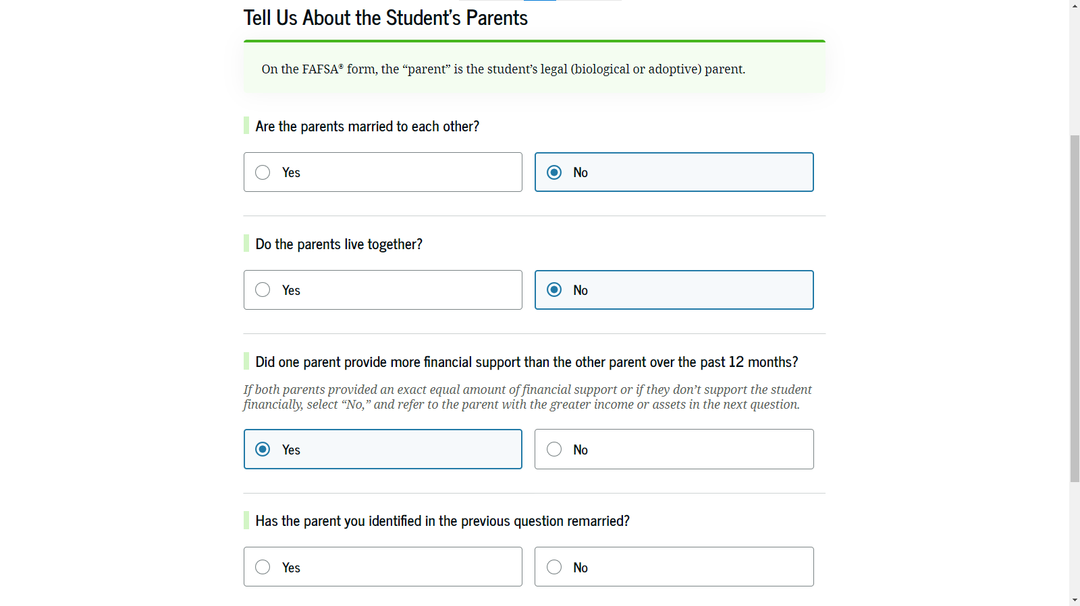
Parents without SSNs
Parents divorced or separated; which parent provided more financial support?
If parent is remarried, then FAFSA will also need stepparent’s info.
Notes:
Onto the student’s finances section. If the student filed taxes in 2022, the new IRS direct data exchange will automatically answer a few questions. If unable, then FAFSA will pose the typical income questions. Unfortunately, not all screenshots are available.

Slide 31
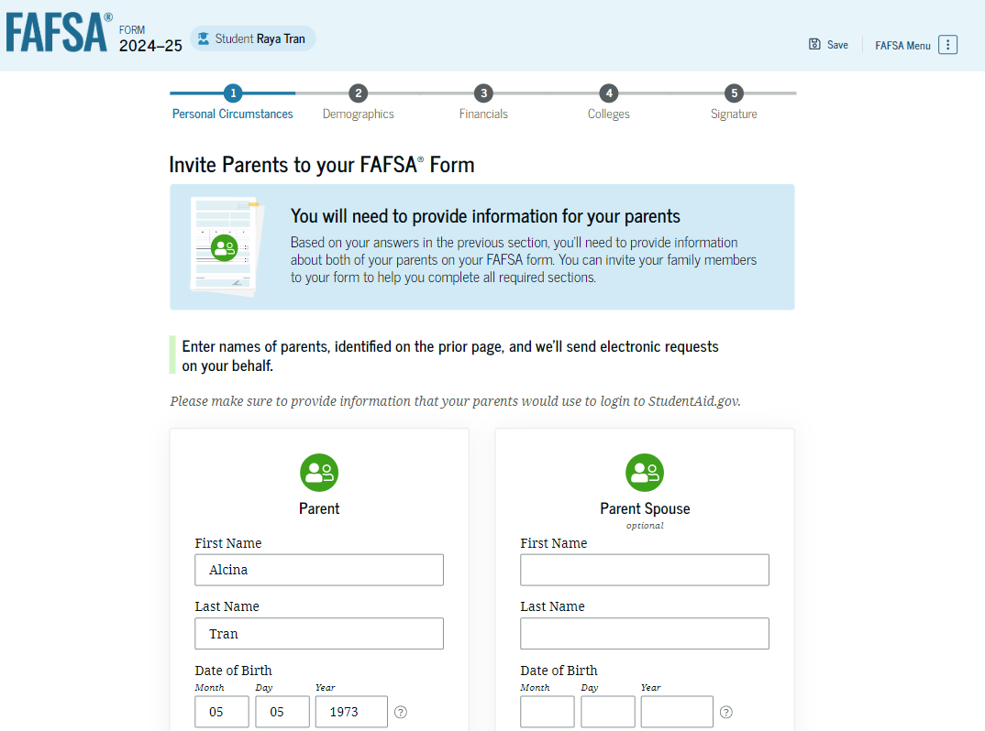
Notes:
To invite parents, the student should report their parent’s first name, last name as listed on their Social Security Card, and date of birth.

Slide 32
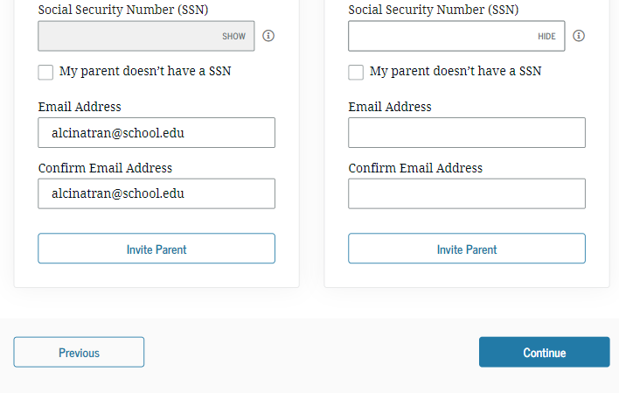
Notes:
…also report the parent’s Social Security Number and email address. Note, the student is able to select my parent doesn’t have a SSN for those who do not.

Slide 33
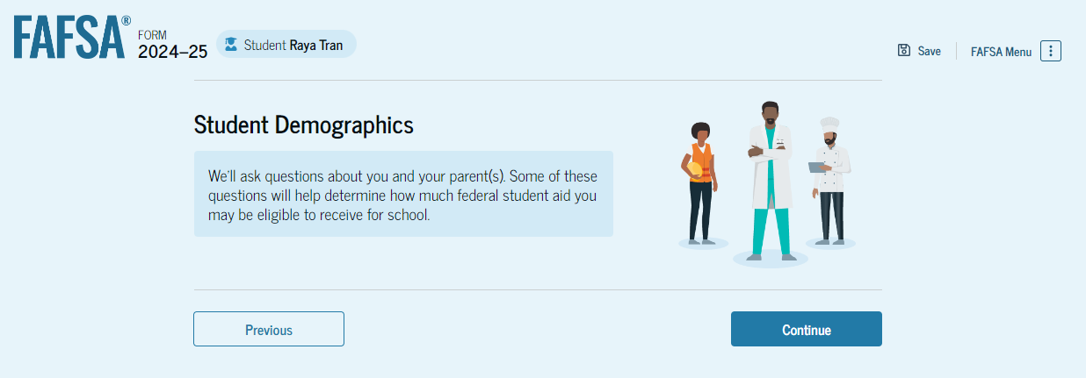
Notes:
Onto the student’s demographics section of the FAFSA.

Slide 34
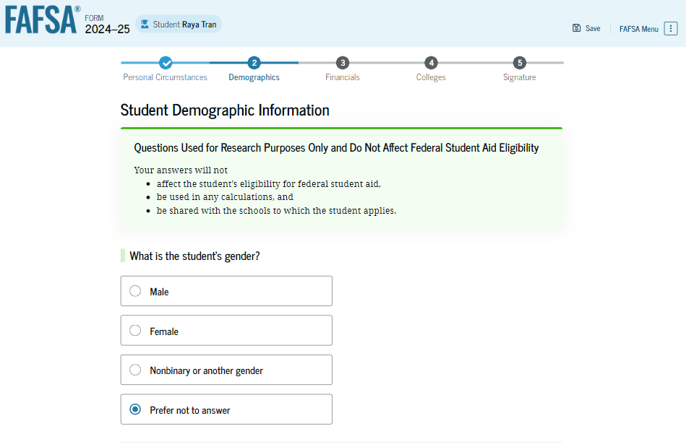
It’s completely okay to select prefer not to answer.
Notes:
Answer the gender question or select prefer not to answer and click continue.

Slide 35
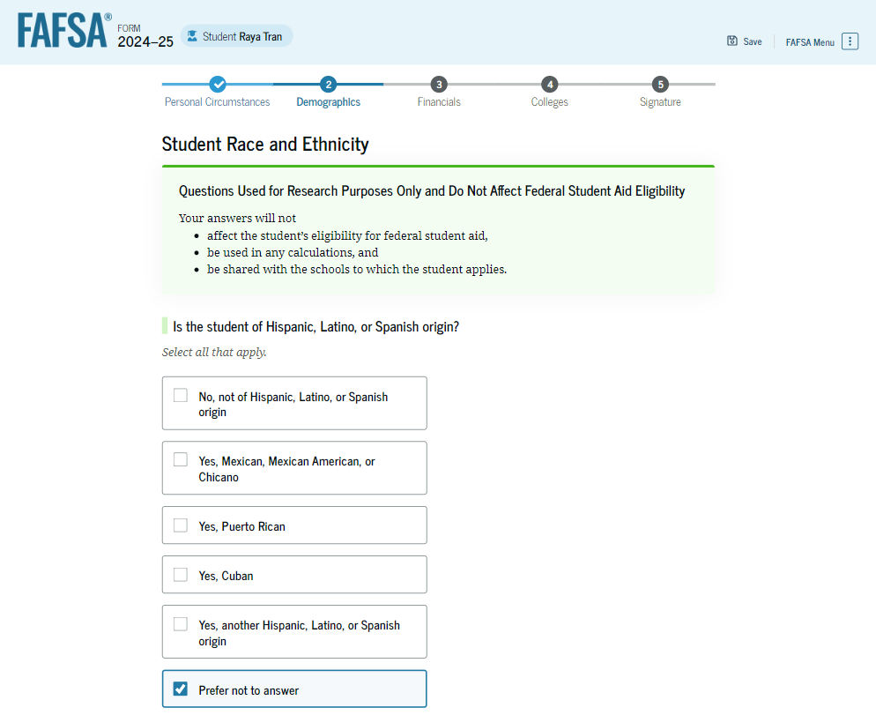
It’s completely okay to select prefer not to answer.
Notes:
Answer the Hispanic, Latino, or Spanish origin question or select prefer not to answer.

Slide 36
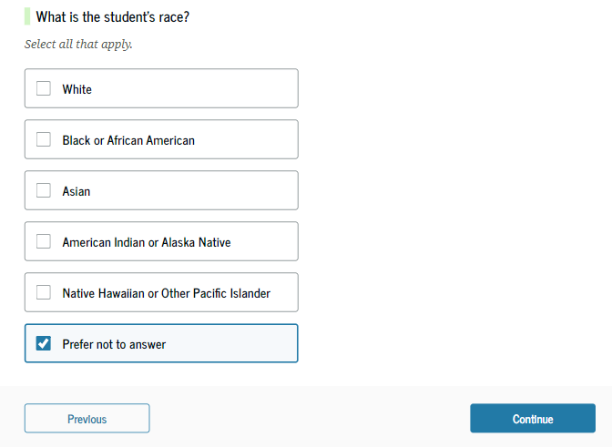
It’s completely okay to select prefer not to answer.
Notes:
Answer the student’s race question or select prefer not to answer and click continue.

Slide 37
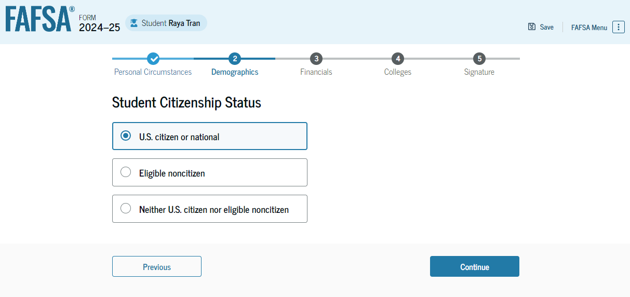
Is the student an eligible noncitizen?
Notes:
If the student is a US citizen, select “US citizen.” If the student is a green card holder, select “eligible noncitizen.” They will then be prompted to enter your Alien Registration Number which is the USCIS# on their green card. [click]

Slide 38
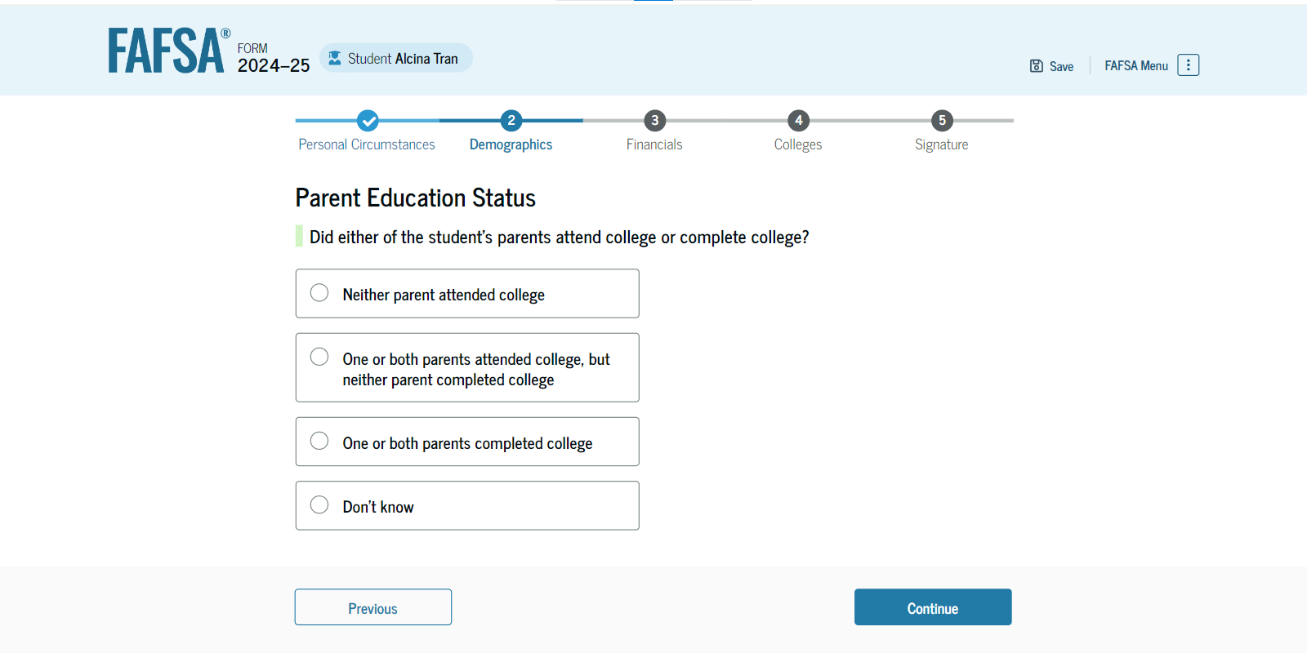
Notes:
Select if either parent attended college or select don’t know and click continue. [click]

Slide 39
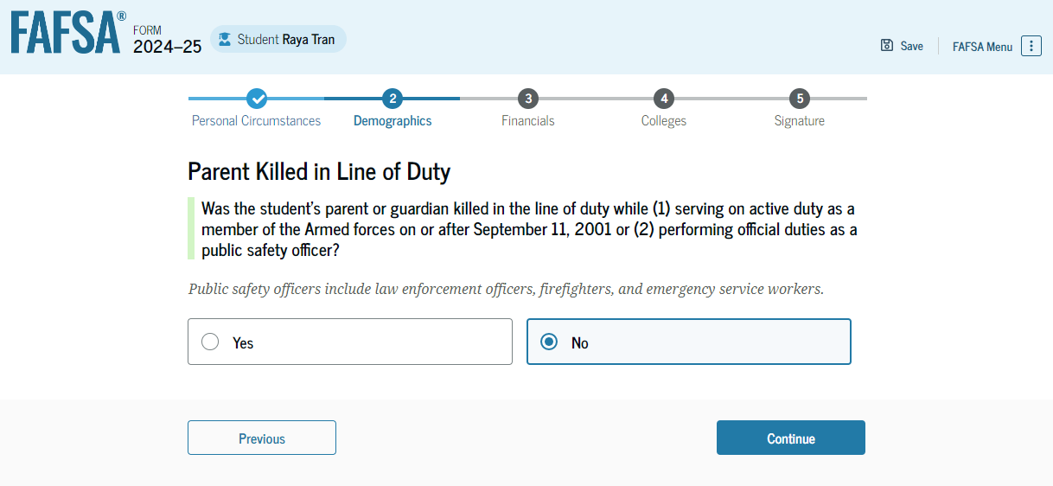
Notes:
This is a new question. Was a parent killed in the line of duty on or after 9/11 or while performing official duties as a police officer, firefighter, or emergency service worker?

Slide 40
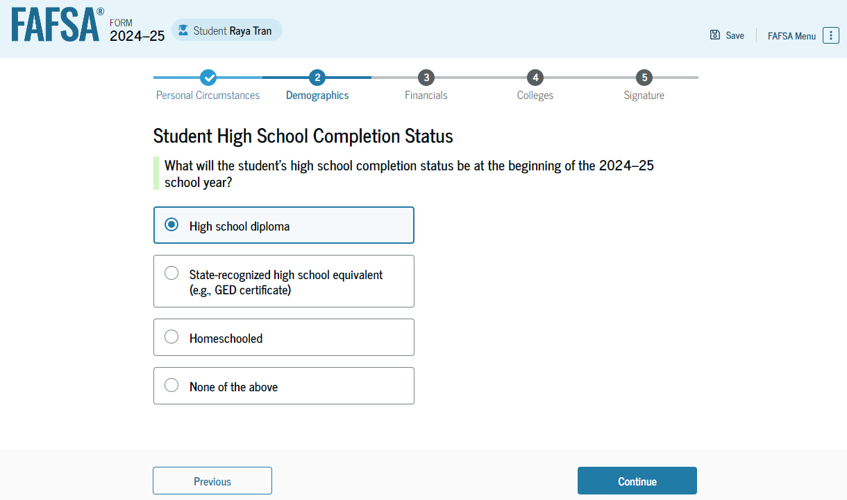
Notes:
What will the student’s high school completion status be at the beginning of the 24-25 school year?

Slide 41
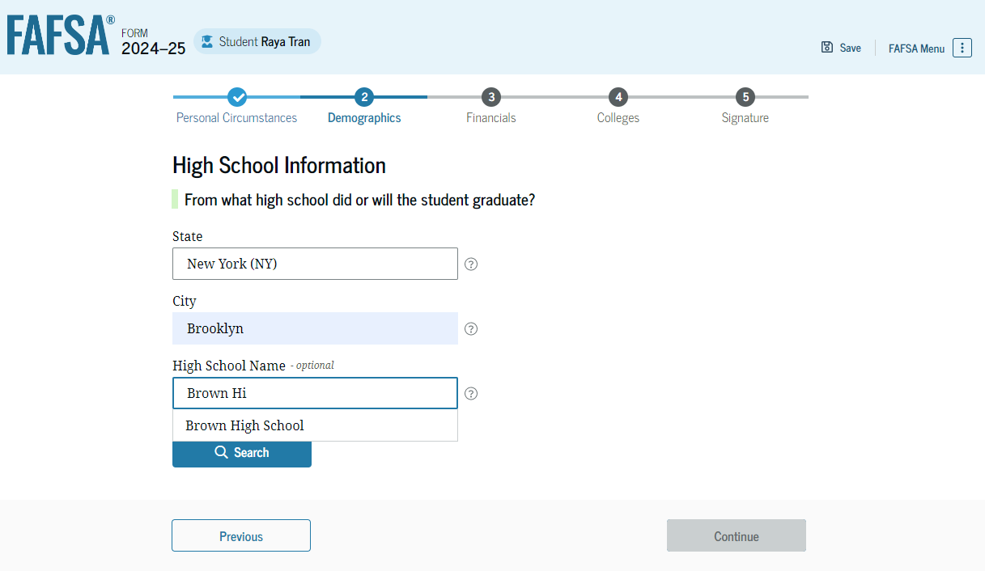
Notes:
From what high school did or will the student graduate? Select state and enter the first word of your high school’s name and click search. [click]

Slide 42
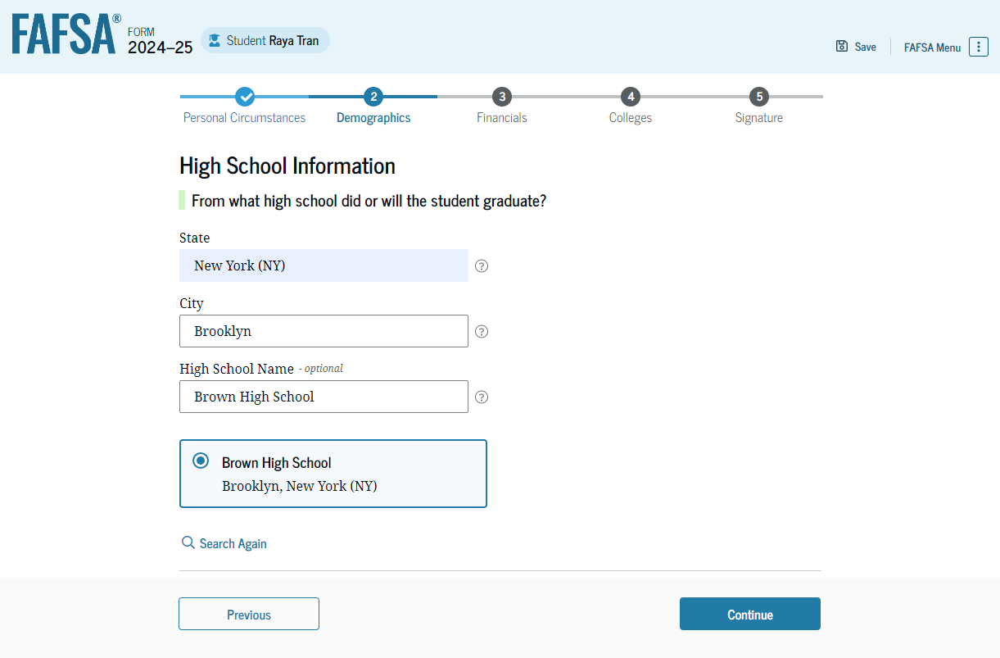
Notes:
All potential matching schools will appear. Select your high school from the list and click continue. [click]

Slide 43
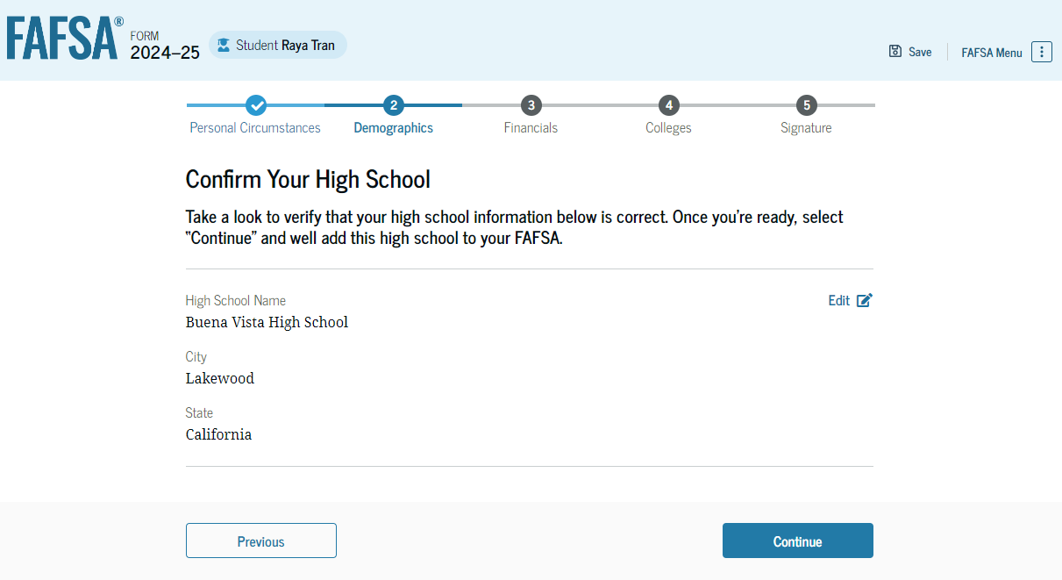
Notes:
Confirm your high school information and click continue. [click]

Slide 44
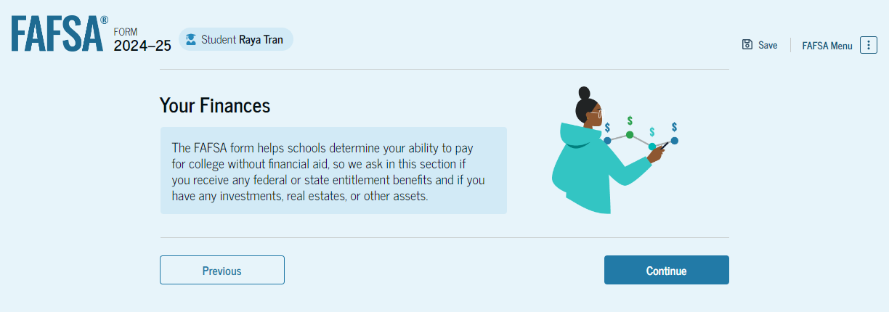
Notes:
Onto the student’s finances section. If the student filed taxes in 2022, the new IRS direct data exchange will automatically answer a few questions. If unable, then FAFSA will pose the typical income questions. Unfortunately, not all screenshots are available.

Slide 45
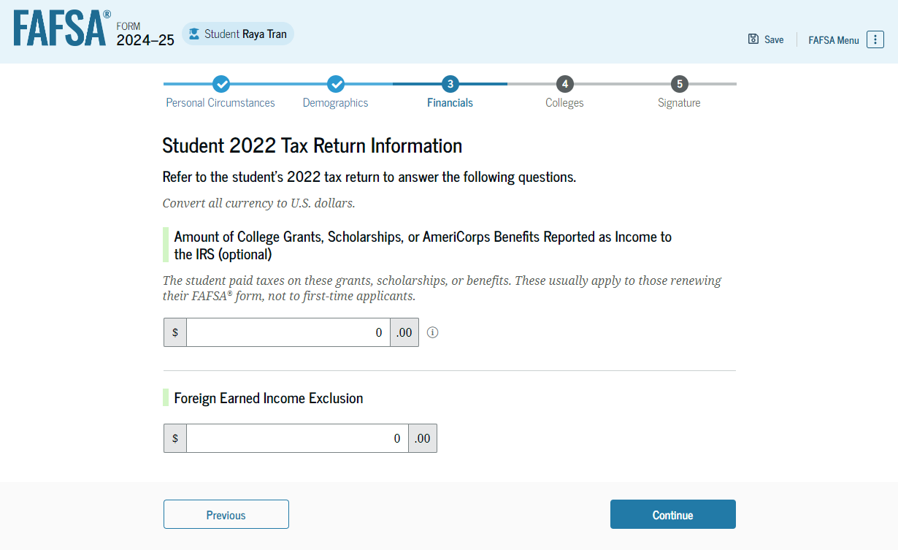
Notes:
The student will answer the remaining income questions accordingly. If a question does not apply, enter zero. [click]

Slide 46
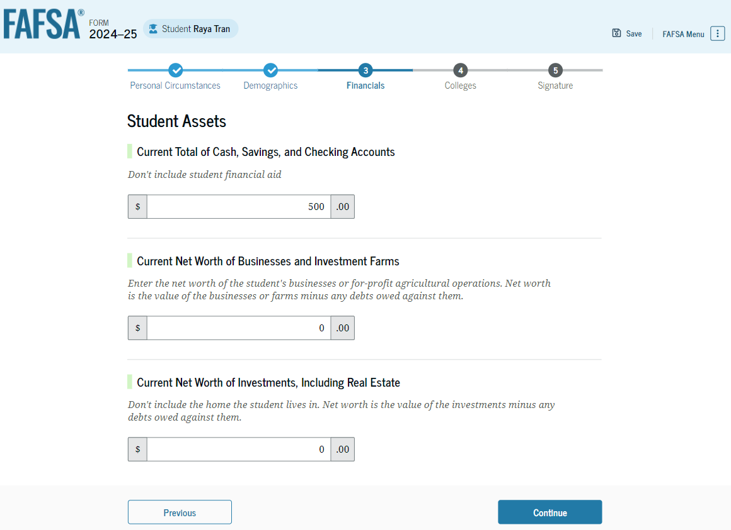
Notes:
The student will next answer the asset questions accordingly. If a question does not apply, enter zero. [click]

Slide 47
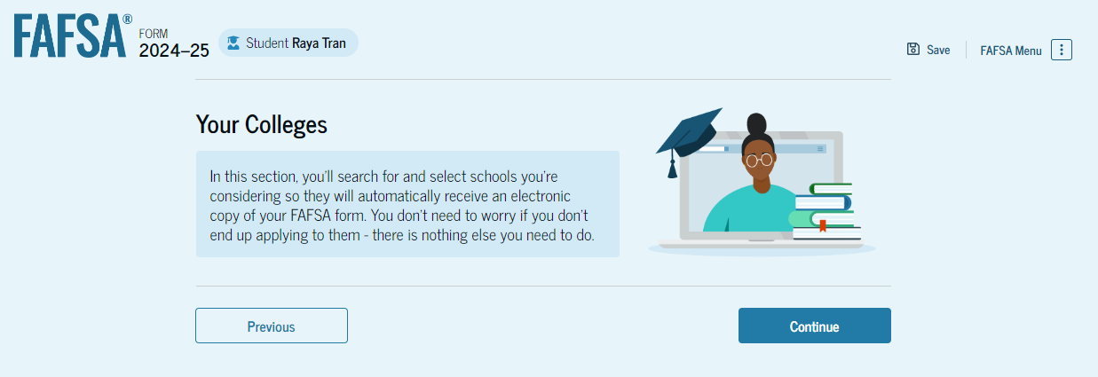
Notes:
Onto the student’s colleges section where students can now send their FAFSA to up to 20 colleges.

Slide 48
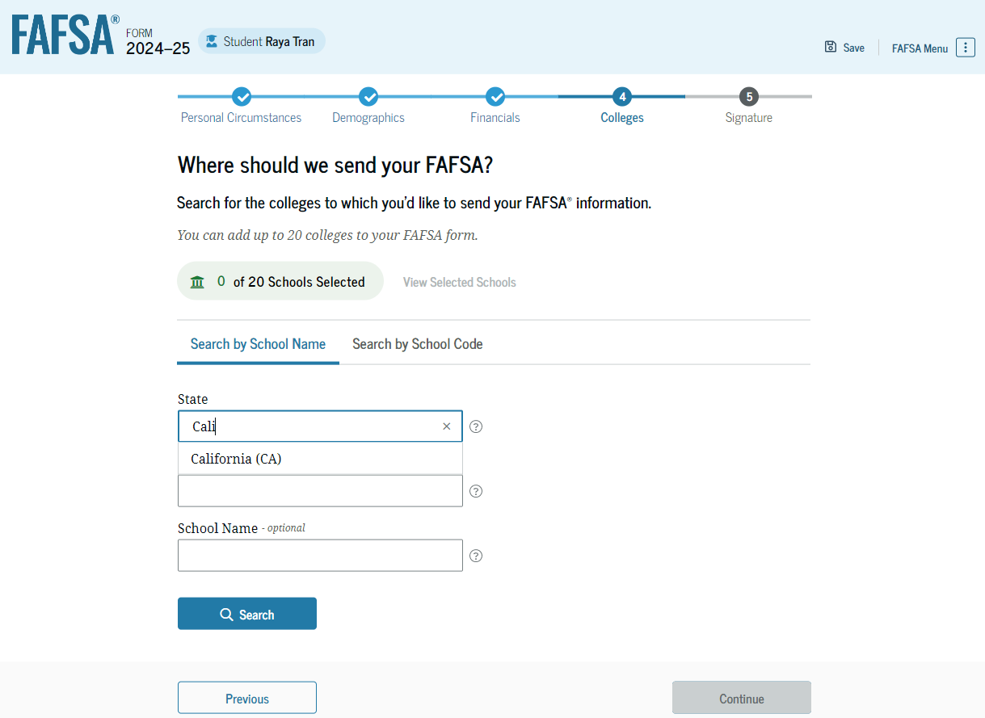
Notes:
Searching for colleges remains the same as with previous FAFSAs. [click]

Slide 49
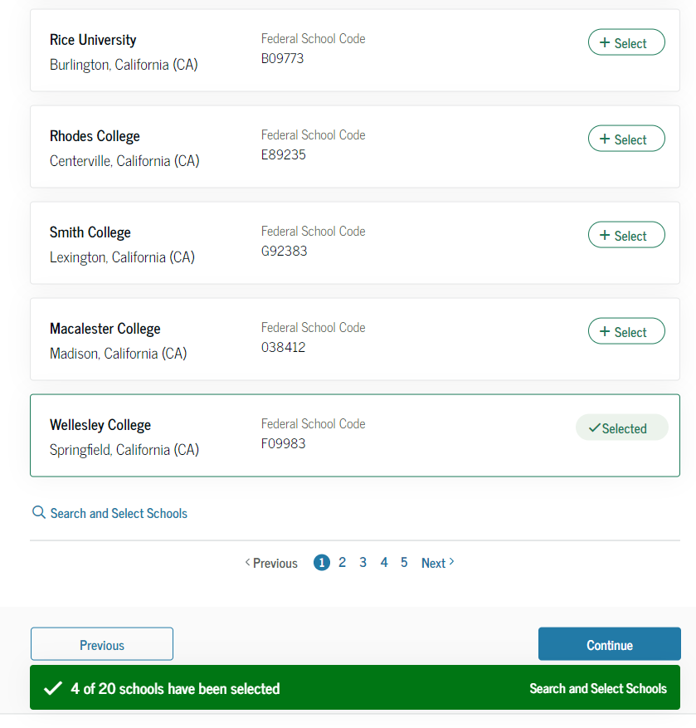
Notes:
As potential matching colleges appear based upon your search, click select beside the colleges you want to send your FAFSA to. [click]

Slide 50
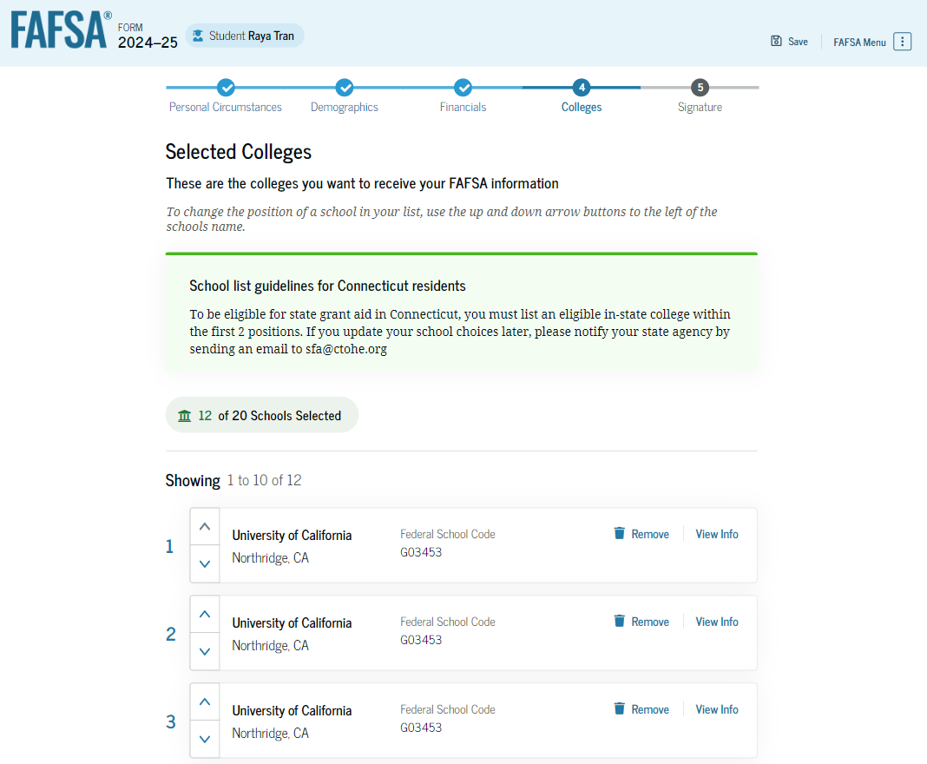
Notes:
All selected colleges will appear prior to moving onto the signature section. Note, students will no longer be asked about their housing plans.

Slide 51
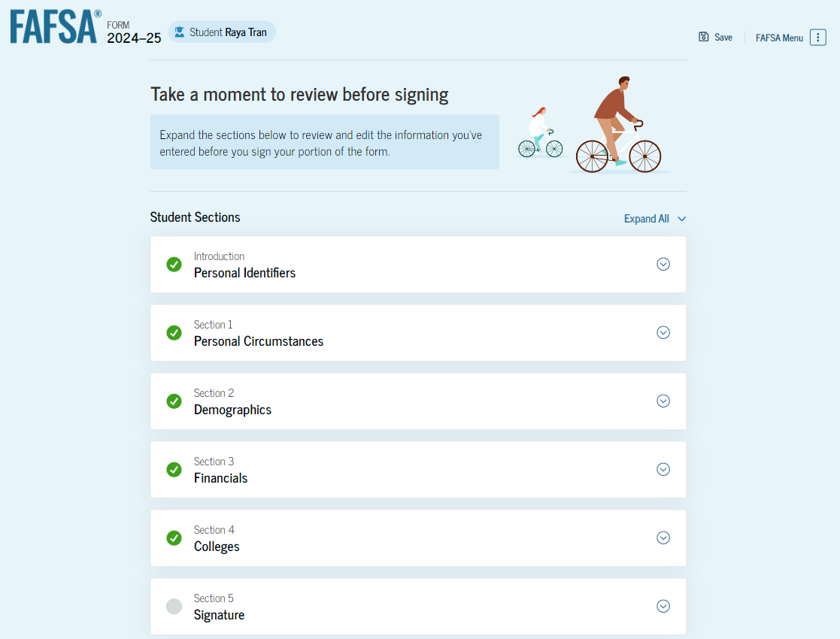
Notes:
Before the student’s signature screen, they can review their responses from any previous section. [click]

Slide 52
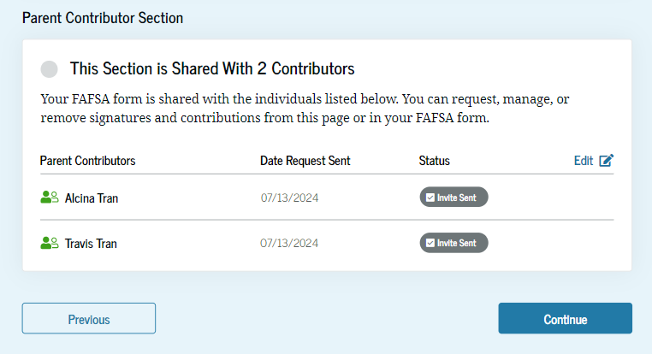
Notes:
The bottom of the summary screen will also outline the contributors, again meaning parents, the student invited earlier to complete the parent portion of the FAFSA.

Slide 53
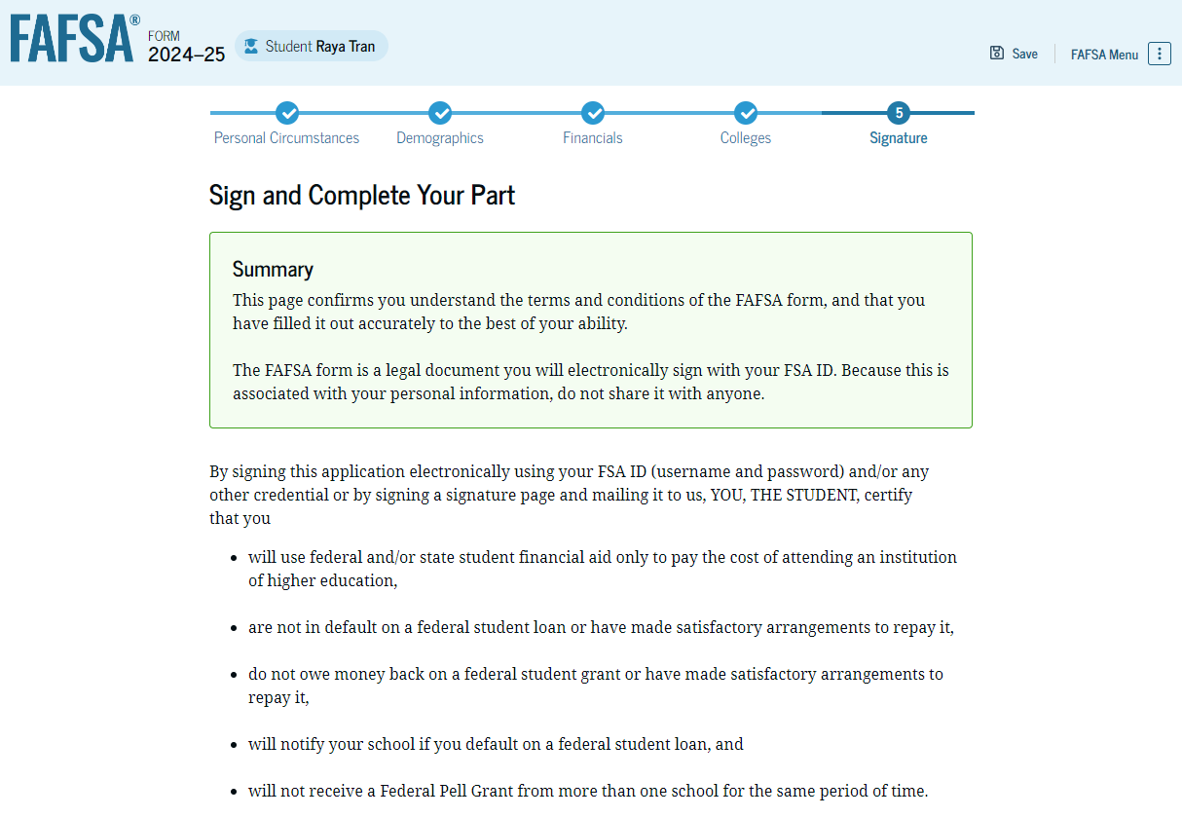
Notes:
To sign, the student should read the terms…

Slide 54
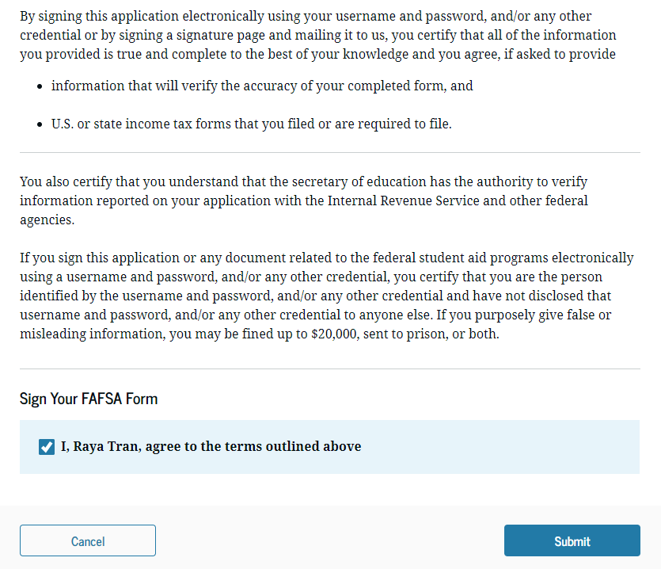
Notes:
Check the box and click submit. [click]

Slide 55
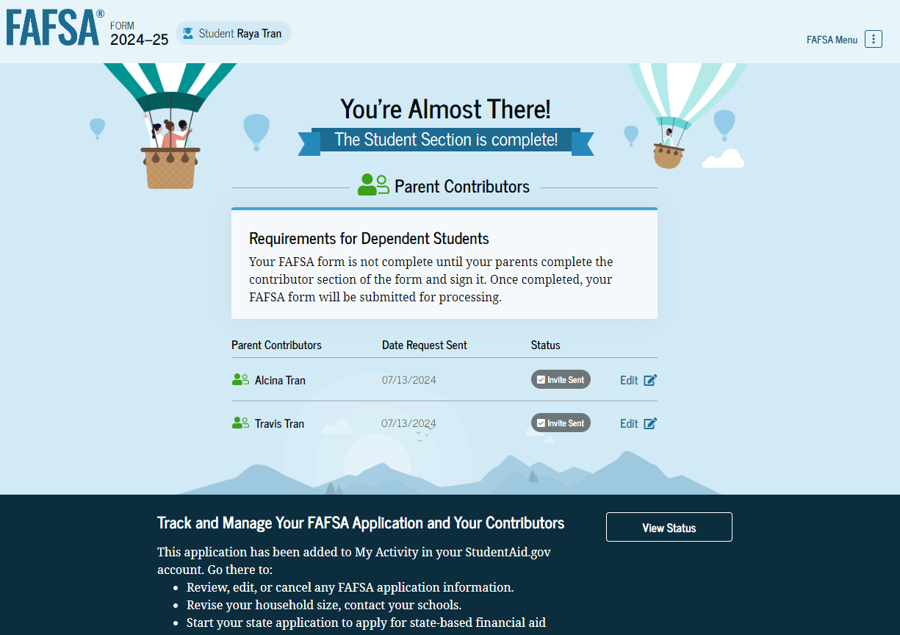
Dependent student section is complete, but FAFSA is not finished until parent(s) complete their section(s).
Notes:
For dependent students, the student section is now complete; however, this FAFSA will not be completely finished until parents complete their sections.

Slide 56
2024-25 FAFSA Preview Part 5: Parent Application
Notes:
Welcome to part 5 of our 24-25 FAFSA preview. [click]

Slide 57
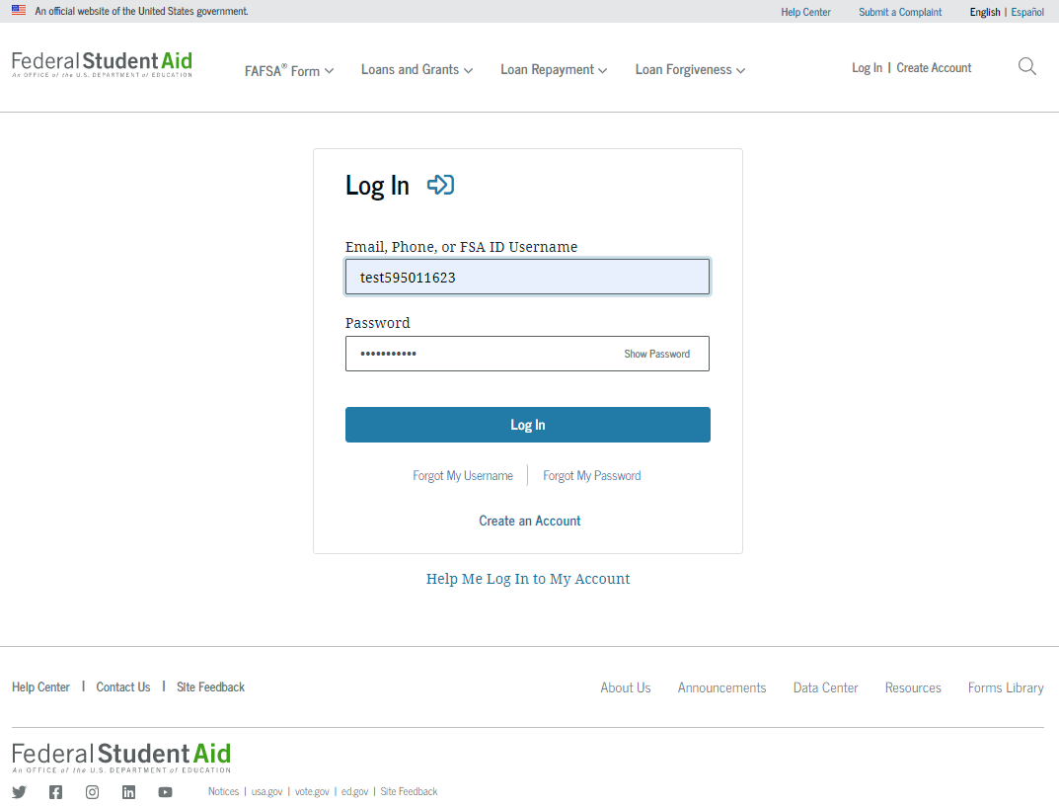
Notes:
A parent may also login directly at studentaid.gov. Enter the parent’s username, password, and click login. [click]

Slide 58
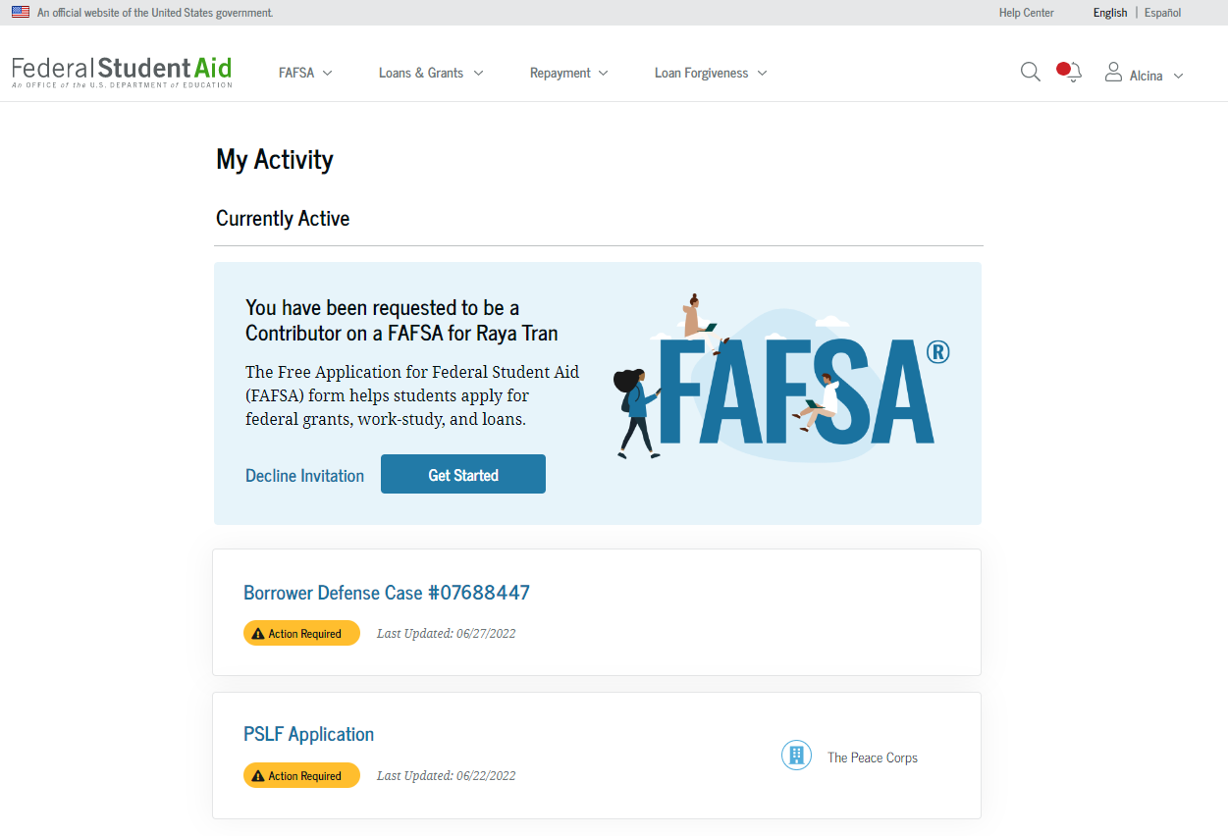
Notes:
The parent will see their information has been requested for the student’s FAFSA. Click get started.

Slide 59
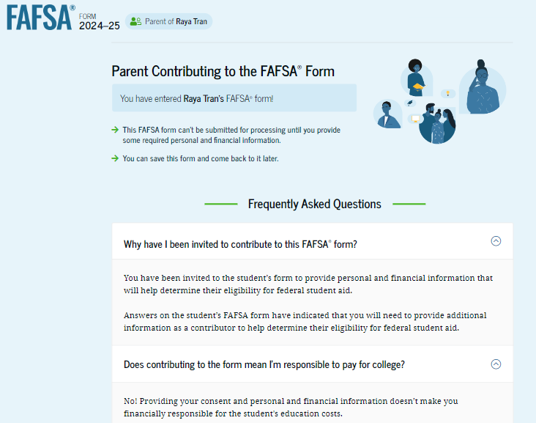
Notes:
When logging into the 24-25 FAFSA for the first time, the parent can read why their information is needed.

Slide 60
Notes:
…and answers to other questions a parent may have completing the FAFSA.

Slide 61
Notes:
Next is the overview of the FAFSA.

Slide 62
Notes:
Followed by the contributor definition screen.

Slide 63
Notes:
Screen 3 of 4 will let the parent know what to expect.

Slide 64
Notes:
Finally, FAFSA will explain what happens after the FAFSA is submitted.

Slide 65
Notes:
The parent will review their information which will autopopulate from their FSA ID.

Slide 66
Notes:
This includes their mailing address. Review and click continue. [click]

Slide 67
Notes:
This a new screen. The parent will have to agree to provide their consent to allow FAFSA to connect with the IRS. If consent is not provided, then the student will not qualify for federal or state aid.

Slide 68
Notes:
Onto the parent’s demographics section of the FAFSA.

Slide 69
Notes:
Parent, what is your marital status? Current preview slides only reflect a married parent. [click]

Slide 70
Notes:
Select the state where you live and enter the month and year you began living in the state. [click]

Slide 71
Notes:
Onto the parent’s finances section. If the parent filed taxes in 2022, the new IRS direct data exchange will automatically answer a few questions. If unable, then FAFSA will pose the typical income questions. Unfortunately, not all screenshots are available.

Slide 72
Notes:
Did anyone in your parents’ household receive federal benefits in 2022 or 2023? Check any that apply or check none of the above and click continue.

Slide 73
If married parents filed 2022 taxes separately, then parent 2 must complete a separate FAFSA parent section.
Notes:
Did the parent file a joint tax return in 2022 with their spouse? Married parents who filed jointly will only have to complete one parent section. However, if married parents filed separately in 2022, then the parent’s spouse must complete a separate parent section of the FAFSA.

Slide 74
Notes:
Is the parents family size different from the number claimed on their 2022 tax return? Answer accordingly.

Slide 75
Notes:
How many people in the parents family meaning their children will be in college between July 1 and June 30?

Slide 76
Notes:
The parent will answer the remaining questions accordingly. If a question does not apply, enter zero. [click]

Slide 77
Assets will be skipped if parent(s) AGI is less than $60,000 or received a federal means-tested benefit.
Notes:
The parent will next answer child support received and their asset questions accordingly. If a question does not apply, enter zero. [click]

Slide 78
FAFSA Assets
Considered
Family farm
Small business
Money Market Funds, Mutual Funds, CDs
Stocks, stock options, bonds
529 college savings plans (parent asset)
Rental property
NOT considered
Value of life insurance
401[k] plans
Pension funds
Annuities
Non-education IRAs
Notes:
Here is an overview of what FAFSA considers an asset and what it does not. Beginning with the 24-25 FAFSA, values of a farm and small business are now considered assets. [click]

Slide 79
If married parents filed 2022 taxes separately, then parent 2 must complete a separate FAFSA parent section.
Notes:
The parent will now enter their spouse’s first name, last name, date of birth, Social Security Number and email address. Again, if married parents filed separately in 2022, then the parent’s spouse must login to studentaid.gov with their own FSA ID to complete a separate parent section of the FAFSA.

Slide 80
Notes:
Before the parent’s signature screen, they can review their responses from any previous section. [click]

Slide 81
Notes:
To sign, the parent should read the terms, check the box, and click sign and submit.

Slide 82
Notes:
When parents complete their section or sections, the student’s FAFSA is now completely finished.

Slide 83
3-5 days

Slide 85
rita.turchetta@tn.gov 615-478-5584
jason.seay@tn.gov 615-319-1740
tnpromise
collegefortn.org

