Slide 1
FAFSA Basics

Slide 2
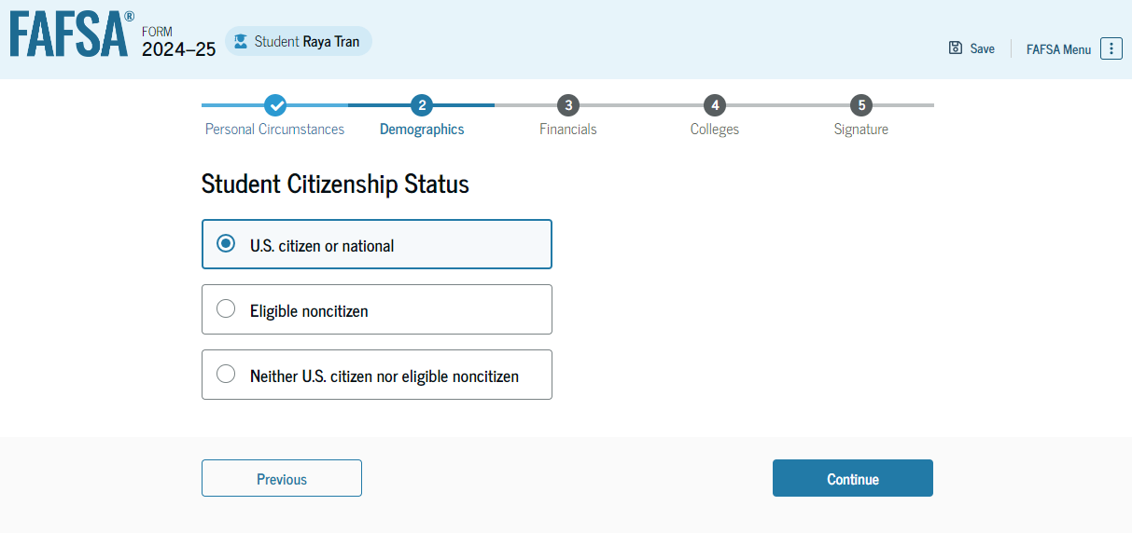
Parents without SSNs
Is the student an eligible noncitizen?
Notes:
If the student is a US citizen, select “US citizen.” If the student is a green card holder, select “eligible noncitizen.” They will then be prompted to enter your Alien Registration Number which is the USCIS# on their green card. [click]

Slide 3
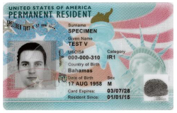
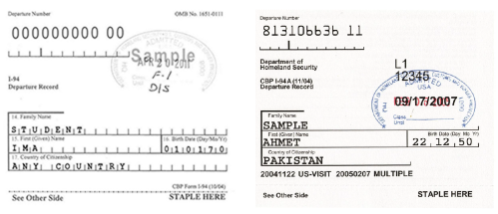
I am an eligible noncitizen
U.S. permanent residents
Individuals with an I-94 showing: Refugee, Asylee, Cuban-Haitian Entrant, or Parolee
Victims of human trafficking (T-Visa)
Battered immigrants and children

Slide 4
Neither citizen nor eligible noncitizen
Holders of nonimmigrant visas (e.g. student, work, tourist)
Individuals with Temporary Protected Status (TPS)
Deferred Action for Childhood Arrivals (DACA) recipients

Slide 5
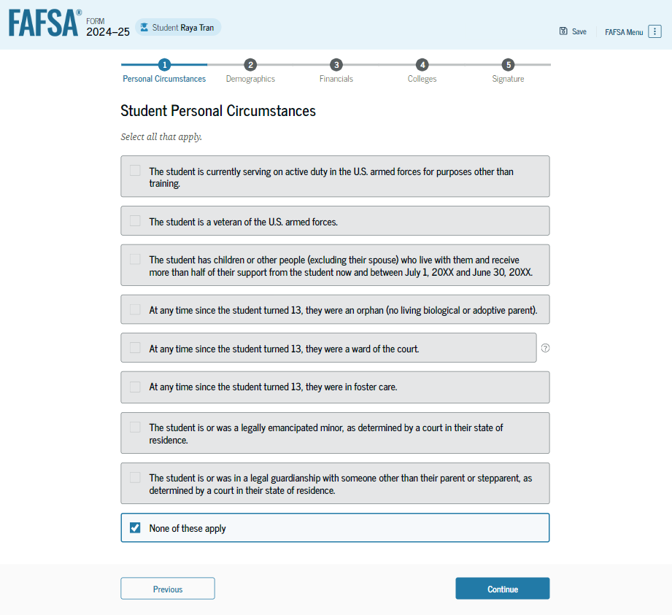
Parents without SSNs
Is the student dependent or independent?
Notes:
Review the following circumstances and select any that apply. If none, select none of these apply and click continue. [click]

Slide 6
“Adult” Circumstances
Age 24?
Married?
Working on master’s/doctorate?
Military veteran/currently serving?
Have children you financially support?

Slide 7
“Minor” Circumstances
Emancipated minor?
Have court-ordered legal guardian*?
Since age 13 – were an orphan, were in foster care, or were a ward of the court?
*If court papers read custody instead of guardianship, student will answer no and contact their college for guidance (e.g. unusual circumstance).

Slide 8
Homeless Circumstance
Homeless/ Unaccompanied Youth?
*High School Student should have proof for the current academic year from a recognized McKinney-Vento practitioner.

Slide 9
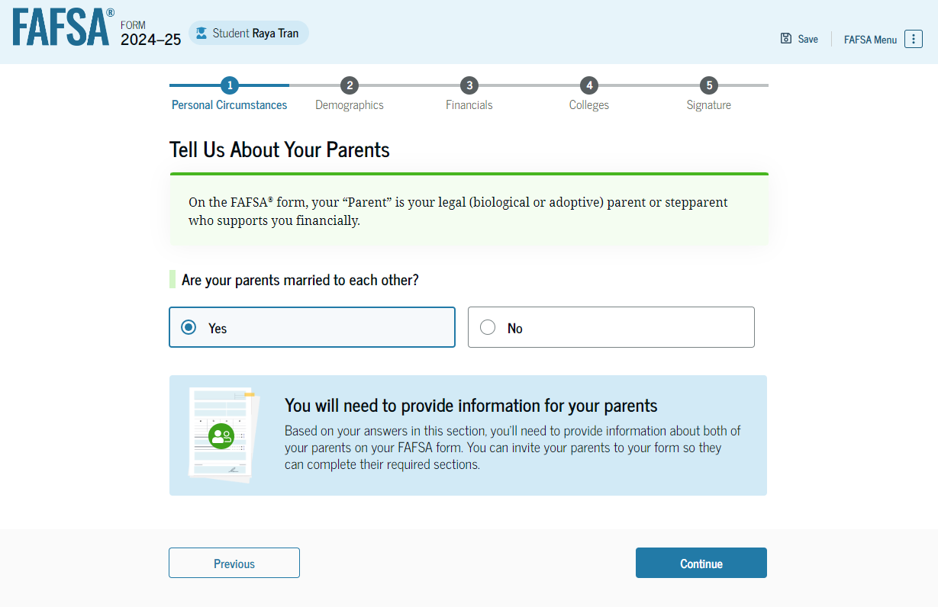
Parents without SSNs
Who is a FAFSA parent?
Notes:
This is a new screen for dependent students. Tell us about your parents. If parents are married to one another, select yes. If not, then the student will be posed more questions to determine which parent’s information to provide. Such screenshots are not available yet.

Slide 10
FAFSA parent(s)
Biological parent
Stepparent
If married to biological parent
Adoptive parent
Unless student was in foster care at age 13+

Slide 11
Who is NOT a FAFSA parent*?
Grandparent
Aunt/Uncle
Brother/Sister
Legal Guardian
Relative whom claimed the student for tax purposes
*Unless they have adopted the student

Slide 12
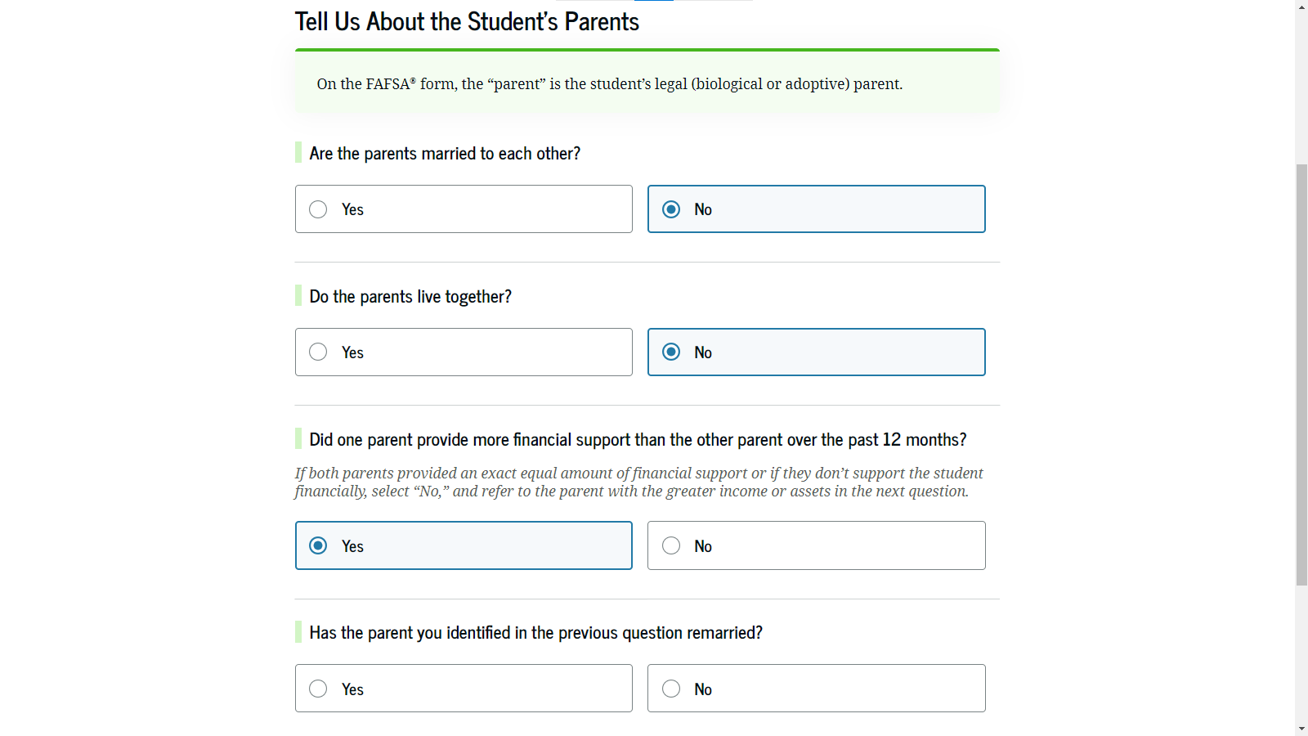
Parents without SSNs
Parents divorced or separated; which parent provided more financial support?
If parent is remarried, then FAFSA will also need stepparent’s info.
Notes:
Onto the student’s finances section. If the student filed taxes in 2022, the new IRS direct data exchange will automatically answer a few questions. If unable, then FAFSA will pose the typical income questions. Unfortunately, not all screenshots are available.

Slide 13
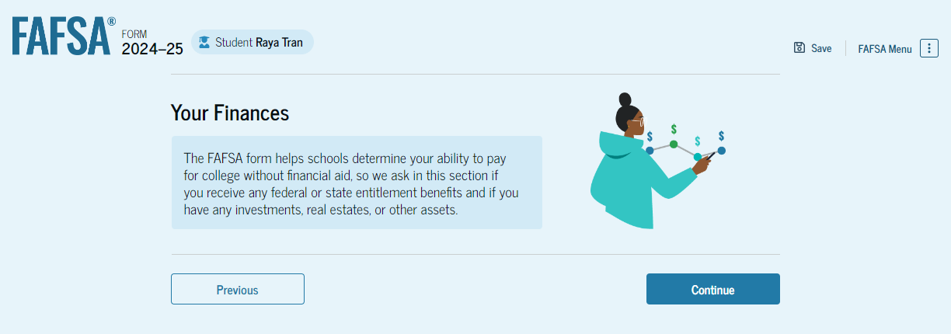
Parents without SSNs
When must someone file taxes?
Notes:
Onto the student’s finances section. If the student filed taxes in 2022, the new IRS direct data exchange will automatically answer a few questions. If unable, then FAFSA will pose the typical income questions. Unfortunately, not all screenshots are available.

Slide 14
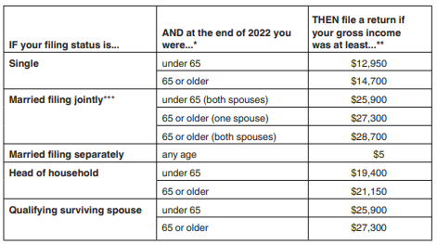
2022 IRS Filing Requirements

Slide 15
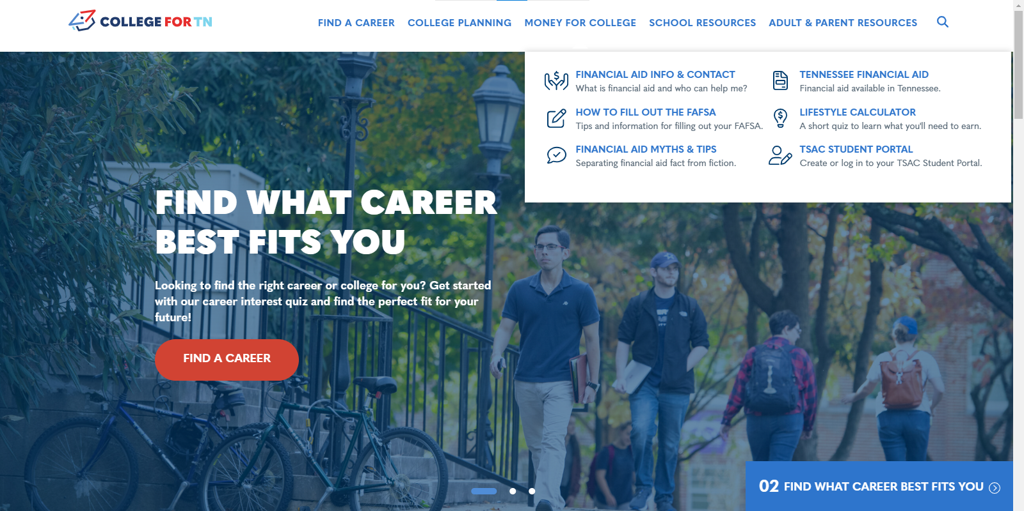
Notes:
This concludes part 6 of the 24-25 FAFSA preview. For more information about the FAFSA and our state aid programs, check out money for college at collegefortn.org.

Slide 16





jason.seay@tn.gov 615-319-1740
tnpromise
collegefortn.org

